Slide 1
Week00
Hans the Announcement Parrot
🦜
introduce class
introduce self
take roll
syllabus
type
whitespace
scope
success tips
fix Eclipse installs
NOTE: lecture is recorded and posted ~noon same day
NOTE: Homework00 is due on Monday
NOTE: Help Hours start on Monday

Slide 2
record lecture!

Slide 3
introduce class

Slide 4
what is CS 136?
a computer science major requirement 🎉
a bridge between coding and theory
about how you store data (HINT: in an array)
harder problems
bigger problems
good prep for coding interviews 💸
going beyond "it works" to different measures of "good"
speed 🦔
space 🐘
elegance? ✨

Slide 5
introduce self

Slide 6
[other slide deck]

Slide 7
take roll

Slide 8
take roll
this is the only time i will ever take roll
this is also the only time i will wear a coat 😢
please correct me if i mispronounce your name
if you are not yet enrolled, please fill out the other sheet now

Slide 9
syllabus

Slide 10
syllabus

Slide 11
syllabus
🚌

Slide 12
syllabus
🚌
🪟

Slide 13
the syllabus is online https://github.com/james-bern/CS136/wiki

Slide 14
grading

Slide 15
final grade
final grade is 1/3 homework, 1/3 midterm exam, 1/3 final exam
homework is on an A- (90), A (95), A+ (100) scale
A- is meant to be doable
A is meant to be challenging
A+ is meant to be a growth opportunity 🪴
i will go over some of your homework with you during lab and ask you questions about it 🙂👍
exams are in-person, on-paper, no-notes
questions are either similar to homework, or similar to PracticeExam
"if you understand the (A- and A) homework, the exam should be unsurprising and approachable"

Slide 16
😈 ChatGPT

Slide 17
ChatGPT can do every homework in this class up to an A level 😈 it is impossible for me to prove whether or not you used ChatGPT (people who say otherwise are wronggg)

Slide 18
so, ChatGPT, etc. are "allowed," but...
you are not allowed copy and paste code from anywhere
bad bad very bad don't do it
(unless i gave you the code then it's fine 🙂👍)
you can't use ChatGPT, etc. on exams
😈 "if your coding job can be done by an AI, then it will be done by an AI"

Slide 19
collaboration

Slide 20
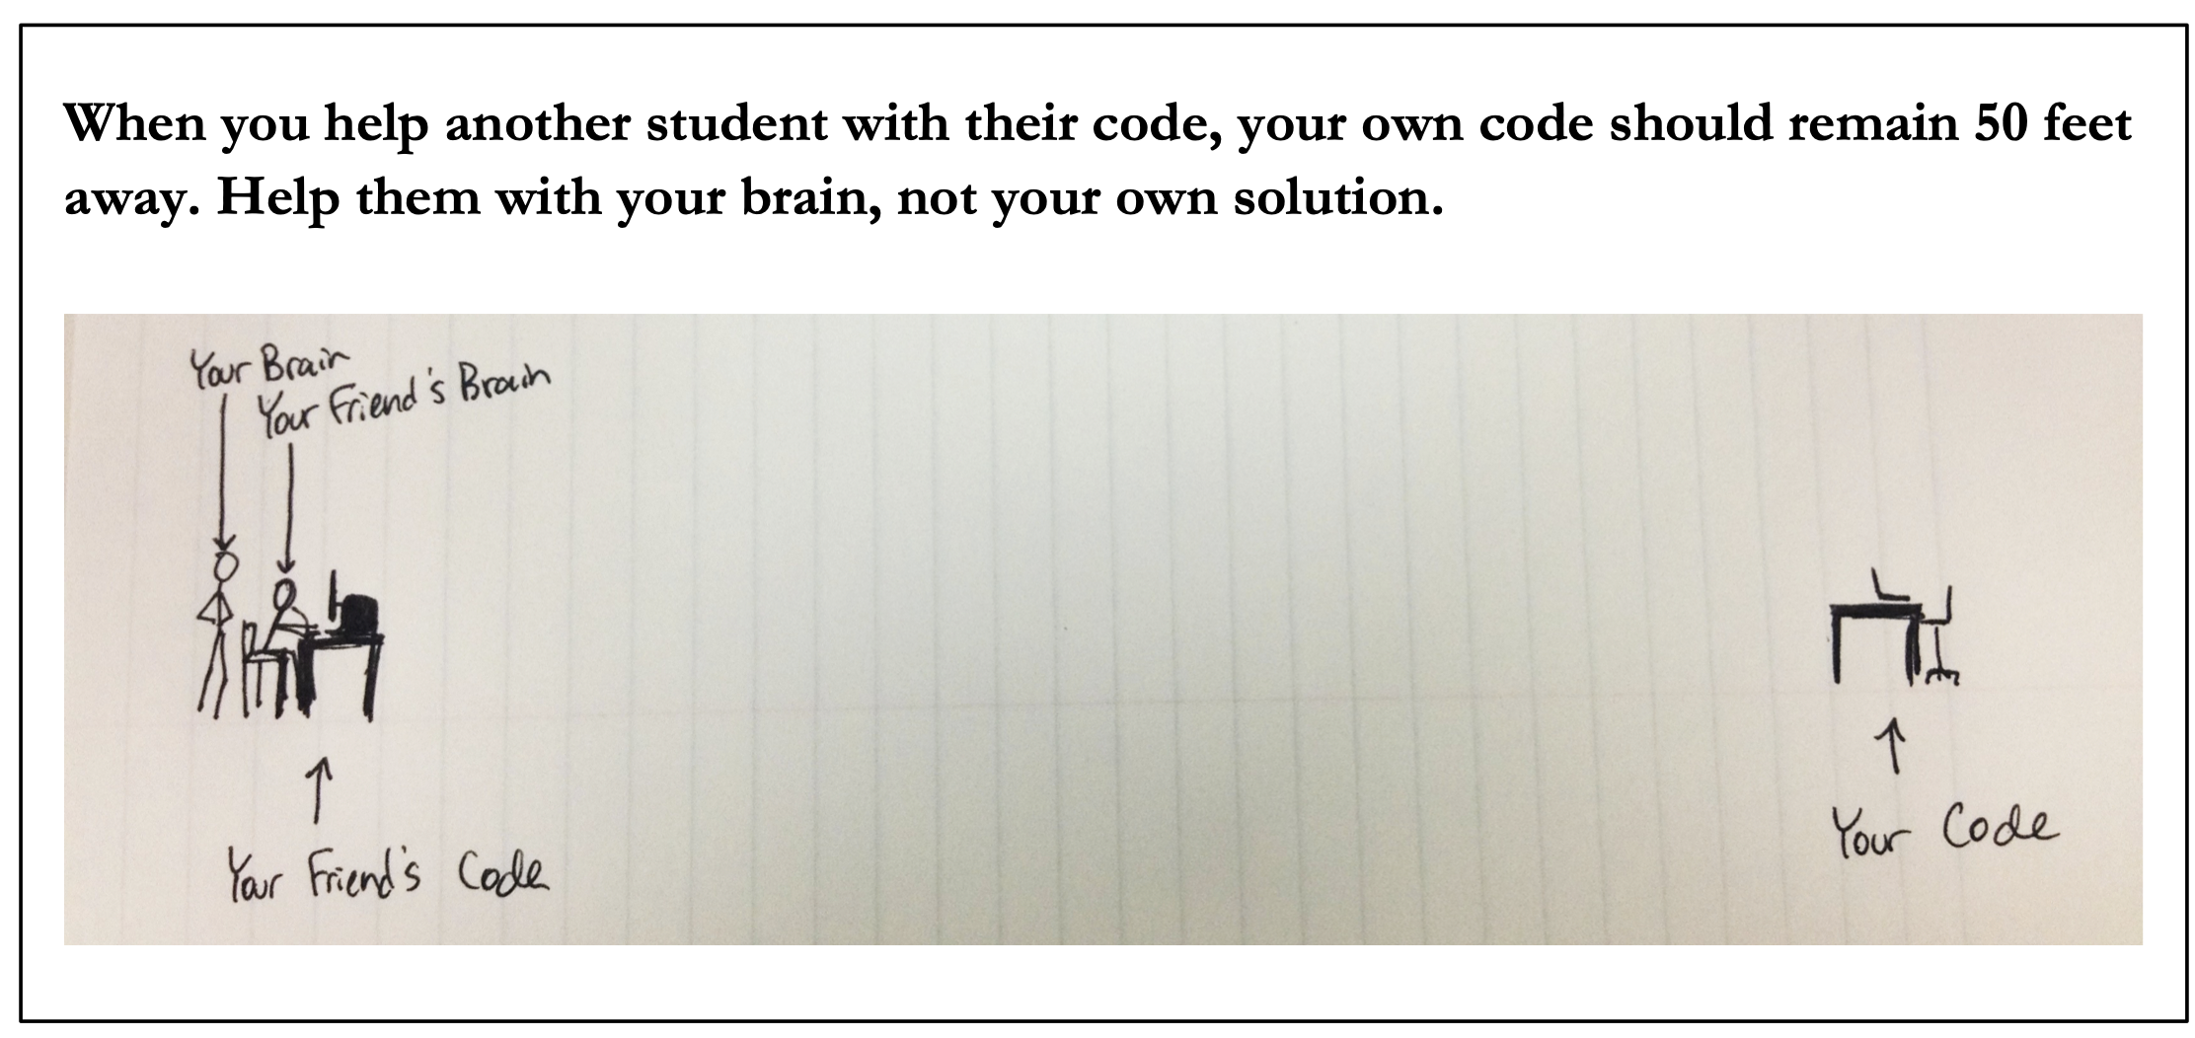
😈

Slide 22
Java

Slide 23
Java

Slide 24
☕️

Slide 25
this class is in Java

Slide 26
this class is in Cow.Java

Slide 27
which is basically C

Slide 28
by which I mean Java

Slide 29
type

Slide 30
type

Slide 31
a variable in Java has a type
# okay in Python
foo = 7 # foo is an int
foo = False # now, foo is a boolean
// NOT okay in Java
int foo = 7; // foo is an int
foo = false; // Error: incompatible types:
// boolean cannot be converted to int

Slide 32
declaring and initializing are separate things
// Option A: one line int foo = 7; // declare int foo and initialize it to 7
// Option B: two lines int foo; // declare a variable foo of type int foo = 7; // initialize foo to 7

Slide 33
primitive types

Slide 34
primitive types
in this class, "a variable being a primitive" means that the variable is a boolean, char, double, or int
primitive types are simple
primitive types are small
primitive types are NOT Objects
we will talk about Objects later
examples of Objects: String, MyCoolClass, int[] (array of ints)

Slide 35
boolean, char, double, int
a boolean stores a truth value
true, false
a char stores a character
'\0', 'a', 'Z', '!', '\n'
a double stores a real number
0.0, -0.5, 3.1415926, Double.NEGATIVE_INFINITY
an int stores an integer
0, -1, 4

Slide 36
primitive type Venn diagram
integers
numbers
char
double
boolean
int

Slide 37
char is an integer type
a char is an integer type
each char has a corresponding integer, for example ('a' == 97)
the letters are in order ('a' == 97), ('b' == 98), ('c' == 99)...
the numbers are also in order ('0' == 48), ('1' == 49)...
you can do math with char's
char foo = 'a' + 2; // foo is 'c'
char bar = '0' + 7; // bar is '7'
int baz = '6' - '0'; // baz is 6

Slide 38
zero
each primitive data type has its own notion of what it means to "be zero"
int zero = 0;
double zero = 0.0;
boolean zero = false;
char zero = '\0'; // the "null character"

Slide 39
whitespace

Slide 40
whitespace

Slide 41
whitespace
whitespace includes spaces, tabs, and newlines
🐍 Python does care about whitespace (indentation changes what code does)
☕️ Java does NOT care about whitespace (it cares about curly braces)
🗣️ do you care about whitespace?
some guidelines:
be consistent
make sure your curly braces line up
✨ use Eclipse's auto-indentation feature (see Tut00)! no excuses!
sparks joy | NOT equivalent -- doesn’t spark joy
for (int i = 0; i < 10; ++i) { if (i % 3 == 0) { System.out.println("fizz"); } } | for (int i = 0; i < 10; ++i) { if (i % 3 == 0) { } System.out.println("fizz"); }

Slide 42
scope

Slide 43
scope

Slide 44
scope
a scope is a region of code in which variables live
in Java, a scope is (usually) defined by a pair of curly braces
OUTER_SCOPE { INNER_SCOPE } OUTER_SCOPE
{
int i;
{
int j;
// you CAN use i here 🙆‍♂️
// you CAN use j here 🙆‍♂️
}
// you CAN use i here 🙆‍♂️
// you CANNOT use j here 🙅
}

Slide 45
common scope-related errors

Slide 46
cannot be resolved to a variable
Compile Error: foo cannot be resolved to a variable
class Main extends Cow {
public static void main(String[] arguments) {
if (...) {
int foo = 0;
} else {
int foo = 1;
}
PRINT(foo);
}
}

Slide 47
cannot be resolved to a variable
class Main extends Cow {
public static void main(String[] arguments) {
int foo;
if (...) {
foo = 0;
} else {
foo = 1;
}
PRINT(foo);
}
}

Slide 48
duplicate local variable
Compile Error: duplicate local variable foo
class Main extends Cow {
public static void main(String[] arguments) {
int foo;
if (...) {
int foo = 0;
} else {
foo = 1;
}
PRINT(foo);
}
}

Slide 49
duplicate local variable
class Main extends Cow {
public static void main(String[] arguments) {
int foo;
if (...) {
foo = 0;
} else {
foo = 1;
}
PRINT(foo);
}
}

Slide 51
success tips

Slide 52
success tips (1/3)
establish basic study habits (this might not have been necessary in highschool; it most likely is now)
start homework early! (very hard to code well while stressed)
don't work in a vaccuum
collaborate with your friends / acquaintences / enemies
come to help hours (they are there for you!)
code a lot (ideally, 5+ days per week)
if the homeworks are feeling too hard, talk to me; we have resources!
if the homeworks are too easy, do the A+ / A++; do side projects; just keep coding; code code code code code; COOOOOOOOODE

Slide 53
success tips (2/3)
try to find your own bugs
this is a huge skill; it takes time (and pain) to build
try to answer your own questions (using Google!) ("what does IDE stand for?"; "what does this error message mean?")
this is also a huge skill; it also takes time (and pain) to build
however, if you are stuck (>= 10+ minutes of pain), ASK FOR HELP
there is literally no judgement here; we all have different starting points; my only goal is for all students to get stronger and have fun 🙂👍
and, for what it's worth, i was a mechanical engineering undergrad and my first comp sci course was *terrifying* (though, eventually, fun)

Slide 54
most importantly though

Slide 55

you gotta push the button

Slide 58
come see me if you had trouble with Tut00 otherwise, see you in class on Monday 🌞

Slide 59
Week01
🦜
tips and tricks
operators
control flow
Cow.Java
WARMUP
foo = (2 * 5.0) - 1.0;
what type is foo?
what value is foo?
bar = (3 > foo);
what type is bar?
what value is bar?
char baz = 'A' + ('7' - '5');
what value is baz?

Slide 60
tips and tricks

Slide 61
"hot code replace failed" Eclipse message

Slide 62
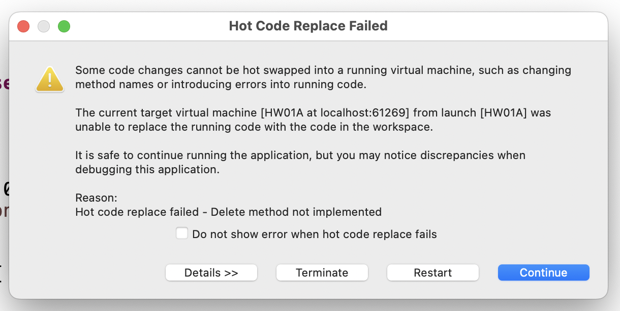
if you've been getting this error a bunch...

Slide 63
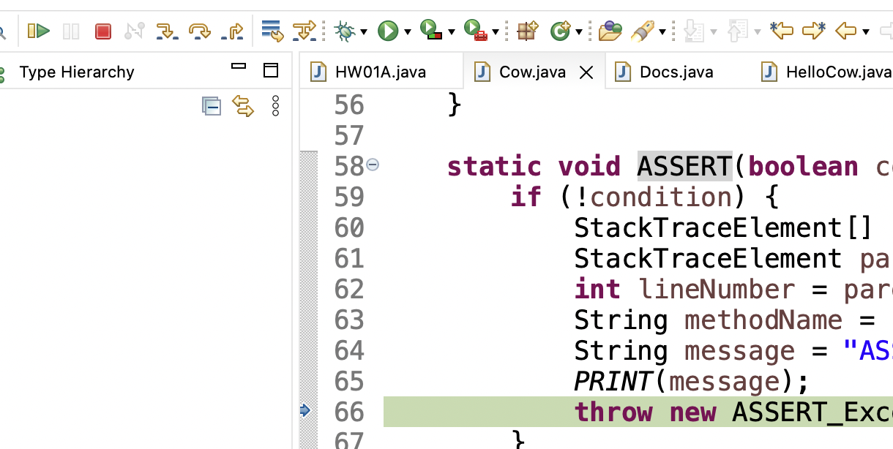
make sure you are pressing this button after every crash / failed assert (otherwise Eclipse keeps your program running, and will try to "hot swap" your changes into it)

Slide 64
you can also press this button (which, for us, does basically the same thing)

Slide 65
you can also just close Eclipse and reopen it if anything really weird happens 🤷

Slide 66
how to email jim

Slide 67
first, how to email not-jim
Subject Line: Question Regarding The Reading
Email Body:
Dear Prof. Dr. Professorson Ph.D Exquire,
I hope you are having a wonderful afternoon; that the morning sun is shining upon you this fine evening, and that you do not feel the quiet whisper of the all-consuming Void chilling you to your very core.
I am writing because I am unclear on the assigned reading for tomorrow. Your very, very helpful syllabus says to read pages 300 – 500 of Beowulf, however the book is, it seems, much fewer than 500 pages long.
Thank you so much for your help with this matter. I appreciate the time you take in supporting me in my studies—I could not do this without you.
Sincerely,
James Bern
Caltech '15

Slide 68
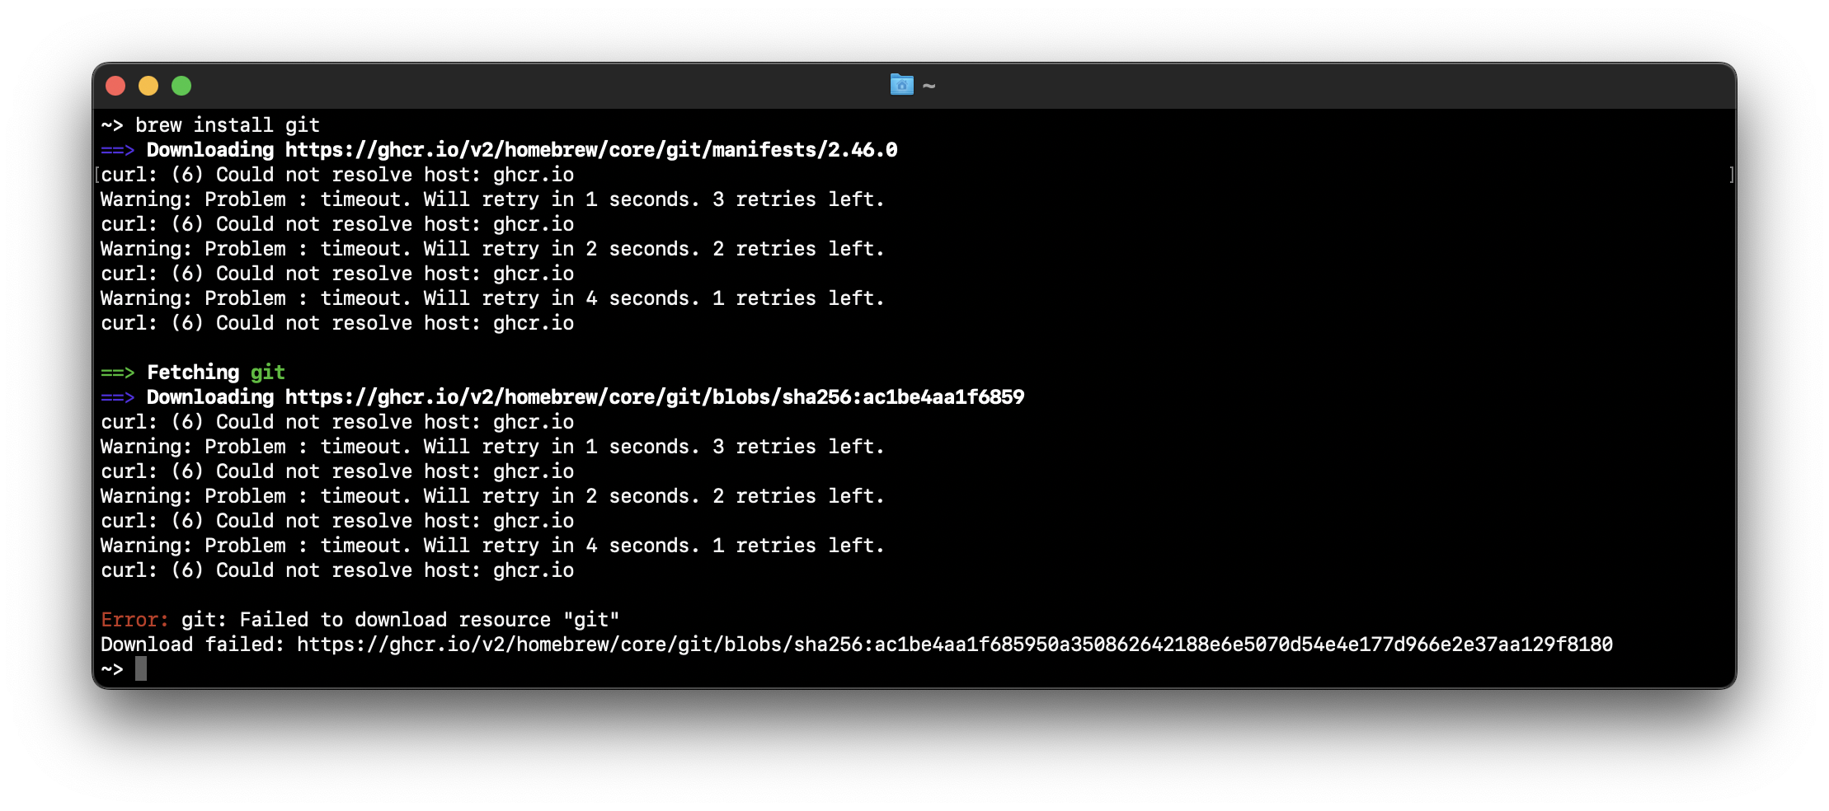
how to email jim
Subject Line: brew won't install 😡

Slide 69
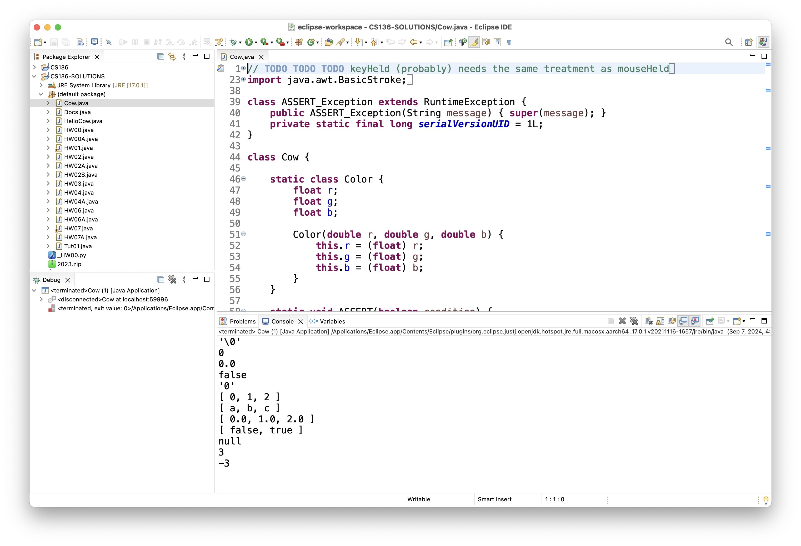
how to email jim
Subject Line: can't run tic tac toe 😢

Slide 70
this is the fastest way to get your question answered i will not be offended i promise

Slide 71
how to do HW

Slide 72
implement one thing at a time get it working perfectly then, try the next thing

Slide 73
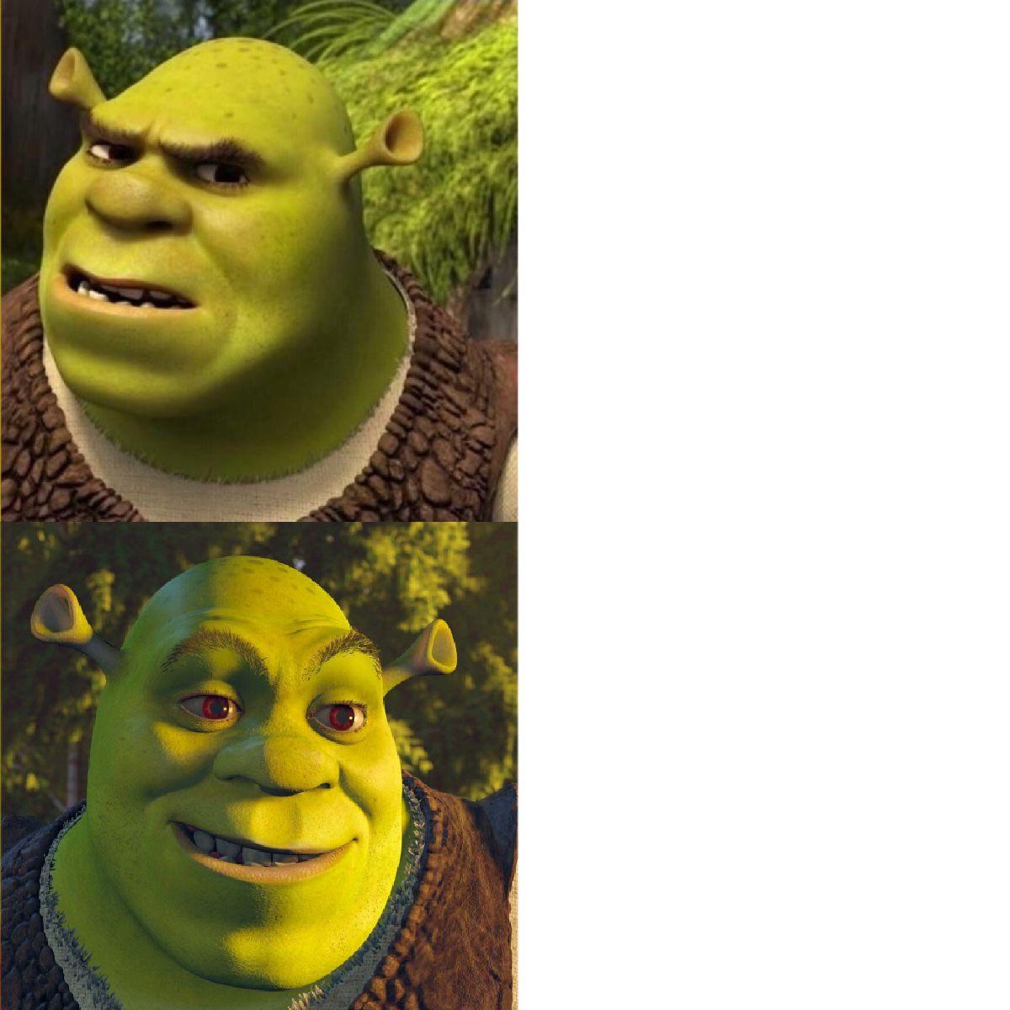
code up the entire homework without ever trying to run it
compile early; compile often

Slide 74

compilers

Slide 75
operators (except for bitwise operators, which we'll do later maybe)

Slide 76
assignment operator

Slide 77
assignment operator
= assigns the value on the right-hand side to the variable on the left-hand side
int i = 0; // 0 ("int i now has the value 0")
double foo = coolFunction();
☠ the assignment operator returns the value it assigned this is usually pretty confusing
boolean b = false;
boolean c = (b = foo());

Slide 78
arithmetic operators

Slide 79
basic arithmetic (number) operators
+ adds two numbers
- subtracts two numbers
* multiplies two numbers
/ divides two numbers
☠ an int divided by an int is an int
int foo = 8 / 2; // 4
int bar = 7 / 2; // 3
Java "throws away the remainder"
- returns the negative of a number
int bar = -7; // -7 ("negative 7" or "minus 7")
int baz = -bar; // 7

Slide 80
modulo
x % y returns the remainder of (x / y) and is read "x modulo y"
int foo = 17 % 5; // 2 ("17 divided by 5 is 3 remainder 2")
☠ % probably doesn't do what you expect for negative numbers; if x can be negative, use MODULO(x, y) instead
5 % 3 // 2
4 % 3 // 1
3 % 3 // 0
2 % 3 // 2
1 % 3 // 1
0 % 3 // 0
-1 % 3 // -1 🤔
MODULO(-1, 3) // 2 🙂👍

Slide 81
modulo

Slide 82
7 % 3
2
R1
3
7
-
6
1

Slide 83
🐍 -7 % 3
☕️ MODULO(-7, 3)
☕️ -7 % 3
-2
R-1
3
-7
-7 - (-6)
= -7 + 6
= -1
+ 3 = 2
-
-6
-1
-1

Slide 84
%
x % y returns the remainder of (x / y) and is read "x modulo y"
int foo = 17 % 5; // 2 ("17 divided by 5 is 3 remainder 2")
☠ % probably doesn't do what you expect for negative numbers; if x can be negative, use Math.floorMod(x, y) instead
5 % 3 // 2
4 % 3 // 1
3 % 3 // 0
2 % 3 // 2
1 % 3 // 1
0 % 3 // 0
-1 % 3 // -1 WAIT WHAT 🤔
MODULO(-1, 3) // 2 🙂👍

Slide 85
MODULO(x, y)
MODULO( 5, 3) // 2
MODULO( 4, 3) // 1
MODULO( 3, 3) // 0
MODULO( 2, 3) // 2
MODULO( 1, 3) // 1
MODULO( 0, 3) // 0
MODULO(-1, 3) // 2
MODULO(-2, 3) // 1
MODULO(-3, 3) // 0
MODULO(-4, 3) // 2
MODULO(-5, 3) // 1
MODULO(-6, 3) // 0
MODULO(-7, 3) // 2

Slide 86
logical operators

Slide 87
logical operators (1/2)
|| returns whether the left-hand side or the right-hand side is true
(true || true) // true
(true || false) // true
(false || true) // true
(false || false) // false
&& returns whether the left-hand side and the right-hand side are true
(true && true) // true
(true && false) // false
(false && true) // false
(false && false) // false
! returns the opposite of a boolean, and is read as "not"
(!true) // false ("not true")
(!false) // true

Slide 88
logical operators (2/2)
// example, step by step
boolean a = (2 + 2 == 5); // false
boolean b = true; // true
boolean c = (a || b); // true
boolean d = !c; // false
// same thing all on one line
boolean d = !((2 + 2 == 5) || true); // false
// equivalent code
boolean d = false;

Slide 89
☠ logical operator short-circuiting
(false && foo()) "lazily" evaluates to false without evaluating foo()
(true || foo()) "lazily" evaluates to true without evaluating foo()

Slide 90
comparison operators

Slide 91
☠ equality (is equal to)
== returns whether the left-hand side is equal to the right-hand side
boolean b = (foo == bar);
if (foo == bar) { ... }
☠ this does NOT work for String's
instead, use (stringA.equals(stringB))
☠ this (usually) does NOT work for double's
instead, use ARE_EQUAL(double1, double2)

Slide 92
is greater than, is less than
> returns whether the left-hand side is greater than the right-hand side
< returns whether the left-hand side is less than the right-hand side

Slide 93
convenient operators (feel free to ignore these for now)

Slide 94
inequality
!= returns whether the left-hand side is not equal to the right-hand side
(left != right) is exactly the same as (!(left == right))

Slide 95
greater than or equal to, less than or equal to
>= returns whether the left-hand side is greater than or equal to the right-hand side
(left >= right) is basically the same as ((left > right) || (left == right)) greater-than or equal
<= returns whether the left-hand side is less than or equal to the right-hand side

Slide 96
arithmetic assignment operators
a += b; // a = a + b;
a -= b; // a = a - b;
a *= b; // a = a * b;
a /= b; // a = a / b;

Slide 97
String concatenation
+ concatenates two String's
// String foo = "Hello".concat("World"); String foo = "Hello" + "World"; // "HelloWorld"
it also does some conversions for you (very convenient, kind of confusing)
// String foo = "Hello".concat(Integer.toString(2)); String foo = "Hello" + 2; // "Hello2"

Slide 98
increment operator
to "increment" means to increase the value of a number by one
i = i + 1;
i += 1;
the pre-increment ++i increments i and returns the new value of i
j = ++i; // i = i + 1;
// j = i;
the post-increment i++ increments i and returns the old value of i
j = i++; // j = i;
// i = i + 1;

Slide 99
decrement operator
to "decrement" means to decrease the value of a number by one
i = i - 1;
i -= 1;
the pre-decrement --i decrements i and returns the new value of i
j = --i; // i = i - 1;
// j = i;
the post-decrement i-- decrements i and returns the old value of i
j = i--; // j = i;
// i = i - 1;

Slide 100
Week01b
🦜
🐝
record lecture
tips and tricks
operators
control flow
Cow.Java
REVIEW
foo = true;
bar = false;
baz = (!(!foo || !bar) && !!foo);
what value is baz?
WARMUP
A) imagine if code didn't have for, while, or functions...
B) imagine if it didn't have if...
could it get the job done?
could it ✨spark joy✨?

Slide 101
control flow

Slide 102
the execution of a Java program starts at the top of main(...) and flows down down down

Slide 103
let's step through this program in our minds, and then in a debugger
class Main extends Cow {
public static void main(String[] arguments) {
double a = 3.0;
double b = 4.0;
double result = SQRT(a * a + b * b);
PRINT(result);
}
}

Slide 104
[visualizing the flow of HW00A in a debugger] 💻👥

Slide 105
functions (preview)

Slide 106
functions (preview)
when a function is called, control flow jumps to the top of the function, flows down through it, and then jumps back to right after the function call
class Main {
static double pythagoreanTheorem(double a, double b) {
return Math.sqrt(a * a + b * b);
}
public static void main(String[] arguments) {
double hypotenuse = pythagoreanTheorem(3.0, 4.0);
System.out.println(hypotenuse);
}
}

Slide 107
ASSERT

Slide 108
ASSERT(condition);
an assert statement crashes the program if its condition is false
ASSERT(false); crashes the program no matter what
class Main {
static double pythagoreanTheorem(double a, double b) {
ASSERT(a > 0.0);
ASSERT(b > 0.0);
return Math.sqrt(a * a + b * b);
}
public static void main(String[] arguments) {
double hypotenuse = pythagoreanTheorem(3.0, 4.0);
PRINT(hypotenuse);
}
}

Slide 109
assert condition; (Java Java)
☠ Java's asserts are actually disabled by default (wat)
you can enable them in Eclipse, but it's easy to forget to do

Slide 110
if and else

Slide 111
if (condition) { body }
an if statement lets a program make a decision (instead of just stepping down down down forever down)
int choice = getIntFromUser();
if (choice == 0) {
System.out.println("The user chose 0. What a fine choice");
}

Slide 112
if (...) { if-body } else { else-body }
the body of an else statement is executed if its corresponding if statement's condition is false
int choice = getIntFromUser();
if (choice == 0) {
System.out.println("The user chose 0. What a fine choice");
} else {
System.out.println("The user did not choose 0.");
System.out.println("How avant-garde!");
}

Slide 113
if (...) { ... } else if (...) { ... } ... else { ... }
if and else statements can be chained together
this is great for decisions with many options
int choice = getIntFromUser();
if (choice == 0) {
...
} else if (choice == 1) {
...
} else if (choice == 2) {
...
} else {
ASSERT(false);
}

Slide 114
while and do...while

Slide 115
while (condition) { body }
a while loop repeats a block of code as long as the condition holds (if the condition is false the first time we see it, we never execute the body)
while (true) { ... } is an infinite loop
while (!gameOver) {
...
if (player.health <= 0) {
gameOver = true;
}
}

Slide 116
do { ... } while (...);
a do...while loop is (sometimes) useful when you know you need to do something at least once (and then potentially a bunch more times)
int choice;
do {
choice = getIntFromUser();
} while (!(0 <= choice && choice <= 2));
int choice = getIntFromUser();
while (!(0 <= choice && choice <= 2)) {
choice = getIntFromUser();
}

Slide 117
for

Slide 118
for (...; condition; ...) { ... } (1/2)
a for loop can be a convenient alternative to a while loop
for (int i = 0; i < n; ++i) {
...
}
{
int i = 0;
while (i < n) {
...
++i;
}
}

Slide 119
for (...; condition; ...) { ... } (2/2)
for loops can be kind of wild (probably stick with simple ones for now)
for (double a = 10.0; (a > 1.01); a = SQRT(a)) {
...
}
for (int j = n - 1, i = 0; (i < n); j = i++) {
...
}
for (;;) {
...
}

Slide 120
break and continue

Slide 121
break
break breaks out of a loop
while (true) {
...
if (player.health <= 0) {
break;
}
}

Slide 122
continue
continue continues to the next iteration of a loop
for (int i = 0; i < chairs.length; ++i) {
if (chairs[i].hasStudentSittingInIt) {
continue;
}
...PRINT student's name...
}

Slide 123
exceptions to the rule that "scope is the same as curly braces"

Slide 124
for (...; ...; ...) { ... }
variables declared inside the parentheses of a for loop are not available outside of the for loop (this is probably the behavior you already expected)
Compile Error: cannot find symbol i
class Main {
public static void main(String[] arguments) {
for (int i = 0; i < 10; ++i) {
...
}
PRINT(i);
}
}

Slide 125
☠ if, else, for, while without braces (1/2)
☠ if you (intentionally or unintentionally) forget your curly braces, then Java will assume you wanted them go around the first statement after the if (...), else, for (...), or while (...)
in this class, i highly recommend always using curly braces
if (choice == 0)
System.out.println("The user chose 0. What a fine choice");
if (choice == 0) {
System.out.println("The user chose 0. What a fine choice");
}

Slide 126
☠ if, for, while without braces (2/2)
if (choice == 0)
PRINT("The user chose 0. What a fine choice");
else
PRINT("The user did not choose 0.");
PRINT("How avant-garde!");
if (choice == 0) {
PRINT("The user chose 0. What a fine choice");
} else {
PRINT("The user did not choose 0.");
} // whoops!
PRINT("How avant-garde!");

Slide 127
Week01c
🦜
🐝
record lecture
tips and tricks
operators
control flow
Cow.Java
story tiiiime ☕️
NOTE: if lab too loud can use other room
REVIEW / WARMUP
1) what is 1234 % 10?
2) what is 1234 / 10?
3) what is 1 / 10?
4) implement int digitSum(int n) { ... }
using a while loop
BONUS: what does this print?
double a = -42.0;
double b = 0 * a;
PRINT(b);
PRINT(b == 0.0);

Slide 128
Java doesn't have a goto
NOTE: gray sections are just for fun; not on the HW; not on the tests

Slide 129
goto

Slide 130
goto label;
a goto "goes to" some label
it turns out loops are just convenient alternatives to goto's
goto's are considered *spooky*👻
while (condition) {
...
}
label BEGINNING_OF_WHILE:
if (!condition) {
goto END_OF_WHILE;
}
...
goto BEGINNING_OF_WHILE;
label END_OF_WHILE:

Slide 131
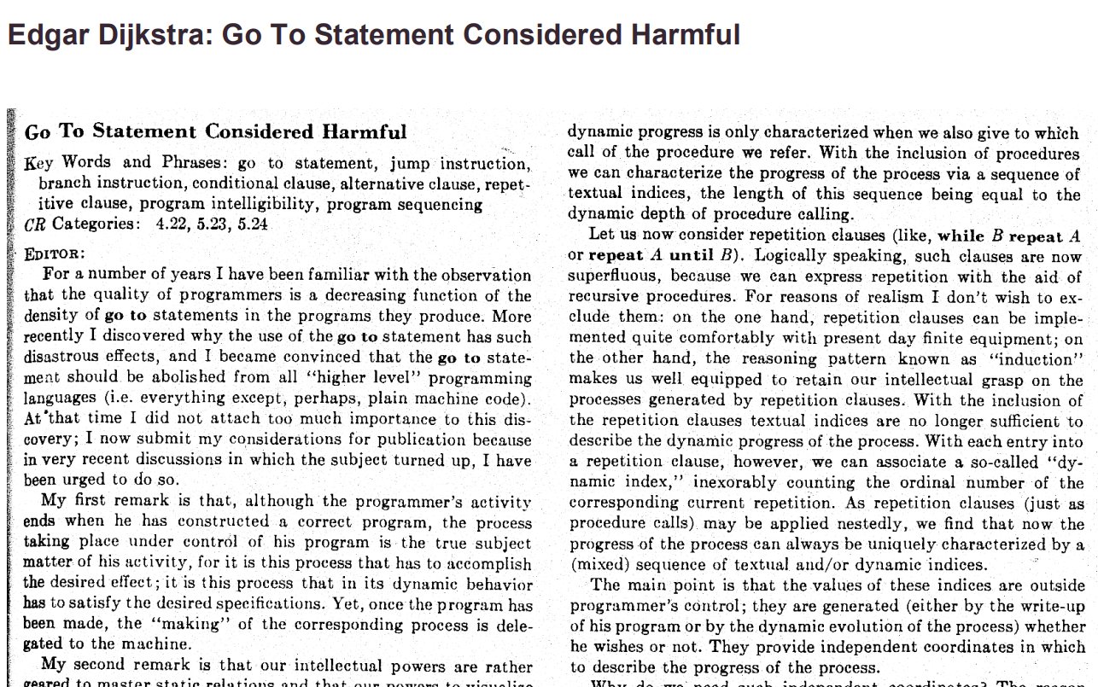

Slide 132
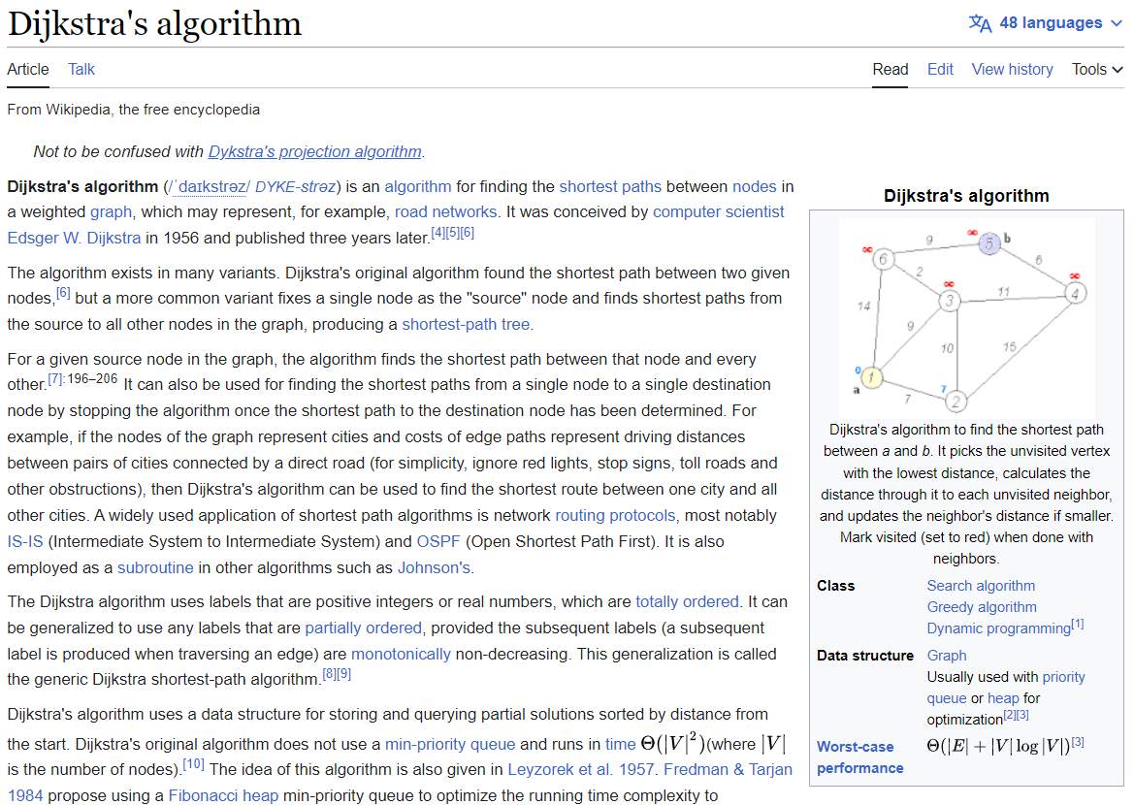

Slide 133
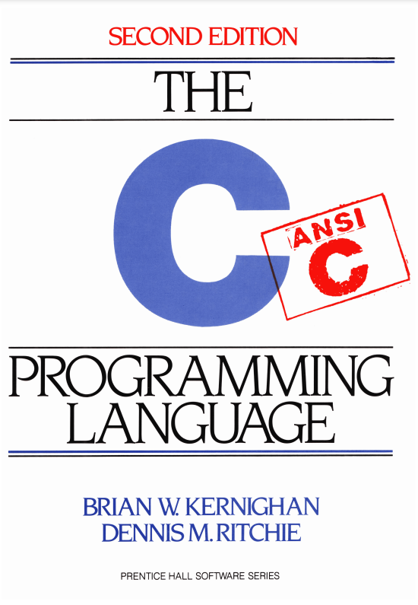

Slide 134
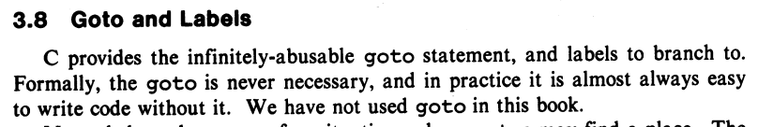
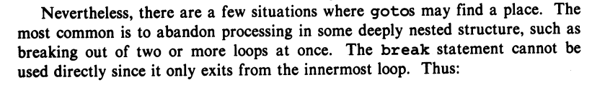
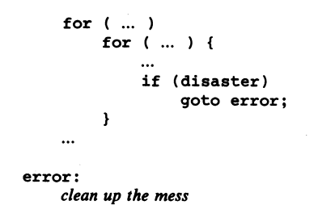

Slide 135
story time ☕️

Slide 136
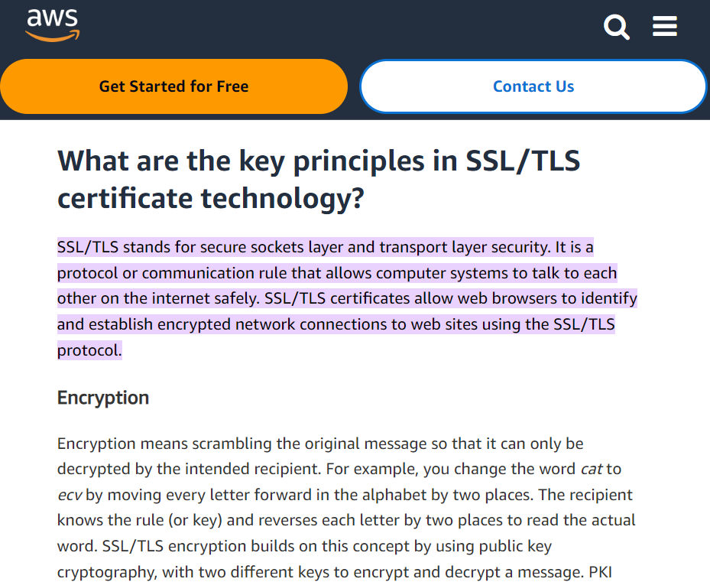

Slide 137
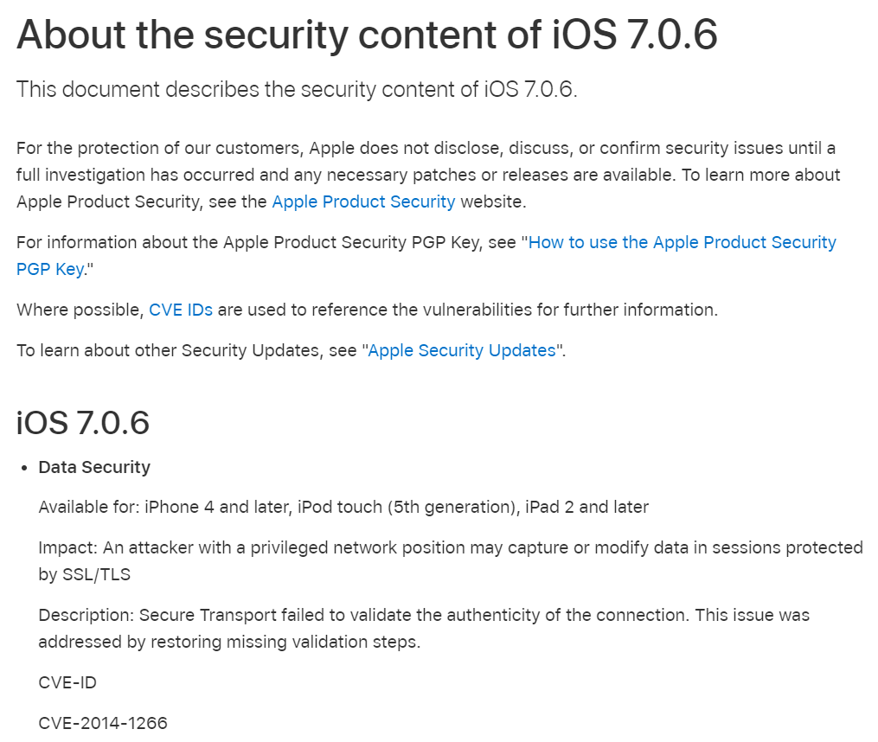

Slide 138
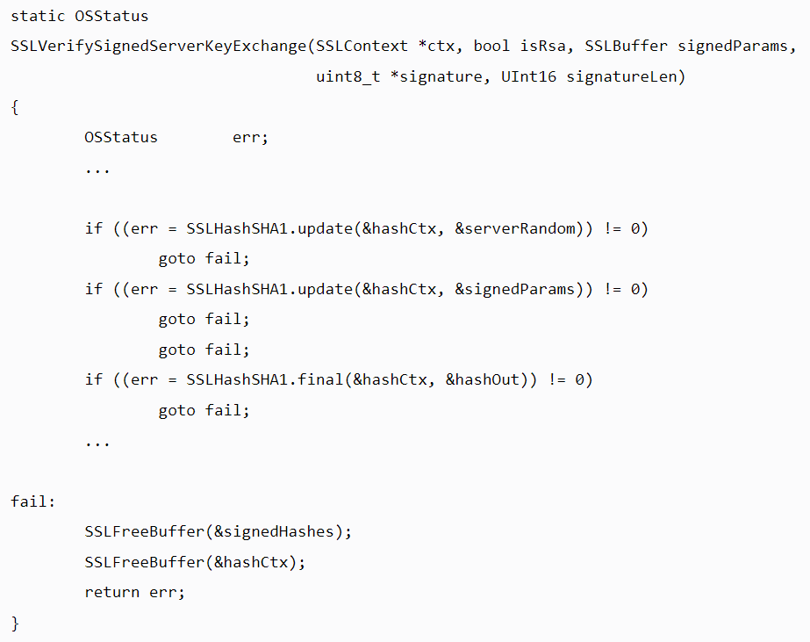

Slide 139
{
}
goto fail;

Slide 140
did the bug really happen because they left out the curly braces?

Slide 141
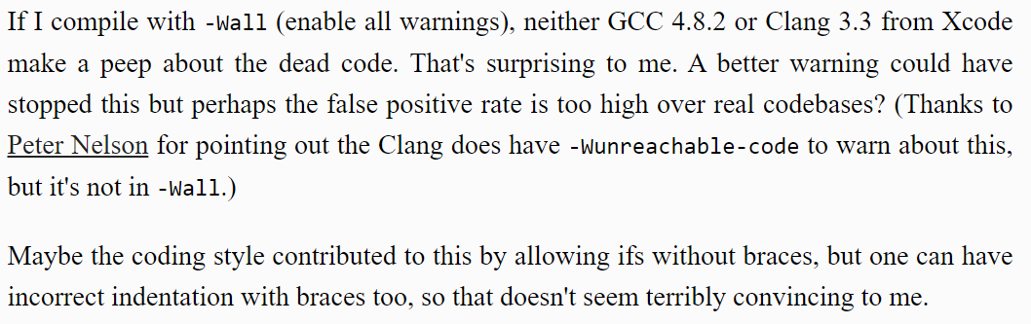

Slide 143
press CTRL+A and then press CTRL+I

Slide 144
🙂👍

Slide 145
Cow.Java

Slide 146
overview during a frame (like a frame of a movie) we update and draw the world

Slide 147

beginFrame()
beginFrame()
beginFrame()
beginFrame()
beginFrame()
beginFrame()

Slide 148
[discussion of update-draw loop]

Slide 149
your best friend

Slide 150

DOCUMENTATION

Slide 151
[examples]

Slide 152
Cow.java examples
rainbow circle example
grid
checkerboard
paint

Slide 153
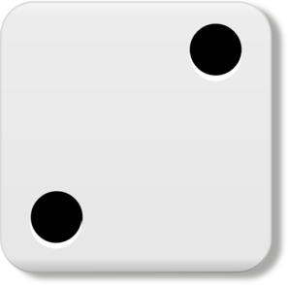
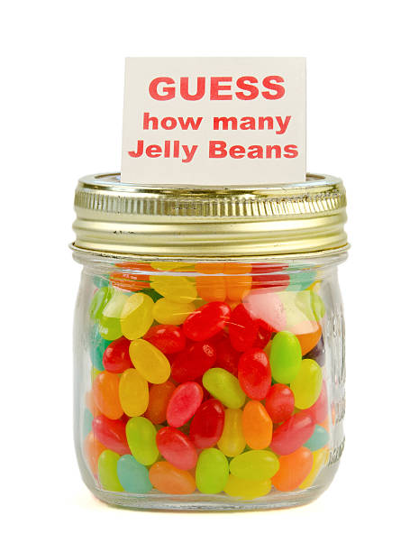
Week02
TODO: record lecture
🦜
NOTE: Jim has jury duty on thu 🎉
🦜
arrays
array examples
swap
array examples that use swaps
WARMUP
Guess how many arrays we used to make this:
https://youtu.be/dadIdXQMBi4
NOTE: an array is a fixed-length sequence of elements, all the same type

Slide 154
how many arrays?
ARRAYS (not counting tiny arrays of 3 double's, which i use to represent points)
NOTE: Counts are very approximate
==========
strings for loading files >5
huge arrays for drawing random stuff (the floor, etc) 2
random stuff in my cow.cpp library (keyboard state, OpenGL objects, etc.) >20
random global variables 1
building the simulation >6
simulation state 3
simulation itself >20
dragon head mesh 7
dragon body mesh 7
dragon mesh 7
sphere mesh 3
cylinder mesh 3
motor configuration 3
arrays that just move data back and forth between C++ <-> unity 8
inverse kinematics >15
physics >10
----------
definitely at least 100; probably less than 1000

Slide 155
arrays

Slide 156
metaphor

Slide 157
an array is like a very organized person's flower planter - one flower per square - the planter can't change size (it is made of artisinal woods or something)

Slide 158
🌻
🌺
🥀
🌹

Slide 159
mental model of an array

Slide 160
mental model of an array
a fixed number of equally-sized boxes, all right next to each other
the array itself lives "in memory"
1 | 5 | 3 | 2 | 7
int[] foo = new int[5];
foo[0] = 1;
foo[1] = 5;
foo[2] = 3;
foo[3] = 2;
foo[4] = 7;

Slide 161
the array itself lives "in memory"
1 | 5 | 3 | 2 | 7

Slide 162

1 | 5 | 3 | 2 | 7

Slide 163
learn about memory and become a real CS pro a couple important questions to ask yourself: https://www.youtube.com/watch?v=BNtcWpY4YLY

Slide 164
arrays

Slide 165
arrays (1/2)
an array is a fixed-length sequence of elements, all of the same type
"an array of 4372 double's"
"an array of 1 int's"
"an array of 64 Student's"

Slide 166
arrays (2/2)
we will often write an array using curly braces
{ 7, 7, 9 } is an array containing 7, 7, and 9
optionally, you can include a comma after the last element
{ 7, 7, 9, }
☠ even though sets from math also use curly braces, Java arrays have nothing to do with sets; in a set, all elements must be unique; in an array, elements do NOT have to be unique

Slide 167
array operations

Slide 168
array operations

Slide 169
creating an array (1/2)
you can create an array by specifying its length (the number of elements); if you do, the array is zero-initialized (all elements are initially set to zero)
int[] A = new int[8]; // { 0, 0, 0, 0, 0, 0, 0, 0 }
double[] B = new double[1]; // { 0.0 }
boolean[] C = new boolean[2]; // { false, false }
char[] D = new char[4]; // { '\0', '\0', '\0', '\0' }
String[] E = new String[3]; // { null, null, null }
[visualize in Eclipse]

Slide 170
creating an array (2/2)
you can also create an array by specifying its elements; if you do, the array's length is the number of elements you specified
int[] array = { 7, 7, 9 }; // new int[3] is implied
NOTE: this syntax can only be used for creation
🙅 NOT okay to do later: array = { 4, 5, 6 };
🙆 OKAY to do later:
array[0] = 4;
array[1] = 5;
array[2] = 6;
boolean[] array = { true };
String[] array = { "hello", "world" };

Slide 171
getting an array's length
after creating an array, you can get (but not set) its length
int[] array = { 7, 7, 9 };
PRINT(array.length); // 3
int[] array = new int[8];
PRINT(array.length); // 8
Error: cannot assign a value to final variable length
array.length = 42;

Slide 172
getting the value of an element of an array
you can get the value of an element of an array using the square brackets and the index of the element
this is also called "accessing the array"
int[] array = { 3, 4, 5 };
int foo = array[0]; // 3
int[] array = { 3, 4, 5 };
int foo = array[42];
java.lang.ArrayIndexOutOfBoundsException: 42

Slide 173
setting the value of an element of an array
you can set the value of an element of an array using the square brackets and the index of the element
int[] array = { 7, 7, 9 };
array[1] = 8;
// { 7, 8, 9 }
int[] array = { 7, 7, 9 };
array[-1] = 1000;
java.lang.ArrayIndexOutOfBoundsException: -1

Slide 174
☠ printing the elements of an array
☠ in Java, you don't simply call System.out.println(array)
instead, you call System.out.println(Arrays.toString(array));
note: this prints with square brackets instead of curly brackets
🤷‍♂️
or just call PRINT(array);
🐄💖✨
(note: also uses square brackets)

Slide 175
iterating over an array

Slide 176
iterating over an array
a for loop can be used to iterate over an array
for (int i = 0; i < array.length; ++i) {
array[i] = ...;
}

Slide 177
[example in Eclipse]

Slide 178
Week02b
🛌
zzz...
arrays
array examples
swap
array examples that use swaps
WARMUP:
On your computer, write an array deep copy from scratch, including test code.
TODO: record lecture

Slide 179
array examples

Slide 180
example: creating an array of the first 100 non-negative integers

Slide 181
example: creating an array of the first 100 non-negative integers [ 0, 1, ..., 99 ]
class Main extends Cow {
public static void main(String[] arguments) {
int[] array = new int[100];
for (int i = 0; i < array.length; ++i) {
array[i] = i;
}
PRINT(array);
}
}

Slide 182
example: (deep) array copy

Slide 183
example: array copy
class Main extends Cow {
public static void main(String[] arguments) {
int[] source = { 3, 4, 5 };
int[] destination = new int[source.length];
for (int i = 0; i < source.length; ++i) {
destination[i] = source[i];
}
PRINT(source);
PRINT(destination);
}
}

Slide 184
☠ example: bad very bad broken array copy

Slide 185
☠ example: bad very bad broken array copy
class Main extends Cow {
public static void main(String[] arguments) {
int[] source = { 3, 4, 5 };
int[] destination = source;
source[0] = 7;
PRINT(source);
PRINT(destination);
}
}

Slide 186
example: circular array
3, 4, 5, 6, 7, 8, 9, 10, 11,

Slide 187
class Main extends Cow {
public static void main(String[] arguments) {
int nextIndex = 0;
int[] circularArray = new int[5];
for (int dataPoint = 1; dataPoint < 100; ++dataPoint) {
// push dataPoint into the circularArray
circularArray[nextIndex] = dataPoint;
// update nextIndex
nextIndex = (nextIndex + 1) % circularArray.length;
}
}
}

Slide 188
example: finding the index (and value) of an array's maximum element

Slide 189
example: finding the index (and value) of an array's maximum element
import java.util.*;
class Main {
public static void main(String[] arguments) {
double[] array = { 1.0, 3.0, -42.0, 1000.0, 99.0 };
int indexOfMaximumElement = -1;
double valueOfMaximumElement = Double.NEGATIVE_INFINITY;
for (int i = 0; i < array.length; ++i) {
if (array[i] > valueOfMaximumElement) {
indexOfMaximumElement = i;
valueOfMaximumElement = array[i];
}
}
System.out.println("array[" + indexOfMaximumElement + "] = " + valueOfMaximumElement);
}
}

Slide 190
multi-dimensional arrays

Slide 191
multi-dimensional arrays

Slide 192
multi-dimensional arrays (arrays of arrays of ...)
multi-dimensional arrays are sometimes really handy
int[][] array = { { 3, 4 }, { 5, 6 }, { 7, 8 } };
PRINT(array);
// [[3, 4], [5, 6], [7, 8]]
PRINT(array[0][1]); // 4
int[][][] array = new int[2][3][4];
array[0][0][0] = 42;
System.out.println(Arrays.toString(array));
// [[[42, 0, 0, 0], [0, 0, 0, 0], [0, 0, 0, 0]], [[0, 0, 0, 0], [0, 0, 0, 0], [0, 0, 0, 0]]]

Slide 193
Week02c
!
juggling club after colloquium today 🤹
🛌
HW01 is being graded
so far only 1 person followed the TODO's... 🥲
(fix for full points back)
Pre-Lab
Post-Lab
arrays
array examples
swap
array examples that use swaps
big O
WARMUP:
How do we swap two numbers...
...in Java?
...in Python?
...in C using XOR and no temporary?
BONUS:
What is the big O runtime of pressing backspace in your text box (n is buffer.length)
TODO: record lecture

Slide 194
swap

Slide 195
🐍 Python swap

Slide 196
🐍 Python swap
a = 0
b = 1
a, b = b, a # Python swap
# a is now 1
# b is now 0

Slide 197
☠️ BAD VERY BAD BROKEN swap

Slide 198
☠️ BAD VERY BAD BROKEN swap
int a = 0;
int b = 1;
{ // BAD VERY BAD BROKEN swap
a = b; // a <- 1
b = a; // b <- 1
}

Slide 199
swap

Slide 200
swap
int a = 0;
int b = 1;
{ // swap
int tmp = a; // tmp <- 0
a = b; // a <- 1
b = tmp; // b <- 0
}

Slide 201
array algorithms that use swaps

Slide 202
reversing an array

Slide 203
out-of-place reverse
we can reverse an array out-of-place using an additional array
static int[] outOfPlaceReverse(int[] array) {
int[] result = new int[array.length];
for (int i = 0; i < array.length; ++i) {
int j = (array.length - 1) - i;
result[i] = array[j];
}
return result;
}

Slide 204
in-place reverse
we can reverse an array in-place using "swaps" (no additional array)
static void inPlaceReverse(int[] array) {
for (int i = 0; i < array.length / 2; ++i) {
int j = (array.length - 1) - i; // "mirror index"
// swap array[i] <-> array[j]
int tmp = array[i];
array[i] = array[j];
array[j] = tmp;
}
}

Slide 205
bubble sort

Slide 206
bubble sort
bubble sort is a simple in-place sorting algorithm that uses swaps
class Main {
public static void main(String[] arguments) {
int[] array = { 2, 4, 1, 6, 0, 3, 5 };
boolean arrayIsSorted;
do {
arrayIsSorted = true;
for (int i = 0; i < array.length - 1; ++i) {
if (array[i] > array[i + 1]) {
arrayIsSorted = false;
// swap
int tmp = array[i];
array[i] = array[i + 1];
array[i + 1] = tmp;
}
}
} while (!arrayIsSorted);
PRINT(array);
}
}

Slide 207
bubble sort
bubble sort is a simple in-place sorting algorithm that uses swaps
boolean arrayIsSorted;
do {
arrayIsSorted = true;
for (int i = 0; i < array.length - 1; ++i) {
if (array[i] > array[i + 1]) {
arrayIsSorted = false;
// swap
int tmp = array[i];
array[i] = array[i + 1];
array[i + 1] = tmp;
}
}
} while (!arrayIsSorted);

Slide 208
big O

Slide 209
big O (math)

Slide 210
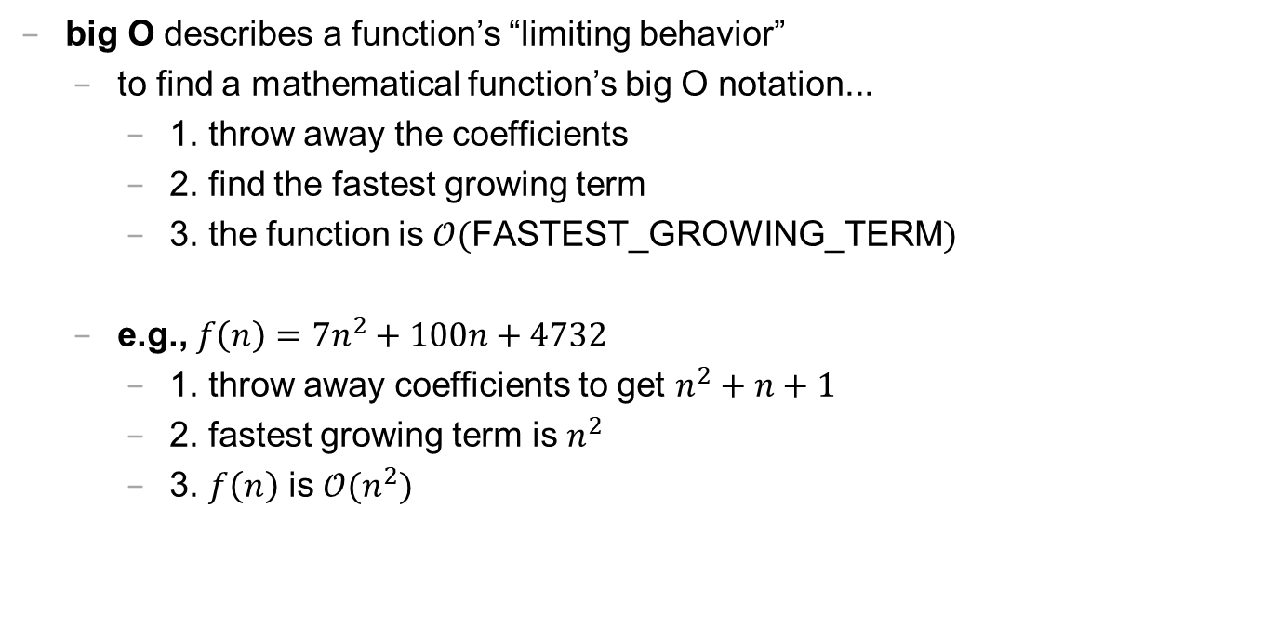
big O (1/2)
big O describes a function’s “limiting behavior”
to find a mathematical function’s big O notation...
1. throw away the coefficients
2. find the fastest growing term
3. the function is $𝒪($FASTEST_GROWING_TERM$)$
e.g., $f\left(n\right)=7n^{2}+100n+4732$
1. throw away coefficients to get $n^{2}+n+1$
2. fastest growing term is $n^{2}$
3. $f\left(n\right)$ is $𝒪(n^{2})$

Slide 211
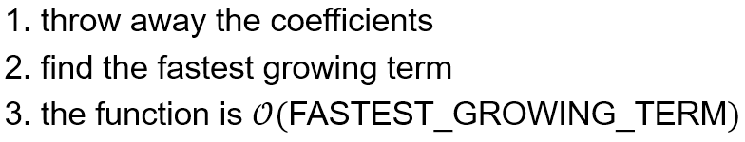
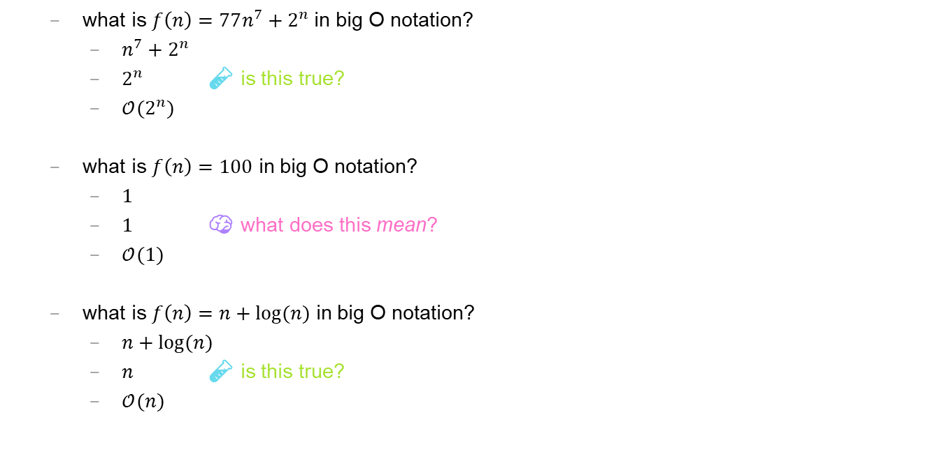
big O (2/2)
what is $f\left(n\right)=77n^{7}+2^{n}$ in big O notation?
$n^{7}+2^{n}$
$2^{n}$ 🧪 is this true?
$𝒪(2^{n})$
what is $f\left(n\right)=100$ in big O notation?
$1$
$1$ 🧠 what does this mean?
$𝒪(1)$
what is $f\left(n\right)=n+log⁡(n)$ in big O notation?
$n+log⁡(n)$
$n$ 🧪 is this true?
$𝒪(n)$

Slide 212
logarithmic growth is the inverse of exponential growth

Slide 213
y = 2^{x}
🧠 solve for x.

Slide 214
y = 2^{x} x = log₂ y

Slide 215
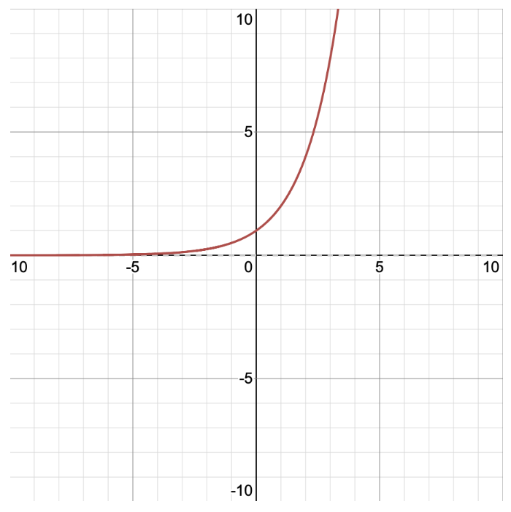
y = 2^{x} x = log₂ y
y
x

Slide 216
y = 2^{x} x = log₂ y
y
x

Slide 217
big O runtime (arrays)

Slide 218
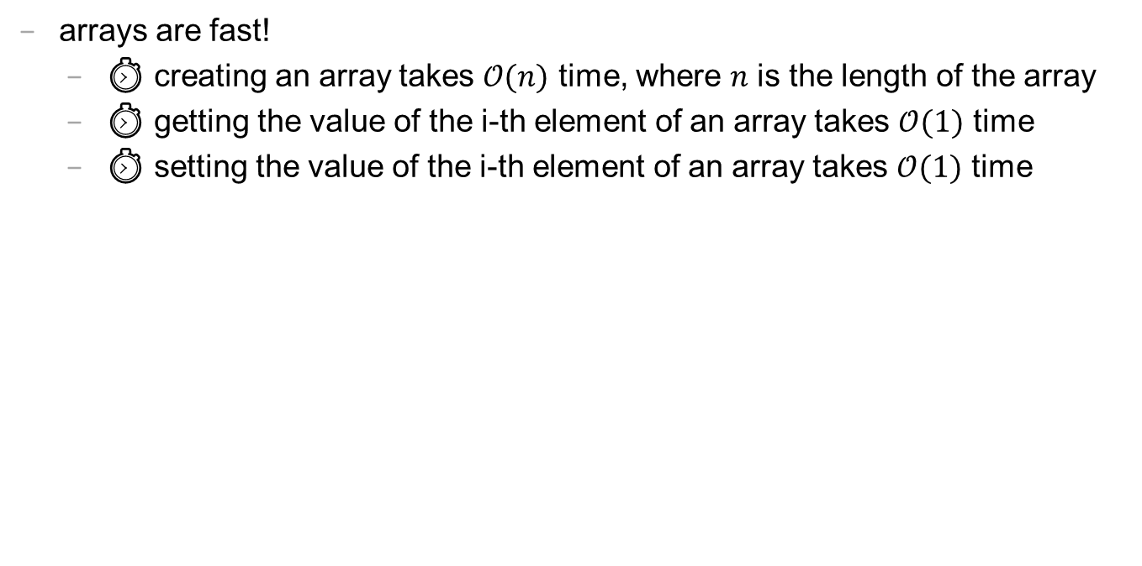
runtime of array operations
arrays are fast!
⏱️ creating an array takes $𝒪(n)$ time, where $n$ is the length of the array
⏱️ getting the value of the i-th element of an array takes $𝒪(1)$ time
⏱️ setting the value of the i-th element of an array takes $𝒪(1)$ time

Slide 219
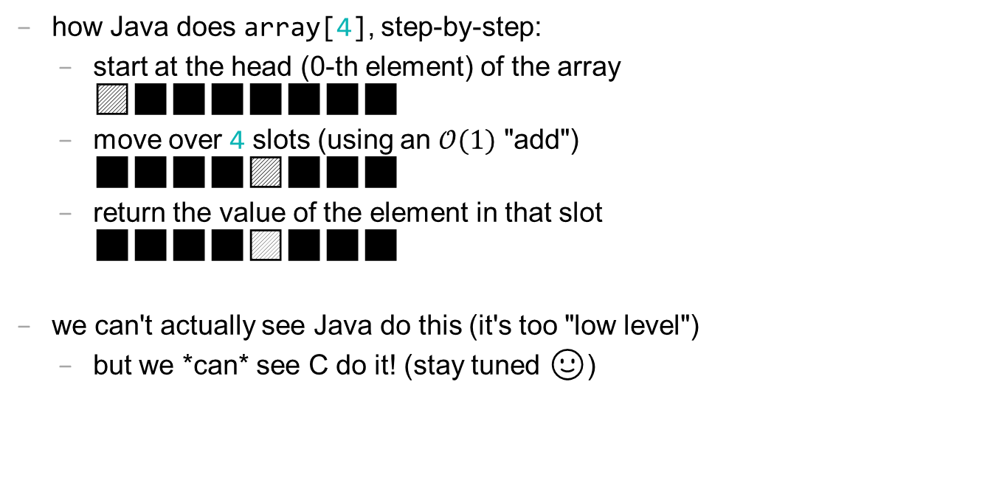
accessing an array "under the hood"
how Java does array[4], step-by-step:
start at the head (0-th element) of the array 🟦⬛⬛⬛⬛⬛⬛⬛
move over 4 slots (using an $𝒪(1)$ "add") ⬛⬛⬛⬛🟦⬛⬛⬛
return the value of the element in that slot ⬛⬛⬛⬛🟨⬛⬛⬛
we can't actually see Java do this (it's too "low level")
but we *can* see C do it! (stay tuned 🙂)

Slide 220
big O runtime (code)

Slide 221
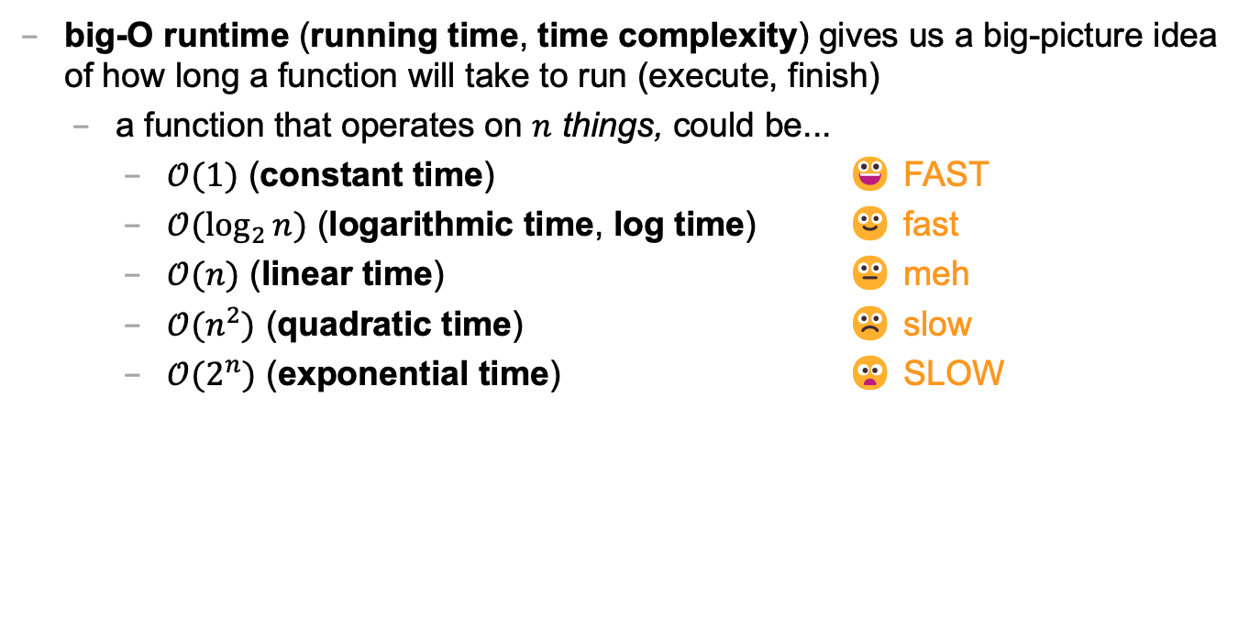
big-O runtime (1/3)
big-O runtime (running time, time complexity) gives us a big-picture idea of how long a function will take to run (execute, finish)
a function that operates on $n$ things, could be...
$𝒪(1)$ (constant time) 😀 FAST
$𝒪(\log_{2}{n})$ (logarithmic time, log time) 🙂 fast
$𝒪(n)$ (linear time) 😐 meh
$𝒪(n^{2})$ (quadratic time) ☹️ slow
$𝒪(2^{n})$ (exponential time) 😦 SLOW

Slide 222
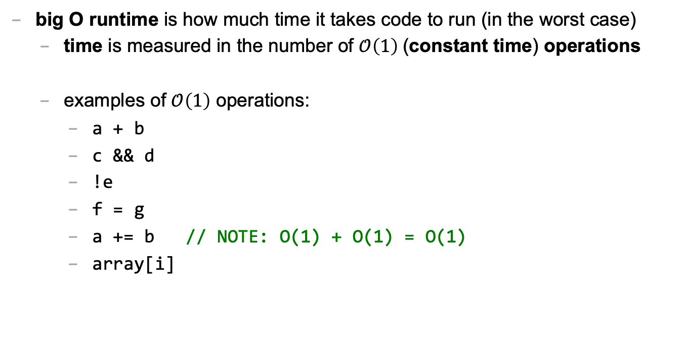
big O runtime (2/3)
big O runtime is how much time it takes code to run (in the worst case)
time is measured in the number of $𝒪\left(1\right)$(constant time) operations
examples of $𝒪\left(1\right)$ operations:
a + b
c && d
!e
f = g
a += b // NOTE: O(1) + O(1) = O(1)
array[i]

Slide 223
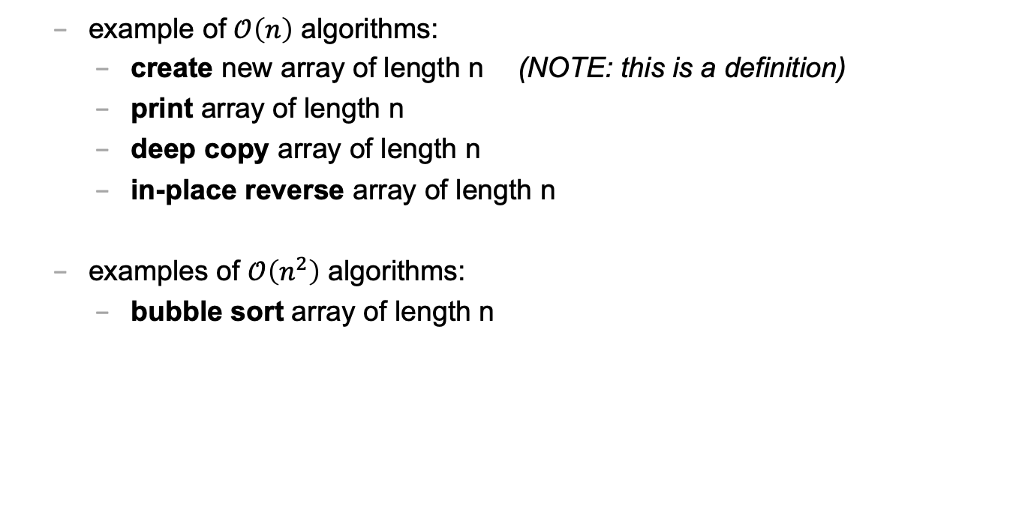
big O runtime (3/3)
example of $𝒪\left(n\right)$ algorithms:
create new array of length n (NOTE: this is a definition)
print array of length n
deep copy array of length n
in-place reverse array of length n
examples of $𝒪\left(n^{2}\right)$ algorithms:
bubble sort array of length n

Slide 224
fun examples

Slide 225
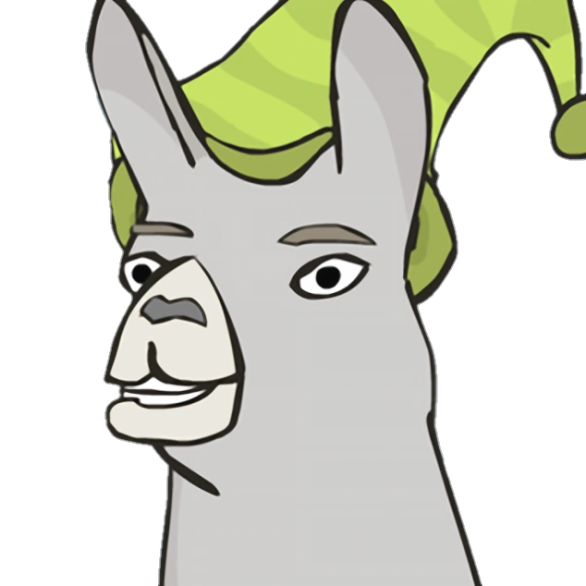
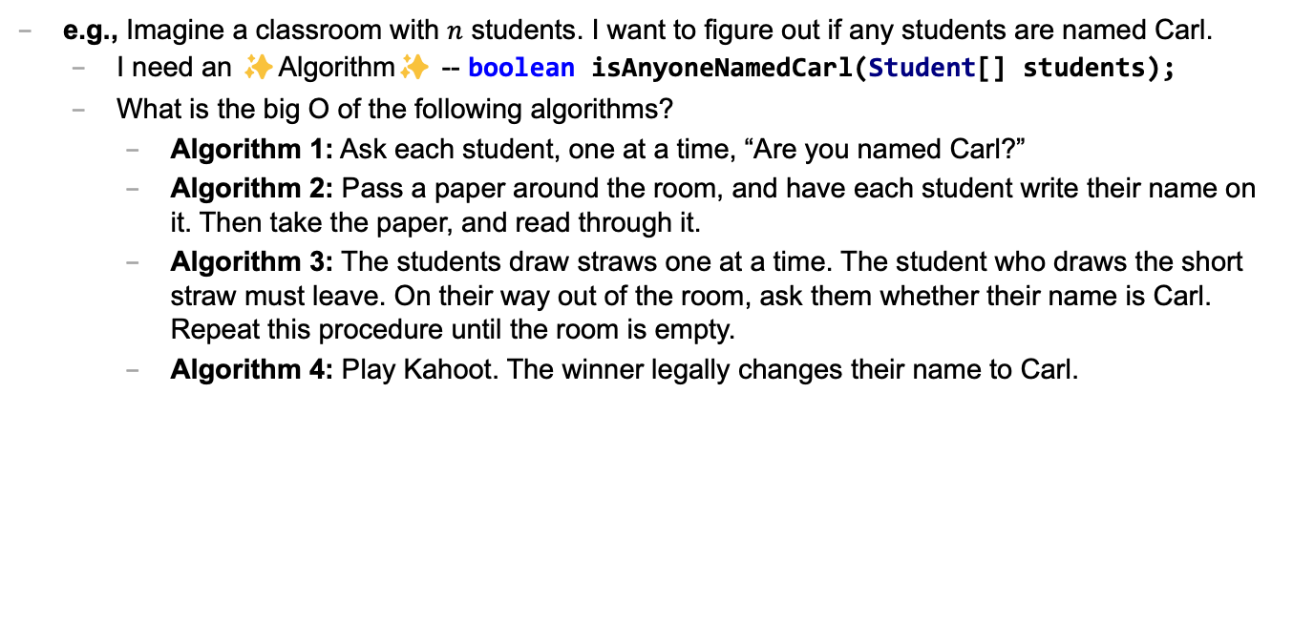
Caaaaaaaaaaaarl
e.g., Imagine a classroom with $n$ students. I want to figure out if any students are named Carl.
I need an ✨Algorithm✨ -- boolean isAnyoneNamedCarl(Student[] students);
What is the big O of the following algorithms?
Algorithm 1: Ask each student, one at a time, “Are you named Carl?”
Algorithm 2: Pass a paper around the room, and have each student write their name on it. Then take the paper, and read through it.
Algorithm 3: The students draw straws one at a time. The student who draws the short straw must leave. On their way out of the room, ask them whether their name is Carl. Repeat this procedure until the room is empty.
Algorithm 4: Play Kahoot. The winner legally changes their name to Carl.

Slide 226
textbox examples

Slide 227
let's say n equals buffer.length

Slide 228
what's the big O of pressing →?

Slide 229
what's the big O of pressing A?

Slide 230
💻 array tutorial

Slide 231
💻 array tutorial

Slide 232
💻 array tutorial
// 🟢 ([5, 4, 7, 0, 7], 7) -> 2
// 🟢 ([5, 4, 7, 0, 7], 3) -> -1
static int findFirstIndexOf(int[] array, int value);
// 🟦 ([1, 3, 3, 2, 3, 4], 3) -> [1, 2, 4]
static int[] removeAllOccurences(int[] array, int value);
// ♦️ [[1, 3], [2, 4, 5], [0, 5]] -> [0, 1, 2, 3, 4, 5, 5]
static int[] mergeArrayOfSortedArrays(int[][] arrays);

Slide 233
Week03
TODO: record lecture
Today is...
✨No-Laptop Monday! ✨
🦜🦜🦜
WARMUP
What is a bullet hell?
HW03 preview
functions
classes
HW03 behind the scenes
references
BONUS
Who wrote the game Everyday Shooter?
What is she working on now?
BONUS
What does Touhou 7: Perfect Cherry Blossom's Extra Stage look like? Who wrote this?

Slide 234
but first, something nice

Slide 235
🦉 secret agent owl

Slide 236
🦉 secret agent owl

Slide 237
🦉 secret agent owl

Slide 238
🦉 secret agent owl

Slide 239
HW03 preview 👻

Slide 240
functions

Slide 241
anatomy of a function

Slide 242
anatomy of a function (1/2)
a function is a lil chunk of code you can call from elsewhere
a function takes any number of arguments
... foo(int arg) { ... } // function foo takes an int
a function with a non-void return type must return a value of that type
int bar(...) { ... } // bar returns an int
void baz(...) { ... } // baz doesn't return anything
ReturnType functionName(ArgumentOneType argumentOne, ...) {
...
}

Slide 243
anatomy of a function (2/2)
void drawLine(
double a_x,
double a_y,
double b_x,
double b_y,
Color color) {
...
}

Slide 244
return

Slide 245
return (1/2)
a return statement stops execution of a function and returns the program to where the function was called
some return statements return a value
return 123;
others do not
return;
✨ this can be used to stop running a void-returning function in the middle

Slide 246
return (2/2)
a function with a non-void return type must return a value of that type, regardless of the path taken through the function
Error: missing return statement
static boolean isEven(int n) {
if (n % 2 == 0) {
return true;
}
}

Slide 247
return (2/2)
a function with a non-void return type must return a value of that type, regardless of the path taken through the function
static boolean isEven(int n) {
if (n % 2 == 0) {
return true;
} return false;
}

Slide 248
return (3/2)
a function with a non-void return type must return a value of that type, regardless of the path taken through the function
static boolean isEven(int n) {
return (n % 2 == 0);
}

Slide 249
return (3/2)
a function with a non-void return type must return a value of that type, regardless of the path taken through the function

Slide 250
return (2/2)
a function with a non-void return type must return a value of that type, regardless of the path taken through the function
Error: missing return statement
static boolean isPrime(int n) {
if (n <= 1) { return false; }
for (int i = 2; i <= SQRT(n); ++i) {
if (n % i == 0) { return false; }
}
}

Slide 251
return (2/2)
a function with a non-void return type must return a value of that type, regardless of the path taken through the function
static boolean isPrime(int n) {
if (n <= 1) { return false; }
for (int i = 2; i <= SQRT(n); ++i) {
if (n % i == 0) { return false; }
}
return true;
}

Slide 252
void

Slide 253
void
void is a special return type meaning a function does not return a value
void functions often modify (the objects referenced by) their arguments
static void inPlaceReverse(int[] array) { ... }
// no need to return a reference to array // (user of the function already has one)
in Java, the main method is a void function (it doesn't return anything)
public static void main(String[] arguments) { ... }

Slide 254
the call stack

Slide 255
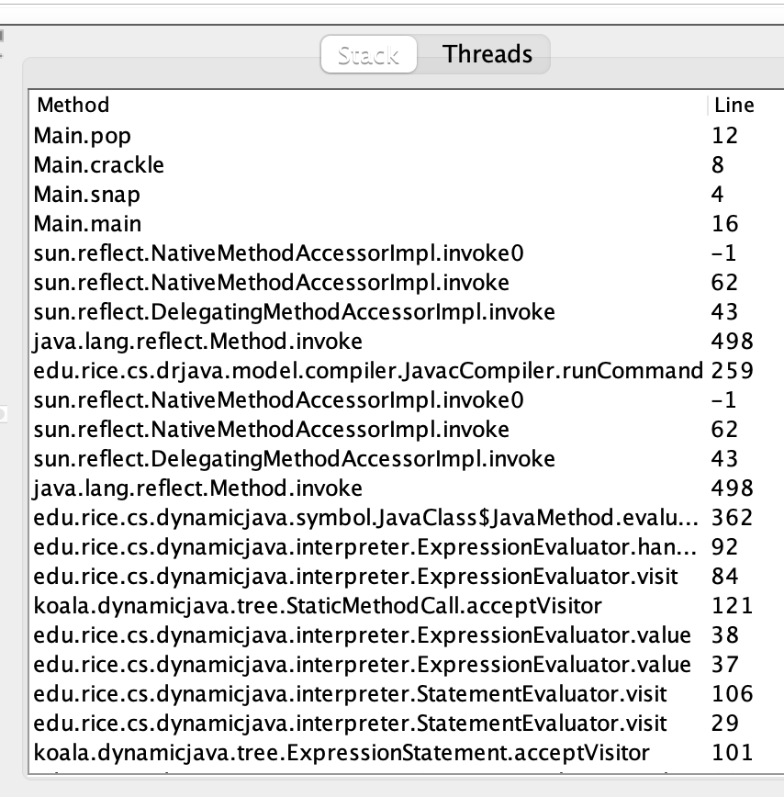
the call stack
functions can call other functions
the resulting "stack" of function calls is called the call stack
class Main {
static void snap() {
crackle();
}
static void crackle() {
pop();
}
static void pop() {
return;
}
public static void main(String[] arguments) {
snap();
}
}

Slide 256
🤔

Slide 257
[let's see what Eclipse does]

Slide 258
recursion

Slide 259
recursion (1/2)
a recursive function is a function that calls itself
each call must make progress towards a base case (when the function finally returns without calling itself)
✨ when in doubt, try something like zero for your base case
class Main extends Cow {
static int digitSum(int n) {
if (n == 0) {
return 0;
}
return digitSum(n / 10) + (n % 10);
}
public static void main(String[] arguments) {
PRINT(digitSum(256)); // 13
}
}

Slide 260
static int digitSum(int n) {
if (n == 0) {
return 0;
}
return digitSum(n / 10) + (n % 10);
}
return 0;
return digitSum(0) + 2;
return digitSum(2) + 5;
return digitSum(25) + 6;
int a = digitSum(256);

Slide 261
static int digitSum(int n) {
if (n == 0) {
return 0;
}
return digitSum(n / 10) + (n % 10);
}
return 0;
return digitSum(0) + 2;
return digitSum(2) + 5;
return digitSum(25) + 6;
int a = digitSum(256);

Slide 262
static int digitSum(int n) {
if (n == 0) {
return 0;
}
return digitSum(n / 10) + (n % 10);
}
return 0 + 2;
return digitSum(2) + 5;
return digitSum(25) + 6;
int a = digitSum(256);

Slide 263
static int digitSum(int n) {
if (n == 0) {
return 0;
}
return digitSum(n / 10) + (n % 10);
}
return 2;
return digitSum(2) + 5;
return digitSum(25) + 6;
int a = digitSum(256);

Slide 264
static int digitSum(int n) {
if (n == 0) {
return 0;
}
return digitSum(n / 10) + (n % 10);
}
return 2;
return digitSum(2) + 5;
return digitSum(25) + 6;
int a = digitSum(256);

Slide 265
static int digitSum(int n) {
if (n == 0) {
return 0;
}
return digitSum(n / 10) + (n % 10);
}
return 2 + 5;
return digitSum(25) + 6;
int a = digitSum(256);

Slide 266
static int digitSum(int n) {
if (n == 0) {
return 0;
}
return digitSum(n / 10) + (n % 10);
}
return 7;
return digitSum(25) + 6;
int a = digitSum(256);

Slide 267
static int digitSum(int n) {
if (n == 0) {
return 0;
}
return digitSum(n / 10) + (n % 10);
}
return 7;
return digitSum(25) + 6;
int a = digitSum(256);

Slide 268
static int digitSum(int n) {
if (n == 0) {
return 0;
}
return digitSum(n / 10) + (n % 10);
}
return 7 + 6;
int a = digitSum(256);

Slide 269
static int digitSum(int n) {
if (n == 0) {
return 0;
}
return digitSum(n / 10) + (n % 10);
}
return 13;
int a = digitSum(256);

Slide 270
static int digitSum(int n) {
if (n == 0) {
return 0;
}
return digitSum(n / 10) + (n % 10);
}
return 13;
int a = digitSum(256);

Slide 271
static int digitSum(int n) {
if (n == 0) {
return 0;
}
return digitSum(n / 10) + (n % 10);
}
int a = 13;

Slide 272
fin.

Slide 273
recursion (2/2)
a stack overflow error happens when functions call too many functions without returning; these errors are usually caused by broken recursive code
class Main {
static void stackOverflow() {
stackOverflow();
}
public static void main(String[] arguments) {
stackOverflow();
}
}
java.lang.StackOverflowError
at Main.stackOverflow(Tmp.java:3)
at Main.stackOverflow(Tmp.java:3)
at Main.stackOverflow(Tmp.java:3)
at Main.stackOverflow(Tmp.java:3)
at Main.stackOverflow(Tmp.java:3)
at Main.stackOverflow(Tmp.java:3)
at Main.stackOverflow(Tmp.java:3)
at Main.stackOverflow(Tmp.java:3)
at Main.stackOverflow(Tmp.java:3)
at Main.stackOverflow(Tmp.java:3)
at Main.stackOverflow(Tmp.java:3)
at Main.stackOverflow(Tmp.java:3)
at Main.stackOverflow(Tmp.java:3)
at Main.stackOverflow(Tmp.java:3)
at Main.stackOverflow(Tmp.java:3)
at Main.stackOverflow(Tmp.java:3)
at Main.stackOverflow(Tmp.java:3)
at Main.stackOverflow(Tmp.java:3)
at Main.stackOverflow(Tmp.java:3)
at Main.stackOverflow(Tmp.java:3)
at Main.stackOverflow(Tmp.java:3)
at Main.stackOverflow(Tmp.java:3)
at Main.stackOverflow(Tmp.java:3)
at Main.stackOverflow(Tmp.java:3)
at Main.stackOverflow(Tmp.java:3)
at Main.stackOverflow(Tmp.java:3)
at Main.stackOverflow(Tmp.java:3)
at Main.stackOverflow(Tmp.java:3)
at Main.stackOverflow(Tmp.java:3)
at Main.stackOverflow(Tmp.java:3)
at Main.stackOverflow(Tmp.java:3)
at Main.stackOverflow(Tmp.java:3)
at Main.stackOverflow(Tmp.java:3)
at Main.stackOverflow(Tmp.java:3)
at Main.stackOverflow(Tmp.java:3)
at Main.stackOverflow(Tmp.java:3)
at Main.stackOverflow(Tmp.java:3)
at Main.stackOverflow(Tmp.java:3)
at Main.stackOverflow(Tmp.java:3)
at Main.stackOverflow(Tmp.java:3)
at Main.stackOverflow(Tmp.java:3)
at Main.stackOverflow(Tmp.java:3)
at Main.stackOverflow(Tmp.java:3)
at Main.stackOverflow(Tmp.java:3)
at Main.stackOverflow(Tmp.java:3)
at Main.stackOverflow(Tmp.java:3)
at Main.stackOverflow(Tmp.java:3)
at Main.stackOverflow(Tmp.java:3)
at Main.stackOverflow(Tmp.java:3)
at Main.stackOverflow(Tmp.java:3)
at Main.stackOverflow(Tmp.java:3)
at Main.stackOverflow(Tmp.java:3)
at Main.stackOverflow(Tmp.java:3)
at Main.stackOverflow(Tmp.java:3)
at Main.stackOverflow(Tmp.java:3)
at Main.stackOverflow(Tmp.java:3)
at Main.stackOverflow(Tmp.java:3)
at Main.stackOverflow(Tmp.java:3)
at Main.stackOverflow(Tmp.java:3)
at Main.stackOverflow(Tmp.java:3)
at Main.stackOverflow(Tmp.java:3)
at Main.stackOverflow(Tmp.java:3)
at Main.stackOverflow(Tmp.java:3)
at Main.stackOverflow(Tmp.java:3)
at Main.stackOverflow(Tmp.java:3)
at Main.stackOverflow(Tmp.java:3)

Slide 274
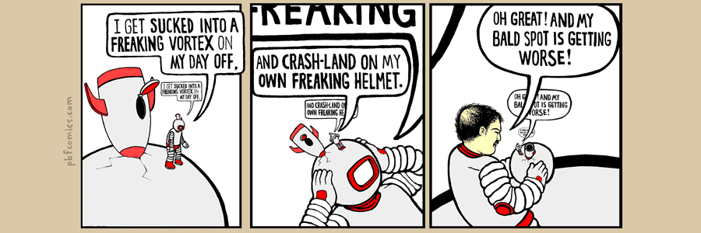

Slide 275
classes

Slide 276
anatomy of a class

Slide 277
anatomy of a class (1/2)
class ClassName {
VariableOneType variableOne;
...
FunctionOneReturnType functionOneName(...) { ... }
...
}
a class lets you bundle together data and functions
a class may have any number of variables (fields)
int foo; // objects of this class have an int called foo
a class may have any number of functions (methods)
int bar() { ... } // objects of class have function bar

Slide 278
anatomy of a class (2/2)
class Thing {
// instance variables
double x;
double y;
Color color;
double radius;
// instance methods
void draw() { ... }
...
}

Slide 279
dot

Slide 280
dot
the dot operator is used to access an object's variables and functions
Thing thing = new Thing();
thing.x = 3.0;
thing.y = 4.0;
thing.draw();

Slide 281
terminology

Slide 282
class vs. object (instance of a class)
a class is NOT the same thing as an object
a class is "a blueprint for making objects"
we can make an instance of a class (an object) using the new keyword
this is called "instantiating the class"
Thing thing = new Thing();

Slide 283
[off the record note on OOP (Object Oriented Programming) terminology]

Slide 284
new and constructors

Slide 285
new
the new keyword create a new instance of a class and calls its appropriate constructor
int[] array = new int[5]; // { 0, 0, 0, 0, 0 }
Color color = new Color(1.0, 0.0, 0.0); // (1.0, 0.0, 0.0)
☠️ you don't need new to create a new string
String string = "strings are their own thing";
☠️ you don't need new to create a new array when using {} syntax
int[] array = { 1, 2, 3 };
☠️ new doesn't actually return the object it created; it returns a reference to the object

Slide 286
constructors (1/2)
a constructor is called when an object is created
if the class does not have a constructor, then the default constructor must be called, which takes no arguments and sets all variables to zero
Color color = new Color(); // (0.0, 0.0, 0.0)

Slide 287
constructors (2/2)
a (non-default) constructor is never necessary, but is often convenient
Color color = new Color(1.0, 1.0, 1.0); // (r=1.0, g=1.0, b=1.0)
Color color = new Color(); // (0.0, 0.0, 0.0)
color.r = 1.0; // (1.0, 0.0, 0.0)
color.g = 1.0; // (1.0, 1.0, 0.0)
color.b = 1.0; // (1.0, 1.0, 1.0)

Slide 288
this 🐍 in Python, this is self

Slide 289
this
this is a reference to the instance of the class whose function we're inside of
✨ especially useful inside a constructor
class Color {
...
void shade() {
this.r /= 2;
this.g /= 2;
this.b /= 2;
}
Color(double r, double g, double b) { // constructor
this.r = r;
this.g = g;
this.b = b;
}
}

Slide 290
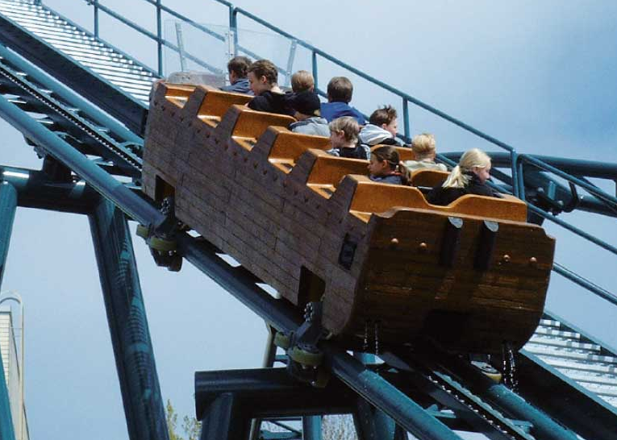
Week03b
Today is...
Wednesday!
(136 is a rollercoaster
that only goes up)
TODO: record lecture
🦜🦜🦜
HW03 preview
functions
classes (not quite done)
memory FUNdaMENTALs
the stack and the heap
passing arguments to functions
WARMUP
what is 42 in hex?

Slide 291
static (wrapping up last lecture)

Slide 292
static variables and static methods

Slide 293
instance variables vs static variables
an instance variable is part of an instance of a class
a static variable (class variable) is part of the class itself
there is only one, period. (it's a global variable that lives "on the class")
class Thing {
int type;
static int TYPE_BULLET = 1;
...
}
// Thing thing = new Thing();
// thing.type = Thing.TYPE_BULLET;

Slide 294
instance methods vs static methods
an instance method must be called on an instance (object) of a class
a static method (class method) can be called on the class itself
✅ there is no this in a static method
class Thing {
void draw() { ... }; // (non-static method)
static boolean collisionCheck(Thing a, Thing b) { ... }
...
}
// Thing a, b;
// a.draw();
// if (Thing.collisionCheck(...)) { ... }

Slide 295
and now... today's lecture!

Slide 296
☠️ this is the hardest lecture in 136

Slide 297
but learning this stuff is very worth 🙂👍 note: you will likely need to review this lecture a few times (i am sure you will all do this)

Slide 298
but learning this stuff is very worth 🙂👍 note: you will likely need to review this lecture a few times (i am sure you will all do this)

Slide 299
but learning this stuff is very worth 🙂👍 note: you will likely need to review this lecture a few times (i am sure you will all do this)

Slide 300
but learning this stuff is very worth 🙂👍 note: you will likely need to review this lecture a few times (i am sure you will all do this 🥲)

Slide 301
note: i am intentionally breaking these examples into many steps to teach you about memory don't actually code this way! int foo = 7; // <-- Good!

Slide 302
memory FUNdaMENTALs

Slide 303
the two kinds of variables in Java

Slide 304
a variable in Java is either... a primitive or a reference to an Object

Slide 305
primitives (review)

Slide 306
primitive types
in this class, "a variable being a primitive" means that the variable is a boolean, char, double, or int
primitive types are simple
primitive types are small
primitive types are NOT Objects
we will talk about Objects later
examples of Objects: String, MyCoolClass, int[] (array of ints)

Slide 307
boolean, char, double, int
a boolean stores a truth value
true, false
a char stores a character
'\0', 'a', 'Z', '!', '\n'
a double stores a real number
0.0, -0.5, 3.1415926, Double.NEGATIVE_INFINITY
an int stores an integer
0, -1, 4

Slide 308
primitives
some examples of primitives
int a; // a is an int
boolean b; // b is a boolean
char c; // c is a char

Slide 309
references to Objects

Slide 310
references (1/2)
we interact with Object's through references
String string; // string is a reference to a String object
Color color; // color is a reference to a Color object
int[] array; // array is a reference to an int array

Slide 311
references (2/2)
a reference is a memory address ("where the object lives in memory")
a memory address is an integer
a memory address is often written in hexadecimal (hex, base-16, 0...9A...F)
Thing a = new Thing();
// ^ refers to a Thing object at memory address 0x70f806418

Slide 312
null

Slide 313
null (1/2)
a null reference refers to nothing
the actual memory address referred to by null is zero (0x00... in hex)
Thing b = null;
// ^ refers to nothing (memory address 0x000000000)

Slide 314
null (2/2)
Thing[] pool = new Thing[7];
// ^ refers to a Thing[] object at memory address 0x70f805b68
//
// NOTE: the Thing array referred to by pool has 7 entries,
// all zero-initialized (null; memory address 0x000000000)
pool[0] = new Thing();
// pool[0] now refers to a Thing object at memory address // 0x70f8079c0

Slide 315
the stack and the heap (where stuff lives)

Slide 316
overview

Slide 317
let's get more specific than saying "variables live in memory" we divide memory into two parts: the stack and the heap

Slide 318
"the stack"
local variable primitives & references to Objects live here
variables undefined (?) by default (will NOT compile if used)
"the heap"
the actual Objects (including arrays and Strings) live here
Objects are cleared to 0 by default

Slide 319
primitives live on the stack

Slide 320
"the stack"
local variable primitives & references to Objects live here
variables undefined (?) by default (will NOT compile if used)
"the heap"
the actual Objects (including arrays and Strings) live here
Objects are cleared to 0 by default

Slide 321
int a;
int b;
a = 3;
b = a;
a = 7;

Slide 322
int a;
int b;
a = 3;
b = a;
a = 7;
a
?

Slide 323
int a;
int b;
a = 3;
b = a;
a = 7;
a
b
?
?

Slide 324
int a;
int b;
a = 3;
b = a;
a = 7;
a
b
3
?

Slide 325
int a;
int b;
a = 3;
b = a;
a = 7;
a
b
3
3

Slide 326
int a;
int b;
a = 3;
b = a;
a = 7;
a
b
7
3

Slide 327
int a;
int b;
a = 3;
b = a;
a = 7;
a
b
7
3

Slide 328
Objects live on the heap (but references to objects live on the stack)

Slide 329
"the stack"
local variable primitives & references to Objects live here
variables undefined (?) by default (will NOT compile if used)
"the heap"
the actual Objects (including arrays and Strings) live here
Objects are cleared to 0 by default

Slide 330
class Thing {
double x;
double y;
}
Thing a;
a = new Thing();
Thing b;
b = a;
a.x = 3.0;
b.y = 4.0;
a = null;

Slide 331
class Thing {
double x;
double y;
}
Thing a;
a = new Thing();
Thing b;
b = a;
a.x = 3.0;
b.y = 4.0;
a = null;
a
?

Slide 332
class Thing {
double x;
double y;
}
Thing a;
a = new Thing();
Thing b;
b = a;
a.x = 3.0;
b.y = 4.0;
a = null;
a
0xb7
.x
.y
0.0
0.0

Slide 333
class Thing {
double x;
double y;
}
Thing a;
a = new Thing();
Thing b;
b = a;
a.x = 3.0;
b.y = 4.0;
a = null;
a
b
0xb7
?
.x
.y
0.0
0.0

Slide 334
class Thing {
double x;
double y;
}
Thing a;
a = new Thing();
Thing b;
b = a;
a.x = 3.0;
b.y = 4.0;
a = null;
a
b
0xb7
0xb7
.x
.y
0.0
0.0

Slide 335
class Thing {
double x;
double y;
}
Thing a;
a = new Thing();
Thing b;
b = a;
a.x = 3.0;
b.y = 4.0;
a = null;
a
b
0xb7
0xb7
.x
.y
3.0
0.0

Slide 336
class Thing {
double x;
double y;
}
Thing a;
a = new Thing();
Thing b;
b = a;
a.x = 3.0;
b.y = 4.0;
a = null;
a
b
0xb7
0xb7
.x
.y
3.0
4.0

Slide 337
class Thing {
double x;
double y;
}
Thing a;
a = new Thing();
Thing b;
b = a;
a.x = 3.0;
b.y = 4.0;
a = null;
a
b
0x00
0xb7
.x
.y
3.0
4.0

Slide 338
class Thing {
double x;
double y;
}
Thing a;
a = new Thing();
Thing b;
b = a;
a.x = 3.0;
b.y = 4.0;
a = null;
a
b
0x00
0xb7
.x
.y
3.0
4.0

Slide 339
stack variables disappear when they leave scope Objects are garbage collected when nothing refers to them anymore

Slide 340
"the stack"
local variable primitives & references to Objects live here
variables undefined (?) by default (will NOT compile if used)
"the heap"
the actual Objects (including arrays and Strings) live here
Objects are cleared to 0 by default

Slide 341
{
int a;
a = 7;
}
{
int[] b;
b = new int[5];
b[4] = 8;
}

Slide 342
{
int a;
a = 7;
}
{
int[] b;
b = new int[5];
b[4] = 8;
}

Slide 343
{
int a;
a = 7;
}
{
int[] b;
b = new int[5];
b[4] = 8;
}
a
?

Slide 344
{
int a;
a = 7;
}
{
int[] b;
b = new int[5];
b[4] = 8;
}
a
7

Slide 345
{
int a;
a = 7;
}
{
int[] b;
b = new int[5];
b[4] = 8;
}
a
7

Slide 346
{
int a;
a = 7;
}
{
int[] b;
b = new int[5];
b[4] = 8;
}

Slide 347
{
int a;
a = 7;
}
{
int[] b;
b = new int[5];
b[4] = 8;
}

Slide 348
{
int a;
a = 7;
}
{
int[] b;
b = new int[5];
b[4] = 8;
}
b
?

Slide 349
{
int a;
a = 7;
}
{
int[] b;
b = new int[5];
b[4] = 8;
}
b
0xb7
[0]
[1]
[2]
[3]
[4]
0
0
0
0
0

Slide 350
{
int a;
a = 7;
}
{
int[] b;
b = new int[5];
b[4] = 8;
}
b
0xb7
[0]
[1]
[2]
[3]
[4]
0
0
0
0
8

Slide 351
{
int a;
a = 7;
}
{
int[] b;
b = new int[5];
b[4] = 8;
}
b
0xb7
[0]
[1]
[2]
[3]
[4]
0
0
0
0
8

Slide 352
{
int a;
a = 7;
}
{
int[] b;
b = new int[5];
b[4] = 8;
}
0
0
0
0
8

Slide 353
{
int a;
a = 7;
}
{
int[] b;
b = new int[5];
b[4] = 8;
}
0
0
0
0
8
🚛

Slide 354
garbage collector

Slide 355
garbage collector
the garbage collector is like a trash truck that drives around in the heap; when it notices an object that your program no longer has any references to, it frees up that memory for future use
🌊 C does NOT have a garbage collector; in C you free heap-allocated memory yourself by calling free(...)

Slide 356
[review all examples at least one more time]

Slide 357
passing arguments to functions

Slide 358
arguments to functions are passed by value (a copy of the) value of the primitive or (a copy of the) value of the reference

Slide 359
primitives are passed by value

Slide 360
void foo(int a) {
a = 8;
}
void main() {
int a = 7;
foo(a);
}

Slide 361
void foo(int a) {
a = 8;
}
void main() {
int a = 7;
foo(a);
}
main

Slide 362
void foo(int a) {
a = 8;
}
void main() {
int a = 7;
foo(a);
}
a
main
7

Slide 363
void foo(int a) {
a = 8;
}
void main() {
int a = 7;
foo(a);
}
foo
a
main
7

Slide 364
void foo(int a) {
a = 8;
}
void main() {
int a = 7;
foo(a);
}
a
foo
a
main
7
7

Slide 365
void foo(int b) {
b = 8;
}
void main() {
int a = 7;
foo(a);
}
b
foo
a
main
7
7

Slide 366
void foo(int a) {
a = 8;
}
void main() {
int a = 7;
foo(a);
}
a
foo
a
main
7
7

Slide 367
void foo(int a) {
a = 8;
}
void main() {
int a = 7;
foo(a);
}
a
foo
a
main
8
7

Slide 368
void foo(int a) {
a = 8;
}
void main() {
int a = 7;
foo(a);
}
a
foo
a
main
8
7

Slide 369
void foo(int a) {
a = 8;
}
void main() {
int a = 7;
foo(a);
}
a
main
7

Slide 370
void foo(int a) {
a = 8;
}
void main() {
int a = 7;
foo(a);
}
a
main
7

Slide 371
void foo(int a) {
a = 8;
}
void main() {
int a = 7;
foo(a);
}

Slide 372
references are also passed by value

Slide 373
void foo(Thing a) {
a.y = 4.0;
a = null;
}
void main() {
Thing a;
a = new Thing();
a.x = 3.0;
foo(a);
a.y = 5.0;
}

Slide 374
void foo(Thing a) {
a.y = 4.0;
a = null;
}
void main() {
Thing a;
a = new Thing();
a.x = 3.0;
foo(a);
a.y = 5.0;
}
main

Slide 375
void foo(Thing a) {
a.y = 4.0;
a = null;
}
void main() {
Thing a;
a = new Thing();
a.x = 3.0;
foo(a);
a.y = 5.0;
}
a
main
?

Slide 376
void foo(Thing a) {
a.y = 4.0;
a = null;
}
void main() {
Thing a;
a = new Thing();
a.x = 3.0;
foo(a);
a.y = 5.0;
}
a
main
0xb7
.x
.y
0.0
0.0

Slide 377
void foo(Thing a) {
a.y = 4.0;
a = null;
}
void main() {
Thing a;
a = new Thing();
a.x = 3.0;
foo(a);
a.y = 5.0;
}
a
main
0xb7
.x
.y
3.0
0.0

Slide 378
void foo(Thing a) {
a.y = 4.0;
a = null;
}
void main() {
Thing a;
a = new Thing();
a.x = 3.0;
foo(a);
a.y = 5.0;
}
foo
a
main
0xb7
.x
.y
3.0
0.0

Slide 379
void foo(Thing a) {
a.y = 4.0;
a = null;
}
void main() {
Thing a;
a = new Thing();
a.x = 3.0;
foo(a);
a.y = 5.0;
}
foo
a
a
main
0xb7
0xb7
.x
.y
3.0
0.0

Slide 380
void foo(Thing a) {
a.y = 4.0;
a = null;
}
void main() {
Thing a;
a = new Thing();
a.x = 3.0;
foo(a);
a.y = 5.0;
}
foo
a
a
main
0xb7
0xb7
.x
.y
3.0
4.0

Slide 381
void foo(Thing a) {
a.y = 4.0;
a = null;
}
void main() {
Thing a;
a = new Thing();
a.x = 3.0;
foo(a);
a.y = 5.0;
}
foo
a
a
main
0x00
0xb7
.x
.y
3.0
4.0

Slide 382
void foo(Thing a) {
a.y = 4.0;
a = null;
}
void main() {
Thing a;
a = new Thing();
a.x = 3.0;
foo(a);
a.y = 5.0;
}
foo
a
a
main
0x00
0xb7
.x
.y
3.0
4.0

Slide 383
void foo(Thing a) {
a.y = 4.0;
a = null;
}
void main() {
Thing a;
a = new Thing();
a.x = 3.0;
foo(a);
a.y = 5.0;
}
a
main
0xb7
.x
.y
3.0
4.0

Slide 384
void foo(Thing a) {
a.y = 4.0;
a = null;
}
void main() {
Thing a;
a = new Thing();
a.x = 3.0;
foo(a);
a.y = 5.0;
}
a
main
0xb7
.x
.y
3.0
5.0

Slide 385
void foo(Thing a) {
a.y = 4.0;
a = null;
}
void main() {
Thing a;
a = new Thing();
a.x = 3.0;
foo(a);
a.y = 5.0;
}
a
main
0xb7
.x
.y
3.0
5.0

Slide 386
void foo(Thing a) {
a.y = 4.0;
a = null;
}
void main() {
Thing a;
a = new Thing();
a.x = 3.0;
foo(a);
a.y = 5.0;
}
3.0
5.0

Slide 387
void foo(Thing a) {
a.y = 4.0;
a = null;
}
void main() {
Thing a;
a = new Thing();
a.x = 3.0;
foo(a);
a.y = 5.0;
}
3.0
5.0
🚛

Slide 388
Week03c
no Jim office hours today
(i have to catch a train)
🦜
Today is Fun Friday!
🦜
String
HW03 questions
review
WARMUP
what is a string?
🦜
TODO: record lecture

Slide 390
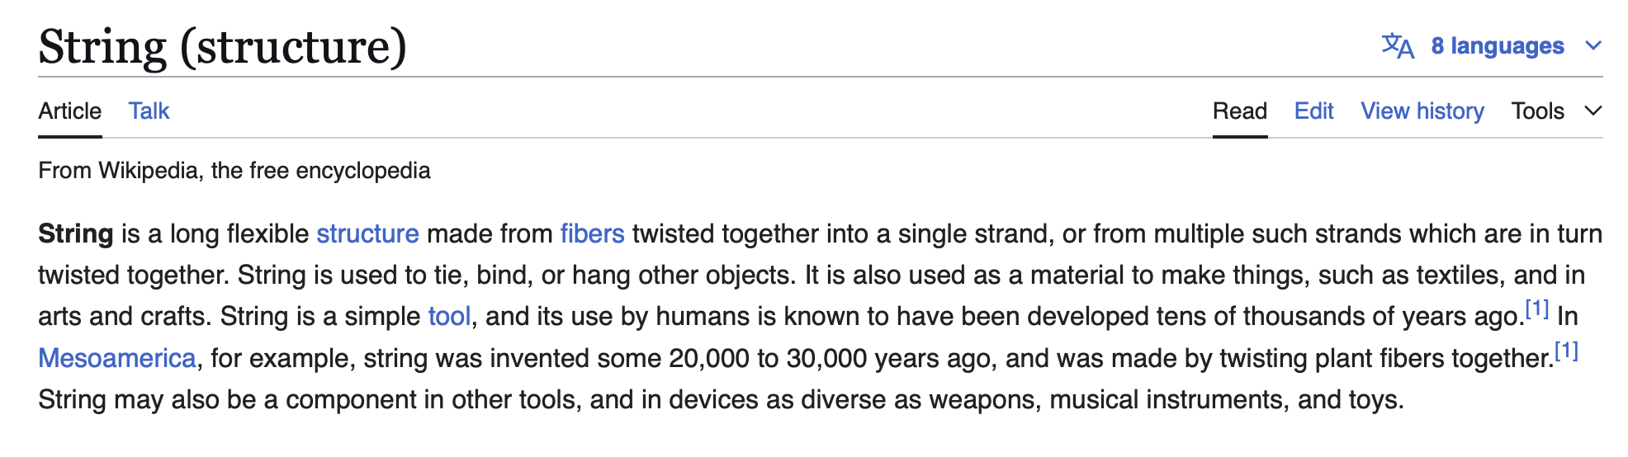

Slide 391
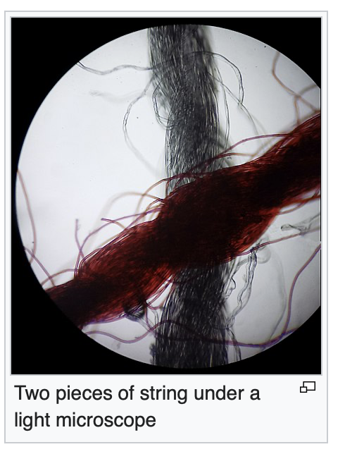

Slide 392


Slide 393
built-in classes (classes that are "built in" to Java)

Slide 394
built-in classes are "special" (they break the rules of other classes in Java)

Slide 395
review: instantiating a class (creating an object)

Slide 396
constructors
// Option A: Use default constructor and initialize using dot
Color color = new Color(); // (r=0.0, g=0.0, b=0.0)
color.r = 1.0; // (r=1.0, g=0.0, b=0.0)
color.g = 1.0; // (r=1.0, g=1.0, b=0.0)
color.b = 1.0; // (r=1.0, g=1.0, b=1.0)
// Option B: Use a custom constructor
Color color = new Color(1.0, 1.0, 1.0); // (r=1.0, g=1.0, b=1.0)

Slide 397
review: array

Slide 398
creating an array (1/2)
you can create a new array by specifying its length inside of square brackets; if you do, the array is zero-initialized (all elements are initially set to zero)
int[] A = new int[8]; // { 0, 0, 0, 0, 0, 0, 0, 0 }
double[] B = new double[1]; // { 0.0 }
boolean[] C = new boolean[2]; // { false, false }
char[] D = new char[4]; // { '\0', '\0', '\0', '\0' }
String[] E = new String[3]; // { null, null, null }

Slide 399
creating an array (2/2)
you can also create a new array by specifying its elements inside of curly braces; if you do, the array's length is the number of elements you specified
int[] array = { 7, 7, 9 }; // new int[3] is implied
NOTE: this syntax can only be used for creation
🙅 NOT okay to do later: array = { 4, 5, 6 };
🙆 OKAY to do later:
array[0] = 4;
array[1] = 5;
array[2] = 6;
boolean[] array = { true };
String[] array = { "hello", "world" };

Slide 400
String

Slide 401
String (1/2)
a String is a sequence of characters
"Hello World", "Foo123"

Slide 402
String (2/2)
you can create a new String by specifying its elements inside of double quotation marks
String string = "Hello";
String has some useful instance methods (see Docs)
PRINT(string.length()); // 5
PRINT(string.charAt(1)); // 'e'
PRINT(string.substring(1, 3)); // "el"

Slide 403
String concatenation (1/2)
+ concatenates two String's
// String foo = "Hello".concat("World"); String foo = "Hello" + "World"; // "HelloWorld"
it also does some conversions for you (very convenient; kind of confusing)
// String foo = "Hello".concat(Integer.toString(2)); String foo = "Hello" + 2; // "Hello2"

Slide 404
String concatenation (2/2)
stringA + foo is the ONLY example of operator overloading in Java
(the * operator just does multiplication)
(the / operator just does division)
...but the + operator does both addition and string concatenation
🐍 Python and 👹C++ let you implement your own operator overloading
(very fun; very confusing)

Slide 405
inside of a String (1/4)
inside of String, there must be a char[]
motivation: as you experienced in HW02, working directly with character arrays is hard / painful
idea: String "wraps up" a char[] into an easy-to-use package

Slide 406
inside of a String (2/4)
if a String is really just a char[]...
...then what does this code actually do? 🧠
String a = "Hello";
String b = "World";
String c = a + b;
PRINT(c);

Slide 407
XStringExample
class XStringExample extends SuperCow {
static class XString {
char[] array;
static XString plus(XString a, XString b) {
XString result = new XString();
// allocates new array that's the sum of both lengths
// O(n) runtime
result.array = new char[a.array.length + b.array.length];
// copies over a
// O(n)
for (int i = 0; i < a.array.length; ++i) { // O(n)
result.array[i] = a.array[i]; // O(1)
}
// copies over b
// O(n)
for (int i = 0; i < b.array.length; ++i) {
result.array[a.array.length + i] = b.array[i];
}
// returning result
// O(1)
return result;
}
}
public static void main(String[] arguments) {
XString a = new XString();
a.array = new char[6];
a.array[0] = 'H';
a.array[1] = 'e';
a.array[2] = 'l';
a.array[3] = 'l';
a.array[4] = 'l';
a.array[5] = 'o';
XString b = new XString();
b.array = new char[5];
b.array[0] = 'W';
b.array[1] = 'o';
b.array[2] = 'r';
b.array[3] = 'l';
b.array[4] = 'd';
XString c = XString.plus(a, b);
PRINT(a.array);
PRINT(b.array);
PRINT(c.array);
}
}

Slide 408
inside of a String (3/4)
if a String is really just a char[]...
...then what does this code actually do? 🧠
.. how many char[]'s are created?
String a = "Hello";
String b = " ";
String c = "World";
String d = "!";
String e = a + b + c + d;
PRINT(e);

Slide 409
interlude
if a String is really just a char[]...
...then what does this code do?
...what is this code's big O runtime? 🧠
int foo = 0;
for (int i = 0; i < n; ++i) { // O(n)
foo += 1; // * O(1)
}
PRINT(foo);

Slide 410
inside a String (4/4)
if a String is really just a char[]...
...then what does this code do?
...what is its big O runtime? 🧠
String scream = "";
for (int i = 0; i < n; ++i) {
scream += "A";
}
PRINT(scream);

Slide 411
questions on HW03?

Slide 412
pool[i] inside of specific updates (don't define enemy1 and enemy2)

Slide 413
why i gave you a player reference

Slide 414
this inside of fireBullet

Slide 415
☕️ the art of coding things in the right order compile and run early, compile and run often

Slide 416

well, let us imagine...

Slide 417
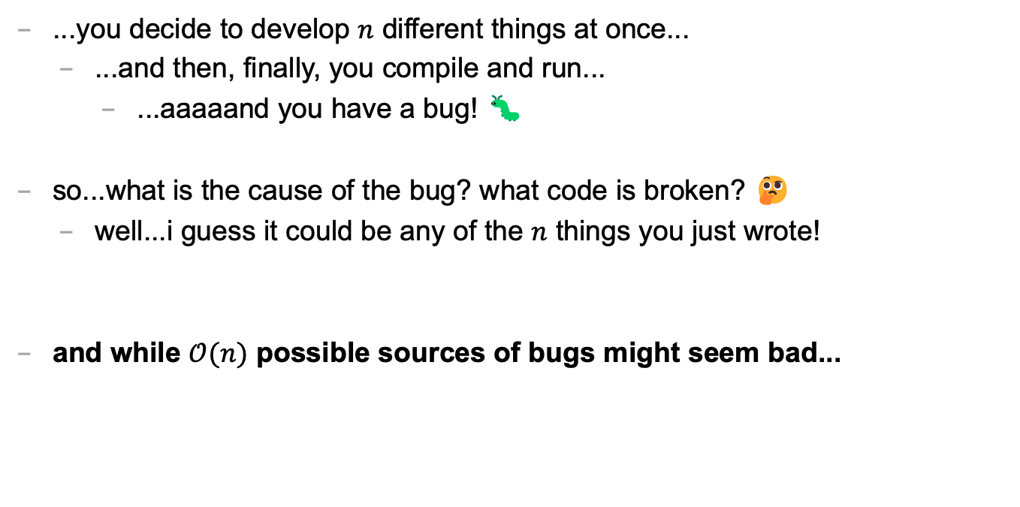
let's imagine...
...you decide to develop $n$ different things at once...
...and then, finally, you compile and run...
...aaaaand you have a bug! 🐛
so...what is the cause of the bug? what code is broken? 🤔
well...i guess it could be any of the $n$ things you just wrote!
and while $𝒪(n)$ possible sources of bugs might seem bad...

Slide 418
...the reality is ✨so much worse✨!

Slide 419

because broken code likes to interact with other broken code, to make✨super bugs✨!

Slide 421
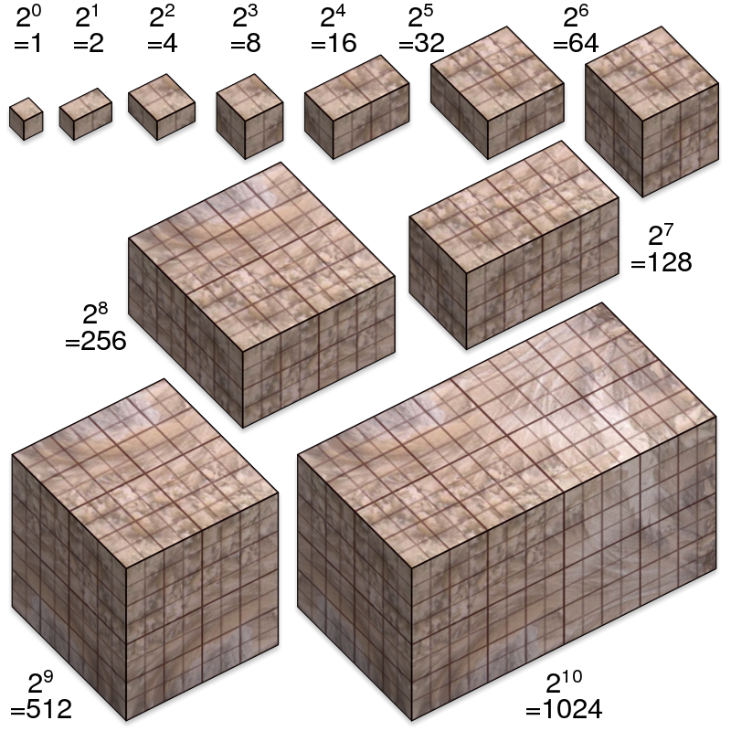
not broken
broken
developing one thing at a time

Slide 422
not broken
A is broken
B is broken
A and B are both broken
developing two things at a time

Slide 423
not broken
A broken
C broken
A and C broken
A and B broken
B broken
B and C broken
A, B, and C broken
developing three things at a time

Slide 424

asymptotic bug-finding time

Slide 425
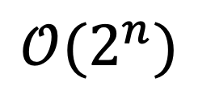
$$𝒪(2^{n})$$
gl;hf 🙂👍

Slide 426
big lesson
implement code one thing at a time
compile and run and test after implementing every single thing
figuring out the order to do things in is a learned skill!
sometimes i choose the wrong order...
...and then i usually have to start over 🙂👍

Slide 427
this is a learned skill!

Slide 428

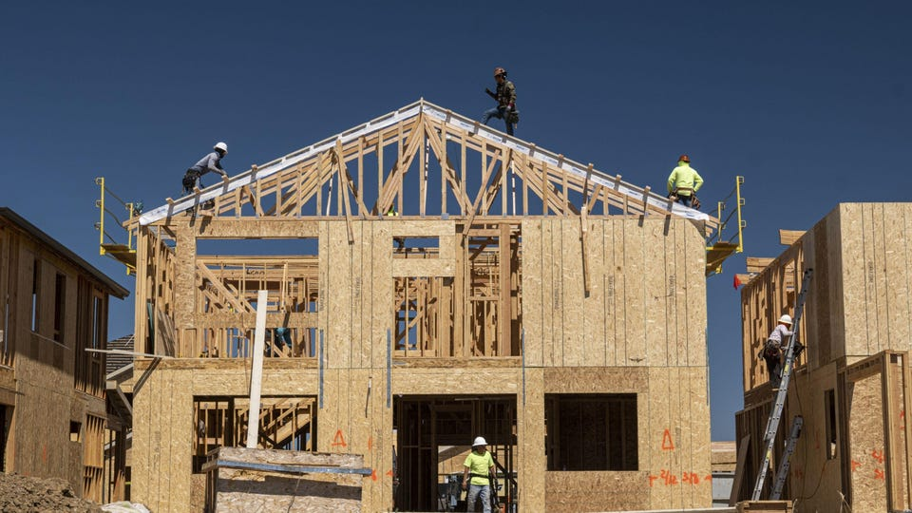
in summary

Slide 429
Week04
Today is...
✨No-Laptop Monday! ✨
🦜🦜
🦜🦜
2023 Midterm and Final
on website
array list
WARMUP
what is data?
what is a data structure?
why are data structures?
TODO: record lecture

Slide 430
where are we?

Slide 431
the finest lecture hall in all of Williams College

Slide 432
at the turning point of CS136
part A: programming fundamentals in Java
part B: data structures
one data structure per week here we gooo 🙂👍

Slide 433
data structures

Slide 434
data

Slide 435
data is numbers

Slide 436
a data structure helps you organizes your data... ...the right data structure for a task is... - easy to work with -- programmer time - runs fast -- runtime (user time)

Slide 437
array list

Slide 438
array list
☠️ even though another name for an array list is a "vector," the array list is NOT related to the notion of a vector from math/physic

Slide 439
motivation

Slide 440
arrays are super useful, but...

Slide 441
arrays are super useful, but... 🧠

Slide 442
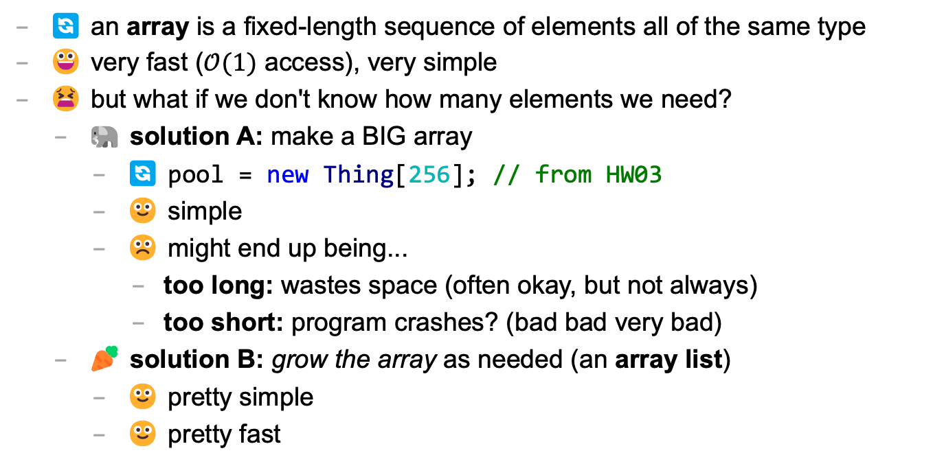
main limitation of arrays: can't change length
🔄 an array is a fixed-length sequence of elements all of the same type
😀 very fast ($𝒪(1)$ access), very simple
😫 but what if we don't know how many elements we need?
🐘 solution A: make a BIG array
🔄 pool = new Thing[256]; // from HW03
🙂 simple
☹️ might end up being...
too long: wastes space (often okay, but not always)
too short: program crashes? (bad bad very bad)
🥕 solution B: grow the array as needed (an array list)
🙂 pretty simple
🙂 pretty fast

Slide 443
review: array metaphor

Slide 444
an array is like a very organized person's flower planter - one flower per square - the planter can't change size (it is made of artisinal woods or something)

Slide 445
🌻
🌺
🥀
🌹

Slide 446
how an array list works (metaphor)

Slide 447
let us imagine...

Slide 448
you have a bunch of pieces of produce you need to put somewhere for quick access, but you don't know how many ...off to the produce bank we go!

Slide 449
👩‍🌾
🥕
list.add(🥕);

Slide 450
🥕
👩‍🌾
list.add(🥕);

Slide 451
🥕
👩‍🌾
🍎
list.add(🍎);

Slide 452
🥕
🍎
👩‍🌾
list.add(🍎);

Slide 453
🥕
🍎
👩‍🌾
🥦
list.add(🥦);

Slide 454
🥕
🍎
🥦
👩‍🌾
list.add(🥦);

Slide 455
🥕
🍎
🥦
👩‍🌾
🌽
list.add(🌽);

Slide 456
🥕
🍎
🥦
🌽
👩‍🌾
list.add(🌽);

Slide 457
🥕
🍎
🥦
🌽
👩‍🌾
🍇
list.add(🍇);

Slide 458
🥕
🍎
🥦
🌽
👷‍♀️
🍇
list.add(🍇);

Slide 459
🍎
🥦
🌽
🥕
👷‍♀️
🍇
list.add(🍇);

Slide 460
🥦
🌽
🥕
🍎
👷‍♀️
🍇
list.add(🍇);

Slide 461
🌽
🥕
🍎
🥦
👷‍♀️
🍇
list.add(🍇);

Slide 462
🥕
🍎
🥦
🌽
👷‍♀️
🍇
list.add(🍇);

Slide 463
🥕
🍎
🥦
🌽
👩‍🌾
🍇
list.add(🍇);

Slide 464
🥕
🍎
🥦
🌽
🍇
👩‍🌾
list.add(🍇);

Slide 465
🥕
🍎
🥦
🌽
🍇
👩‍🌾
🍉
list.add(🍉);

Slide 466
🥕
🍎
🥦
🌽
🍇
🍉
👩‍🌾
list.add(🍉);

Slide 467
ArrayList<Produce> list;
👩‍🌾

Slide 468
interface

Slide 469
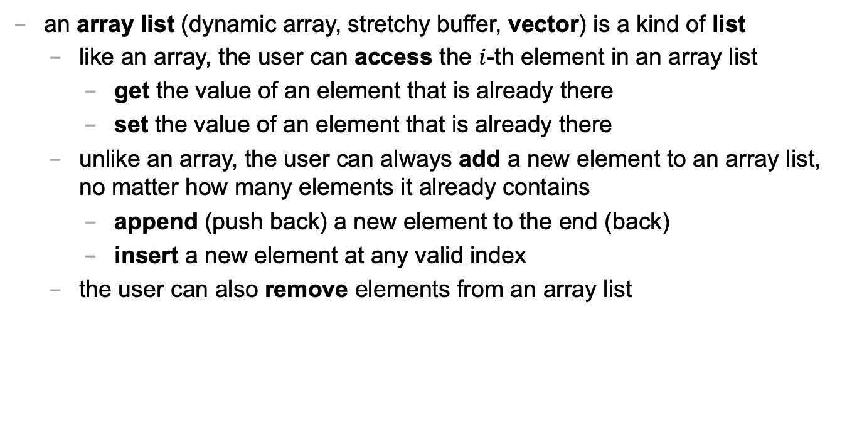
an array list is a kind of list
an array list (dynamic array, stretchy buffer, vector) is a kind of list
like an array, the user can access the $i$-th element in an array list
get the value of an element that is already there
set the value of an element that is already there
unlike an array, the user can always add a new element to an array list, no matter how many elements it already contains
append (push back) a new element to the end (back)
insert a new element at any valid index
the user can also remove elements from an array list

Slide 470
ArrayList<ElementType>
class ArrayList<ElementType> {
void add(ElementType element); // to end
void add(int index, ElementType element);
ElementType get(int index);
void set(int index, ElementType element);
void remove(int index);
int size();
boolean isEmpty(); // (list.size() == 0)
}

Slide 471
ArrayList<ElementType>
Java's ArrayList<ElementType> is generic, which means you choose ElementType when you instantiate the class
ArrayList<Thing> list = new ArrayList<>();
ArrayList<ArrayList<Thing>> lists = new ArrayList<>();
ArrayList<Integer> numbers = new ArrayList<>();
NOTE: In between the angle brackets, use...
Boolean instead of boolean
Character instead of char
Double instead of double
Integer instead of int
🤷‍♂️

Slide 472
usage code

Slide 473
what does this code print? (the home game)
ArrayList<String> list = new ArrayList<>();
PRINT(list);
list.add("Hello");
list.add("World");
PRINT(list);
list.add(1, "Cruel"); // NOTE: insert so "Cruel" has index 1
PRINT(list);
PRINT(list.size());
PRINT(list.get(1));
list.remove(0);
PRINT(list);
list.set(1, "Summer");
PRINT(list);

Slide 474
usage code
ArrayList<String> list = new ArrayList<>();
PRINT(list); // []
list.add("Hello");
list.add("World");
PRINT(list); // [Hello, World]
list.add(1, "Cruel");
PRINT(list); // [Hello, Cruel, World]
PRINT(list.size()); // 3
PRINT(list.get(1)); // Cruel
list.remove(0);
PRINT(list); // [Cruel, World]
list.set(1, "Summer");
PRINT(list); // [Cruel, Summer]

Slide 475
size (length) of the list vs. the list's capacity

Slide 476
capacity (8)
length (5)
🥕
🍎
🥦
🌽
🍇
👩‍🌾

Slide 477
capacity (8)
size() (5)
🥕
🍎
🥦
🌽
🍇
👩‍🌾

Slide 478
the internal array
an array list's length (size) is the number of elements stored in the list
an array list stores its elements inside of an internal array
an array list's capacity is the length of this array
✅ length <= capacity
class ArrayList<ElementType> {
private int length; // NOTE: call size() to get this
private ElementType[] internalArray;
// NOTE: the list's capacity is internalArray.length
}

Slide 479
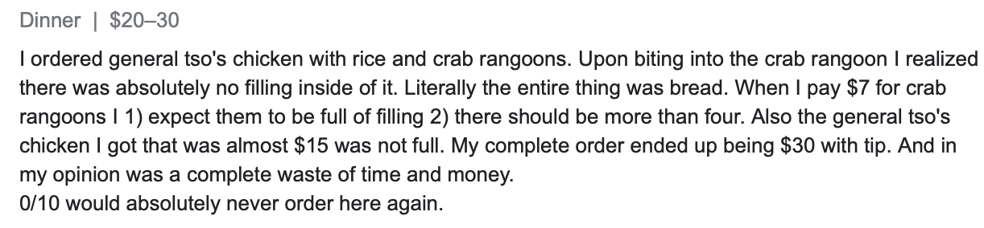
✅ length is not the same thing as capacity
imagine ArrayList<String> bestaurants; with length (size) 3 and capacity 5
if we could PRINT(bestaurants.internalArray)... ["Blango", "Sproot", "Sparket", null, null] ...we would see 5 – 3 = 2 "empty slots"

Slide 480
implementation continued

Slide 481
ArrayList() { ... } // constructor
a new array list should have...
this.length = 0;
this.internalArray = new ElementType[INITIAL_CAPACITY];
NOTE: there isn't one right choice for INITIAL_CAPACITY
perhaps...0?
perhaps 8?
🤷‍♂️

Slide 482
ElementType get(int index) { ... }
to get an element with a given index...
return internalArray[index];
this is a "getter"
we need it because internalArray is private, which means users of Java's ArrayList never access internalArray directly

Slide 483
void add(ElementType element) { ... }
to append (push back) a new element to the back (end) of an array list...
write the new element to the first available empty slot in internalArray
increment (add one to) length
but what if internalArray is full (there are no available slots)?

Slide 484
add (details)

Slide 485
void add(ElementType element) { ... }
to append (push back) a new element to the back (end) of an array list...
if internalArray is full...
make a new array two times the length of the current internal array
copy the elements of the current internal array into this new array (using a for loop)
update the internalArray reference to refer to this new array
write the new element to the first available empty slot in internalArray
increment length

Slide 486
4
list.add(🍇)
length
internalArray
🥕
🍎
🥦
🌽

Slide 487
4
list.add(🍇)
length
internalArray
🥕
🥕
🍎
🍎
🥦
🥦
🌽
🌽
tmp

Slide 488
4
list.add(🍇)
🍇
length
internalArray
🥕
🍎
🥦
🌽
🥕
🍎
🥦
🌽
tmp

Slide 489
4
list.add(🍇)
🍇
length
internalArray
🥕
🍎
🥦
🌽
🥕
🍎
🥦
🌽
tmp

Slide 490
4
list.add(🍇)
🍇
🍇
length
internalArray
🥕
🍎
🥦
🌽

Slide 491
5
list.add(🍇)
length
internalArray
🥕
🍎
🥦
🌽
🍇

Slide 492
void add(int index, ElementType element)
to insert a new element so it has a given index...
ASSERT that the given index is valid!
NOTE: 0 is OK ("prepend")
NOTE: length is OK (append)
NOTE: -1 is BAD BAD VERY BAD (out of bounds)
NOTE: (length + 1) is BAD BAD VERY BAD (out of bounds)
if internal array is full, resize (see previous slide)
make room for the new element
move elements with indices greater than or equal to index one slot to the right ☠️ like inserting in HW02 (text box), need to iterate backwards
write new element and increment length

Slide 493
4
list.add(🌽, 2)
length
internalArray
🍎
🍇
🥕
🥦
🍇

Slide 494
4
list.add(🌽, 2)
length
internalArray
🍎
🥕
🥦
🍇
🍇
🥦

Slide 495
4
list.add(🌽, 2)
🌽
length
internalArray
🍎
🥕
🥦
🥦
🍇

Slide 496
5
list.add(🌽, 2)
length
internalArray
🍎
🥕
🌽
🥦
🍇

Slide 497
☠️ like in HW02 (text box), need to iterate backwards

Slide 498
ep|elia

Slide 499
eph|eeee

Slide 500


Slide 501
4
list.add(🌽, 2)
length
internalArray
🍎
🥕
🥦
🍇
🥦

Slide 502
4
list.add(🌽, 2)
length
internalArray
🍎
🥕
🥦
🥦

Slide 503
4
list.add(🌽, 2)
length
🥦
internalArray
🍎
🥕
🥦
🥦

Slide 504
4
list.add(🌽, 2)
🌽
length
internalArray
🍎
🥕
🥦
🥦
🥦

Slide 505
5
list.add(🌽, 2)
length
internalArray
🍎
🥕
🌽
🥦
🥦

Slide 506
final note on add

Slide 507
final note on add
the special-case add to end (append) can be implemented using the general-purpose add (insert)
void add(ElementType element) { add(this.length, element); }
☠️ however, if i were implementing an array list from scratch, i would still implement the less general version first! (it is simpler, and i will learn stuff by implementing it)
(🐣 baby steps)

Slide 508
Week04
Today is...
✨Laptop Wednesday! ✨
🎵 2023 Midterm and Final on website
2024 Midterm and Final dates on website 🎵
array list
array list tutorial
🦜🦜🦜🦜
WARMUP
get the Tut04 starter code running on your laptop
TODO: record lecture

Slide 509
review animations from Week04a

Slide 510
Tut04

Slide 511
Week04c
Today is...
✨Fun Friday! ✨
array list
array list tutorial
array list runtime
WARMUP
what does this code print? why?
if (2 + 2 == 5); {
PRINT("hmm...");
}
⛰️🥲
🦜
🦜
🦜
🦜
TODO: record lecture

Slide 512
big-O runtime of void add(ElementType e);

Slide 513
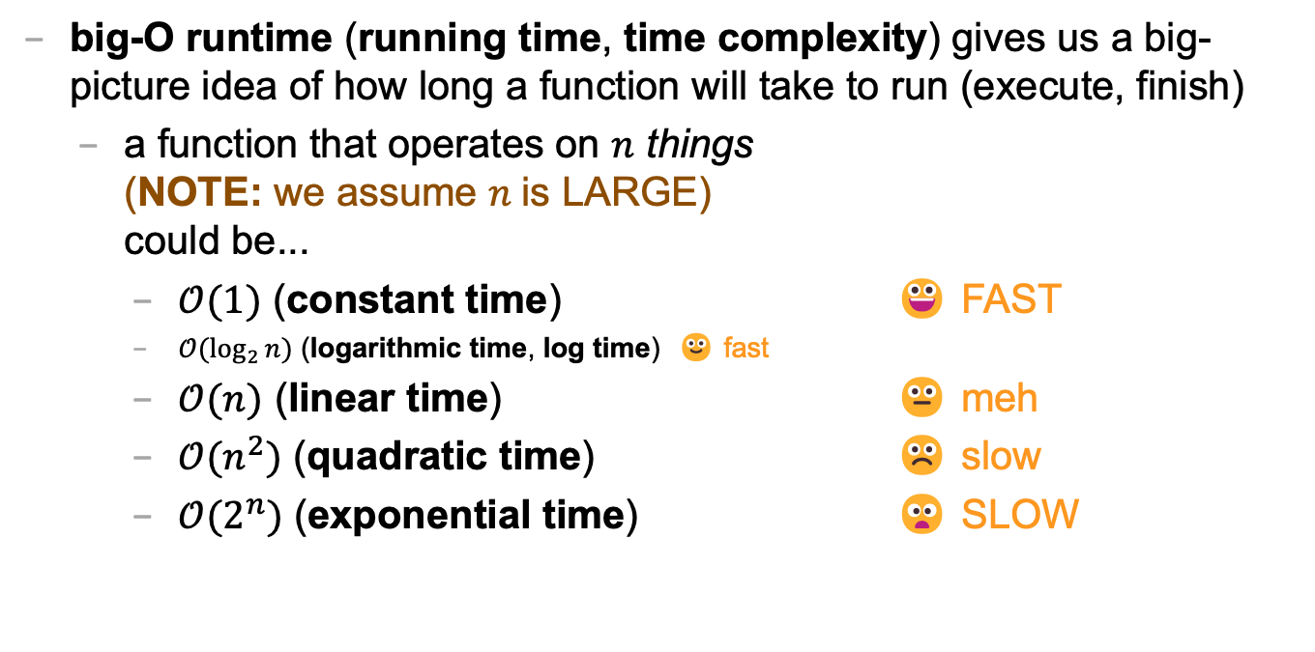
review: big-O runtime
big-O runtime (running time, time complexity) gives us a big-picture idea of how long a function will take to run (execute, finish)
a function that operates on $n$ things (NOTE: we assume $n$is LARGE) could be...
$𝒪(1)$ (constant time) 😀 FAST
$𝒪(\log_{2}{n})$ (logarithmic time, log time) 🙂 fast
$𝒪(n)$ (linear time) 😐 meh
$𝒪(n^{2})$ (quadratic time) ☹️ slow
$𝒪(2^{n})$ (exponential time) 😦 SLOW

Slide 514
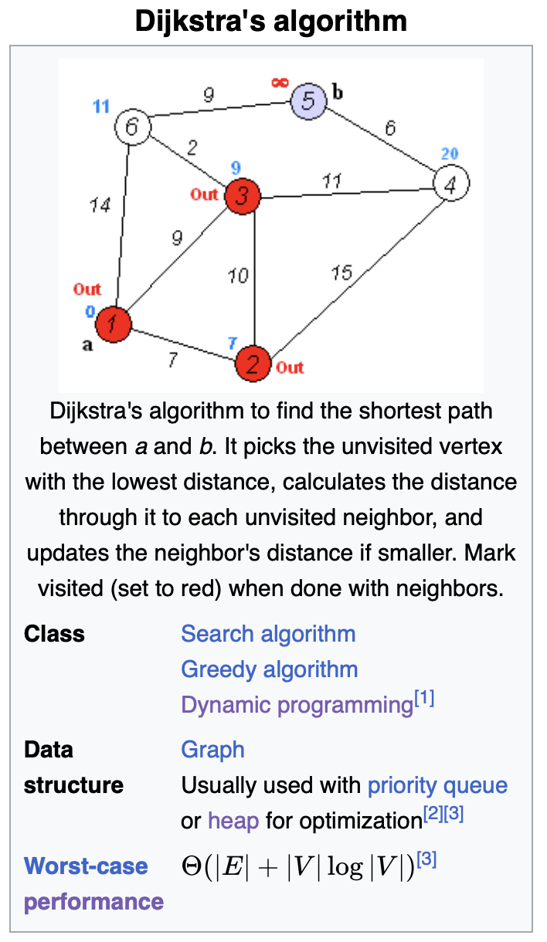
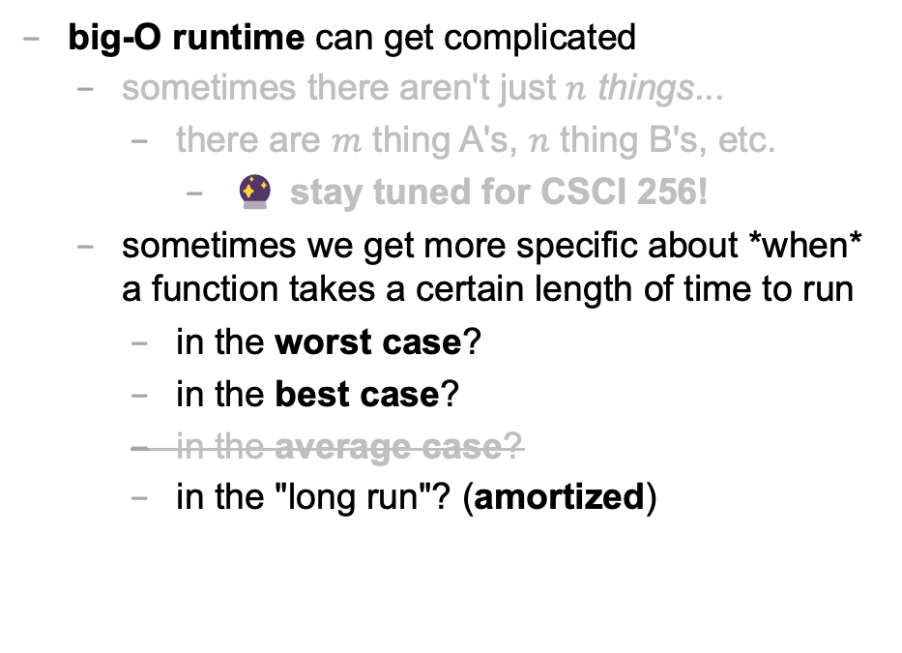
big-O runtime
big-O runtime can get complicated
sometimes there aren't just $n$ things...
there are $m$ thing A's, $n$ thing B's, etc.
🔮 stay tuned for CSCI 256!
sometimes we get more specific about *when* a function takes a certain length of time to run
in the worst case?
in the best case?
in the average case?
in the "long run"? (amortized)

Slide 515
best case and worst case runtime of adding to the back of an array list

Slide 516
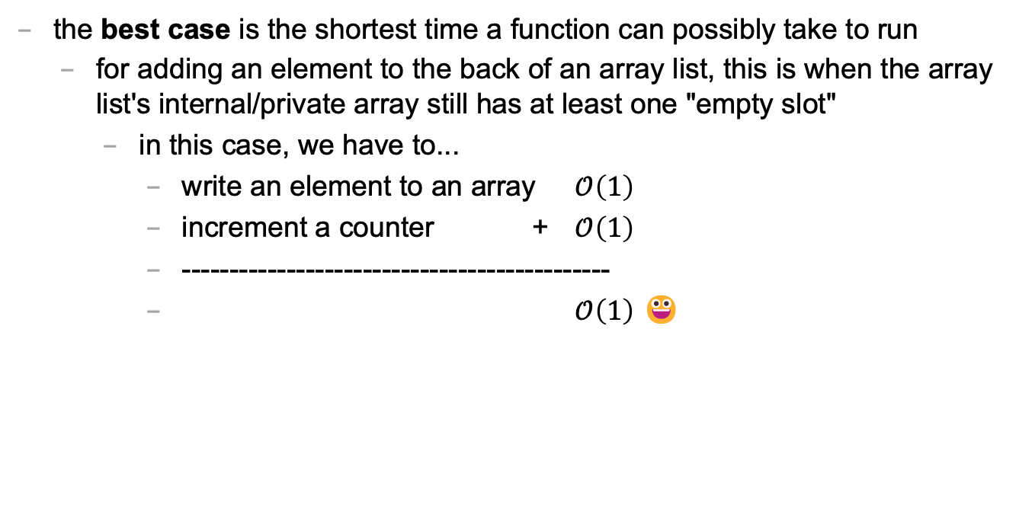
best case
the best case is the shortest time a function can possibly take to run
for adding an element to the back of an array list, this is when the array list's internal/private array still has at least one "empty slot"
in this case, we have to...
write an element to an array $𝒪\left(1\right)$
increment a counter + $𝒪\left(1\right)$
---------------------------------------------
$𝒪\left(1\right)$ 😀

Slide 517
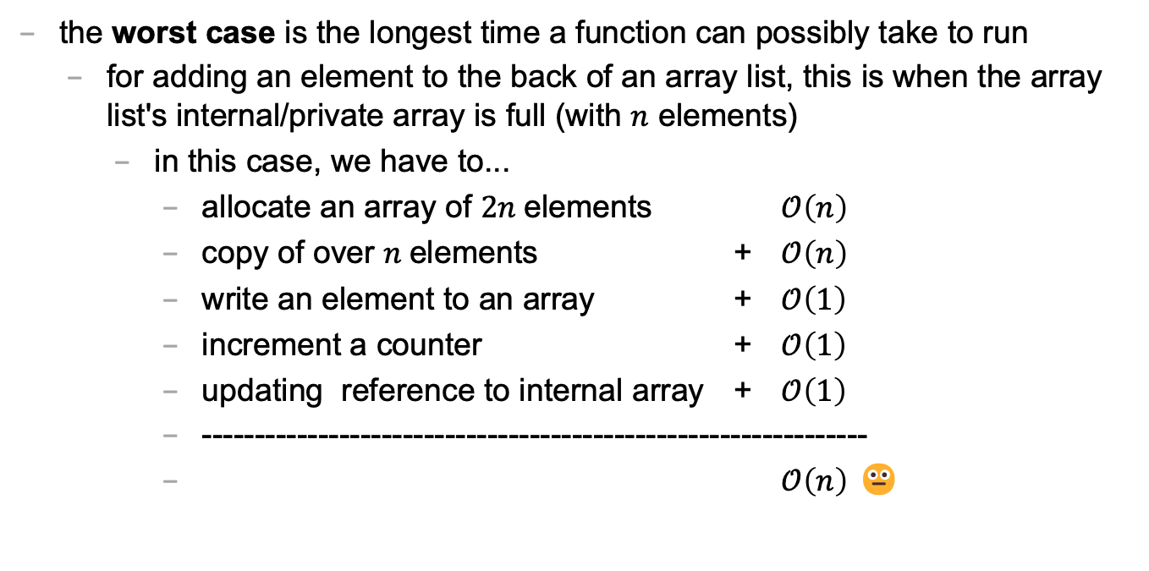
worst case
the worst case is the longest time a function can possibly take to run
for adding an element to the back of an array list, this is when the array list's internal/private array is full (with $n$ elements)
in this case, we have to...
allocate an array of $2n$elements $𝒪\left(n\right)$
copy of over $n$elements + $𝒪\left(n\right)$
write an element to an array + $𝒪\left(1\right)$
increment a counter + $𝒪\left(1\right)$
updating reference to internal array + $𝒪\left(1\right)$
---------------------------------------------------------------
$𝒪\left(n\right)$ 😐

Slide 518
sometimes the best case and worst case are very different

Slide 519
amortized runtime of adding to the back of an array list

Slide 520
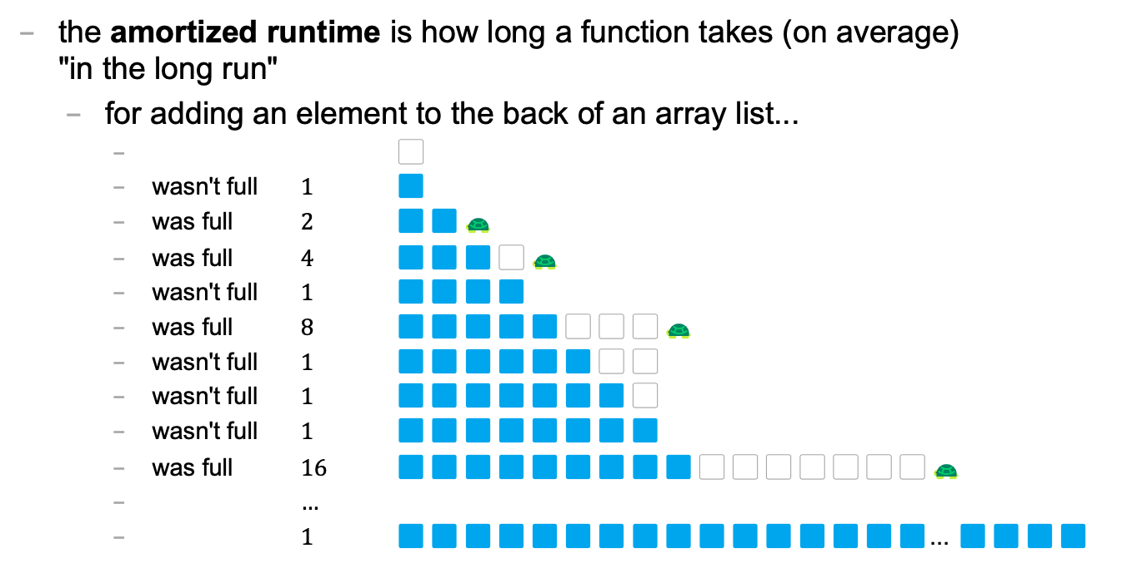
amortized
the amortized runtime is how long a function takes (on average) "in the long run"
for adding an element to the back of an array list...
⬜️
wasn't full $1$ 🟦
was full $2$ 🟦🟦🐢
was full $4$ 🟦🟦🟦⬜️🐢
wasn't full $1$ 🟦🟦🟦🟦
was full $8$ 🟦🟦🟦🟦🟦⬜️⬜️⬜️🐢
wasn't full $1$ 🟦🟦🟦🟦🟦🟦⬜️⬜️
wasn't full $1$ 🟦🟦🟦🟦🟦🟦🟦⬜️
wasn't full $1$ 🟦🟦🟦🟦🟦🟦🟦🟦
was full $16$ 🟦🟦🟦🟦🟦🟦🟦🟦🟦⬜️⬜️⬜️⬜️⬜️⬜️⬜️🐢
$…$
$1$ 🟦🟦🟦🟦🟦🟦🟦🟦🟦🟦🟦🟦🟦🟦🟦🟦... 🟦🟦🟦🟦

Slide 521
⬜️
🟦
🟦🟦🐢
🟦🟦🟦⬜️🐢
🟦🟦🟦🟦
🟦🟦🟦🟦🟦⬜️⬜️⬜️🐢
🟦🟦🟦🟦🟦🟦⬜️⬜️
🟦🟦🟦🟦🟦🟦🟦⬜️
🟦🟦🟦🟦🟦🟦🟦🟦
🟦🟦🟦🟦🟦🟦🟦🟦🟦⬜️⬜️⬜️⬜️⬜️⬜️⬜️🐢
🟦🟦🟦🟦🟦🟦🟦🟦🟦🟦⬜️⬜️⬜️⬜️⬜️⬜️
🟦🟦🟦🟦🟦🟦🟦🟦🟦🟦🟦⬜️⬜️⬜️⬜️⬜️
🟦🟦🟦🟦🟦🟦🟦🟦🟦🟦🟦🟦⬜️⬜️⬜️⬜️
🟦🟦🟦🟦🟦🟦🟦🟦🟦🟦🟦🟦🟦⬜️⬜️⬜️
🟦🟦🟦🟦🟦🟦🟦🟦🟦🟦🟦🟦🟦🟦⬜️⬜️
🟦🟦🟦🟦🟦🟦🟦🟦🟦🟦🟦🟦🟦🟦🟦⬜️
🟦🟦🟦🟦🟦🟦🟦🟦🟦🟦🟦🟦🟦🟦🟦🟦
🟦🟦🟦🟦🟦🟦🟦🟦🟦🟦🟦🟦🟦🟦🟦🟦🟦⬜️⬜️⬜️⬜️⬜️⬜️⬜️⬜️⬜️⬜️⬜️⬜️⬜️⬜️⬜️ 🐢
🟦🟦🟦🟦🟦🟦🟦🟦🟦🟦🟦🟦🟦🟦🟦🟦🟦🟦⬜️⬜️⬜️⬜️⬜️⬜️⬜️⬜️⬜️⬜️⬜️⬜️⬜️⬜️
🟦🟦🟦🟦🟦🟦🟦🟦🟦🟦🟦🟦🟦🟦🟦🟦🟦🟦🟦⬜️⬜️⬜️⬜️⬜️⬜️⬜️⬜️⬜️⬜️⬜️⬜️⬜️
🟦🟦🟦🟦🟦🟦🟦🟦🟦🟦🟦🟦🟦🟦🟦🟦🟦🟦🟦🟦⬜️⬜️⬜️⬜️⬜️⬜️⬜️⬜️⬜️⬜️⬜️⬜️
🟦🟦🟦🟦🟦🟦🟦🟦🟦🟦🟦🟦🟦🟦🟦🟦🟦🟦🟦🟦🟦⬜️⬜️⬜️⬜️⬜️⬜️⬜️⬜️⬜️⬜️⬜️
🟦🟦🟦🟦🟦🟦🟦🟦🟦🟦🟦🟦🟦🟦🟦🟦🟦🟦🟦🟦🟦🟦⬜️⬜️⬜️⬜️⬜️⬜️⬜️⬜️⬜️⬜️

Slide 522
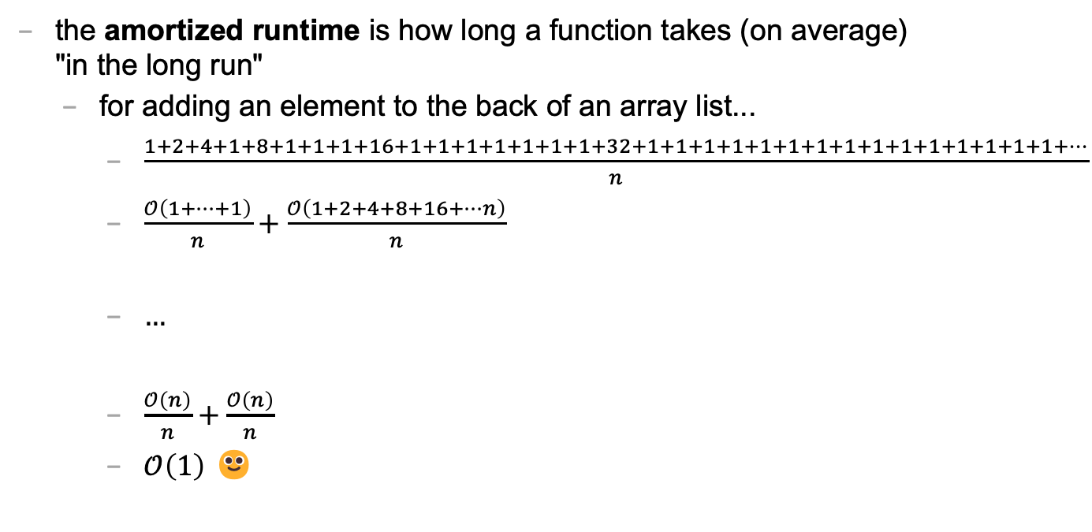
amortized
the amortized runtime is how long a function takes (on average) "in the long run"
for adding an element to the back of an array list...
$\frac{1+2+4+1+8+1+1+1+16+1+1+1+1+1+1+1+32+1+1+1+1+1+1+1+1+1+1+1+1+1+1+1+…}{n}$
$\frac{𝒪\left(1+…+1\right)}{n}+\frac{𝒪\left(1+2+4+8+16+…n\right)}{n}$
$…$
$\frac{𝒪\left(n\right)}{n}+\frac{𝒪\left(n\right)}{n}$
$𝒪\left(1\right)$ 🙂

Slide 523
the amortized run time is less "pessimistic" than worst case

Slide 524
the most relevant runtime depends on context 💭 when might worst case be more relevant? 💭 when might amortized be more relevant?

Slide 525
best case and worst case runtime of inserting into the front of an array list

Slide 526
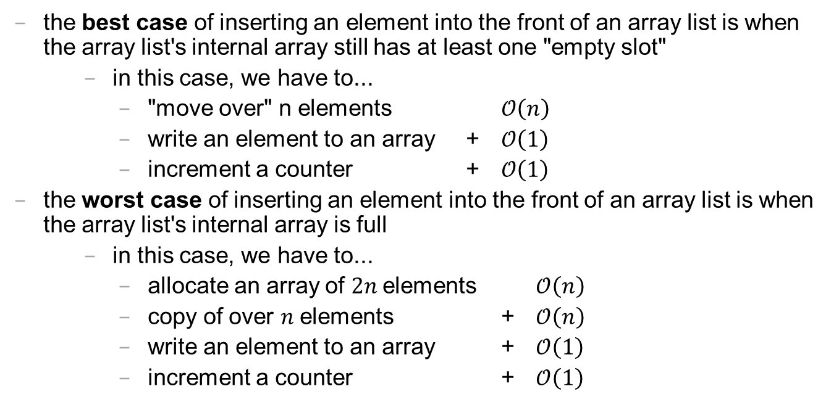
best case and worst cast
the best case of inserting an element into the front of an array list is when the array list's internal array still has at least one "empty slot"
in this case, we have to...
"move over" n elements $𝒪\left(n\right)$
write an element to an array + $𝒪\left(1\right)$
increment a counter + $𝒪\left(1\right)$
the worst case of inserting an element into the front of an array list is when the array list's internal array is full
in this case, we have to...
allocate an array of $2n$elements $𝒪\left(n\right)$
copy of over $n$elements + $𝒪\left(n\right)$
write an element to an array + $𝒪\left(1\right)$
increment a counter + $𝒪\left(1\right)$

Slide 527
lesson?: sometimes best case and worst case are the same

Slide 528
deleting while iterating backwards, grugbrain, comments (including stb), Vim, Kahoot! (including Jim's unpublished Kahoot! op-ed)
choose your own adventure!

Slide 529
https://grugbrain.dev

Slide 531
☕️ the art of coding things in the right order compile and run early compile and run often

Slide 532
why implement Rule 22 first? why not just skip straight to the general case?

Slide 533
well, let us imagine...

Slide 534
let's imagine...
...you decide to develop $n$ different things at once...
...and then, finally, you compile and run...
...aaaaand you have a bug! 🐛
so...what is the cause of the bug? what code is broken? 🤔
well...i guess it could be any of the $n$ things you just wrote!
and while $𝒪(n)$ possible sources of bugs might seem bad...

Slide 535
...the reality is ✨so much worse✨!

Slide 536
because broken code likes to interact with other broken code, to make✨super bugs✨!

Slide 538
not broken
broken
developing one thing at a time

Slide 539
not broken
A is broken
B is broken
A and B are both broken
developing two things at a time

Slide 540
asymptotic bug-finding time

Slide 541
$$𝒪(2^{n})$$
gl;hf 🙂👍

Slide 542
big lesson
implement code one thing at a time
compile and run and test after implementing every single thing
this is a learned skill!
how i would actually implement the automata homework
make the array
print the array as an array
print the array as a string
update the array once using Rule 22 and print the result
wrap the printing and update in a for loop
implement code to handle all rules and test it on Rule 22
test it on the other rules

Slide 543
this is a learned skill!

Slide 544
in summary

Slide 545
colloquium

Slide 546
where is everyone?

Slide 547


San Diego 🌞🏝️🏄‍♀️🌮

Slide 548
we have snacks!

Slide 549
wait till the end 🍪

Slide 550
wait till the end 🥲

Slide 551
🥲

Slide 552
🍪

Slide 553
odd.

Slide 554
announcements

Slide 555
juggling club is after colloquium 🤹‍♀️

Slide 556
juggging club after colloquium 🤹‍♀️
juggling
is
colloquium
club
after

Slide 557
note: alumnus Rich Ward '89 sent us juggling clubs! they are fun and purple and gold

Slide 558


Slide 559
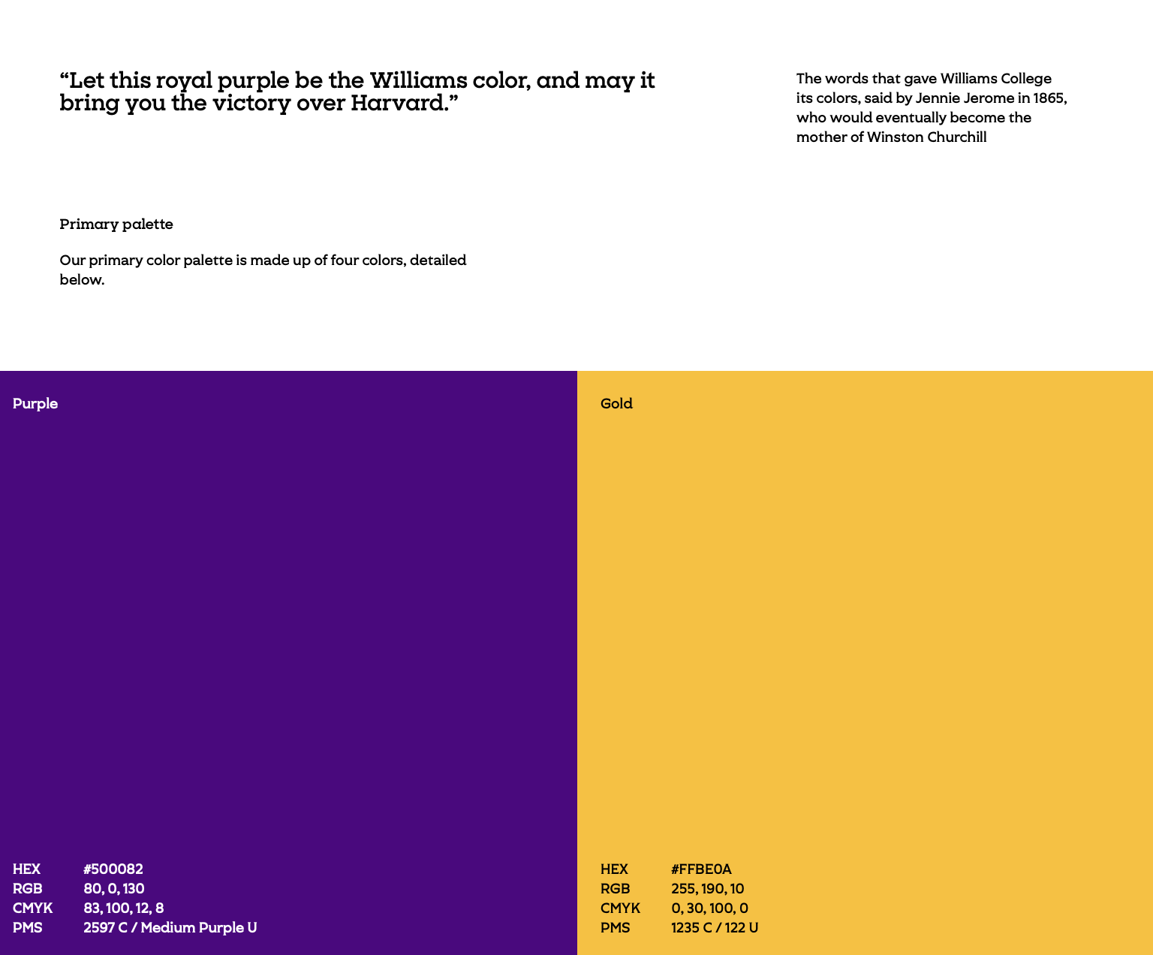

Slide 560
note: alumnus Rich Ward '89 sent us juggling clubs! they are fun and purple and gold

Slide 561
note: in unrelated news, the Registered Student Organization known as the Williams Juggling Club is now the Ward Juggling Club ✨

Slide 562
:D

Slide 563
any other announcements?

Slide 564
speaker

Slide 565
Hannah Gommerstadt
🥾
🥾
Position: Assistant Professor of Computer Science at Vassar
Research: Programming Languages; Concurrent Data Structures
Teaching: Compilers, Functional Programming, Discrete Math
Hobbies: Hiking

Slide 566

ANNOUNCEMENTS this week, the role of Jim will be played by Jeannie & Mark
WARMUP what is a (real-world) TODO list?
why are lists useful?
TODAY array lists

Slide 567
warmup: using lists
When are some real-life list examples?
What actions do you perform on lists?
What properties of lists do you care about?
Keep these in mind!

Slide 568
array list

Slide 569
motivation

Slide 570
limitations of arrays
think back to your days of using lists in Python
how do they compare to arrays in Java?
what are the pros/cons of arrays?

Slide 571
arrays are fixed-length
🔄 an array is a fixed-length sequence of elements all of the same type
🙂 simple, fast ($𝒪(1)$ access)
☹️ fixed-length (what if we don't know how many elements we'll have?)
solution A: make an array that's longer than you'll ever need
🔄 bullets = new Bullet[256]; // from HW-03
🙂 simple
☹️ wastes space, might end up not actually be long enough
solution B: make an array that grows as needed (an array list)

Slide 572
array list

Slide 573
array list
an array list (dynamic array, stretchy buffer, vector) acts like an array that can grow as needed
like an array, the user can access the $i$-th element in an array list
get the value of an element that is already there
set the value of an element that is already there
unlike an array, the user can always add a new element to an array list, no matter how many elements it already has
append (push back) a new element to the back or end
insert a new element at any index
the user can also remove elements from an array list

Slide 574
implementing array list
what properties of lists do we care about?
The items
Total number of items
what actions do we perform on lists?
adding item to end
removing item(s)
inserting item in middle
maybe sorting items? we’ll discuss this later…
these features will guide our implementation
properties: instance variables
actions: instance methods

Slide 575
the internal (private) array
an array list stores its elements inside of an array
an array list's capacity is the length of this array
an array list's size (length) is the number of (non-null) elements currently actually stored in this array
class ArrayList<ElementType> {
private ElementType[] privateArray;
private int numberOfElementsActuallyStoredInPrivateArray;
// int capacity() { return privateArray.length; }
int size() {
return numberOfElementsActuallyStoredInPrivateArray;
};
}

Slide 576
array list
☠️ an array list's capacity is NOT the same thing as its size
imagine ArrayList<String> bestaurants; with capacity 5 and size 3 // if we could print bestaurants.privateArray... ["Blango", "Sproot", "Sparket", null, null] ...we would see 5 – 3 = 2 "empty slots."

Slide 577
array list
☠️ even though another name for an array list is a "vector," the array list is NOT related to the notion of a vector from math/physic

Slide 578
Java's ArrayList<ElementType>

Slide 579
generic
Replace ElementType with the type of object being stored in your array list
Java's ArrayList<ElementType> is generic
// make a list of Foo's ArrayList<Foo> list = new ArrayList<>(); ArrayList<Foo> list = new ArrayList<Foo>();
// make a list of int's // NOTE: you must use Integer instead of int inside the <> ArrayList<Integer> list = new ArrayList<>();
ArrayList<Boolean> list = new ArrayList<>();
ArrayList<Double> list = new ArrayList<>();

Slide 580
generic
Java's ArrayList<ElementType> is generic
// make a list of lists of Vector2's ArrayList<ArrayList<Vector2>> list = new ArrayList<>();

Slide 581
internal array is private
Java's ArrayList<ElementType> uses access modifiers
specifically, its internal array is private (so is the int storing its size)
private means you can't access a variable/function directly
instead, you will need to use the functions (instance methods) given in our Documentation
class ArrayList<ElementType> {
int size(); // number of elements in the list
void add(ElementType element); // add element to the end of the list
void add(int index, ElementType element); // insert element into the list at index
ElementType get(int index); // get element at index
void removeElementAt(int index); // remove element by index
boolean removeElement(ElementType element); // remove element by value
}

Slide 582
the user doesn't think about the "empty slots"
ArrayList<String> list = new ArrayList<>();
System.out.println(list); // []
list.add("Hello");
list.add("World");
System.out.println(list); // [Hello, World]
list.add(1, "Cruel");
System.out.println(list); // [Hello, Cruel, World]
System.out.println(list.size()); // 3
System.out.println(list.get(1)); // Cruel
list.removeElementAt(0);
System.out.println(list); // [Cruel, World]

Slide 583
array list functions (under the hood)

Slide 584
ArrayList() { ... } // constructor
a new array list should have...
this.privateArray = new ElementType[STARTING_CAPACITY];
this.numberOfElementsActuallyStoredInPrivateArray = 0;
there isn't one right answer to what the STARTING_CAPACITY should be
perhaps...8?
8 sounds good.
🙂👍
note: in the tutorial, we'll use 1 🤷

Slide 585
ElementType get(int index) { ... }
to get an element with a given index...
return privateArray[index];
this is a "getter"
we need it because privateArray is private
users never access privateArray directly

Slide 586
void add(ElementType element) { ... }
to append (push back) a new element to the back (end) of an array list...
write the new element to the first available empty slot in privateArray
increment numberOfElementsActuallyStoredInPrivateArray
potential problems?
what if privateArray is full?
need to make room, but how?

Slide 587

TODAY array lists (continued!)

Slide 588
array list
an array list (dynamic array, stretchy buffer, vector) acts like an array that can grow as needed
like an array, the user can access the $i$-th element in an array list
get the value of an element that is already there
set the value of an element that is already there
unlike an array, the user can always add a new element to an array list, no matter how many elements it already has
append (push back) a new element to the back or end
insert a new element at any index
the user can also remove elements from an array list

Slide 589
generic
Replace ElementType with the type of object being stored in your array list
Java's ArrayList<ElementType> is generic
// make a list of Foo's ArrayList<Foo> list = new ArrayList<>(); ArrayList<Foo> list = new ArrayList<Foo>();
// make a list of int's // NOTE: you must use Integer instead of int inside the <> ArrayList<Integer> list = new ArrayList<>();
ArrayList<Boolean> list = new ArrayList<>();
ArrayList<Double> list = new ArrayList<>();

Slide 590
internal array is private
Java's ArrayList<ElementType> uses access modifiers
specifically, its internal array is private (so is the int storing its size)
private means you can't access a variable/function directly
instead, you will need to use the functions (instance methods) given in our Documentation
class ArrayList<ElementType> {
int size(); // number of elements in the list
void add(ElementType element); // add element to the end of the list
void add(int index, ElementType element); // insert element into the list at index
ElementType get(int index); // get element at index
void removeElementAt(int index); // remove element by index
boolean removeElement(ElementType element); // remove element by value
}

Slide 591
ArrayList() { ... } // constructor
a new array list should have...
this.privateArray = new ElementType[STARTING_CAPACITY];
this.numberOfElementsActuallyStoredInPrivateArray = 0;
there isn't one right answer to what the STARTING_CAPACITY should be
perhaps...8?
8 sounds good.
🙂👍
note: in the tutorial, we'll use 1 🤷

Slide 592
ElementType get(int index) { ... }
to get an element with a given index...
return privateArray[index];
this is a "getter"
we need it because privateArray is private
users never access privateArray directly

Slide 593
void add(ElementType element) { ... }
to append (push back) a new element to the back (end) of an array list...
write the new element to the first available empty slot in privateArray
increment numberOfElementsActuallyStoredInPrivateArray
potential problems?
what if privateArray is full?
need to make room, but how?

Slide 594
void add(ElementType element) { ... }
to append (push back) a new element to the back (end) of an array list...
if privateArray is full...
make a new array two times the length of the current private array
copy the elements of the current private array into this new array (using a for loop)
update the privateArray reference to refer to this new array
write the new element to the first available empty slot in privateArray
increment numberOfElementsActuallyStoredInPrivateArray
food for thought: why is new array 2x size of old array? why not just add 1 extra spot? should we ever shrink the array?
this is an example of the time-space tradeoff!

Slide 595
void add(int index, ElementType element)
to insert a new element so it has a given index...
assert that the given index is valid!
0 OK ("prepend")
numberOfElementsActuallyStoredInPrivateArray OK (append)
-1 BAD VERY BAD (out of bounds)
if privateArray is full...
double its length (see previous slide)
make room for the new element!
move elements with index greater than or equal to the given index one slot to the right
how?

Slide 596
b c d e f g h .
a b c d e f g h

Slide 597

for (int i = index; i < numberOfElements-2, ++i) {
privateArray[i+1] = privateArray[i];
}
...
b c d e f g h .
a b b b b b b b

Slide 598

for (int i = numberOfElements-1; i >= index, --i) {
//copy from right to left
privateArray[i+1] = privateArray[i];
}
...
b c d e f g h .
a b c d e f g h

Slide 599
void add(int index, ElementType element)
to insert a new element so it has a given index...
assert that the given index is valid!
0 OK ("prepend")
numberOfElementsActuallyStoredInPrivateArray OK (append)
-1 BAD VERY BAD (out of bounds)
if privateArray is full...
double its length (see previous slide)
make room for the new element!
move elements with index greater than or equal to the given index one slot to the right (starting at the back!)
✨ for (int i = ...; i >= index, --i) { ... }
write the new element to the given index in privateArray
increment numberOfElementsActuallyStoredInPrivateArray

Slide 600
✨ functions can call other functions
the less general add (append) can be implemented using the more general add (insert)
void add(ElementType element) { add(numberOfElementsActuallyStoredInPrivateArray, element); }
☠️ however, if i were implementing an array list from scratch, i would implement the less general version first because it is simpler

Slide 601
void remove(int index) { ... }
to remove an element with a given index...
move elements with index greater than or equal to the given index one slot to the left
decrement numberOfElementsActuallyStoredInPrivateArray

Slide 602
💻 Array List Tutorial (linked on website)

Slide 603
Tut04() {
// TODO: construct new array list with starting capacity of 1
this.privateArray = new String[1];
this.numberOfElementsActuallyStoredInPrivateArray = 0;
}
String get(int index) {
// TODO: get element at given index
assert index >= 0 && index < numberOfElementsActuallyStoredInPrivateArray;
return privateArray[index];
}

Slide 604
void add(String element) {
// TODO: append element to the back of the list
add(numberOfElementsActuallyStoredInPrivateArray, element);
}
void add(int index, String element) {
// TODO: insert element so it has given index in the list
assert index >= 0 && index <= numberOfElementsActuallyStoredInPrivateArray;
if (numberOfElementsActuallyStoredInPrivateArray == privateArray.length) {
//must make array bigger
String tempArray[] = new String[privateArray.length * 2];
for (int i=0; i<privateArray.length; i++){
tempArray[i]=privateArray[i];
}
privateArray = tempArray; // update the reference
}
//room in the array
//copy from right to left down to index
for (int i=numberOfElementsActuallyStoredInPrivateArray-1; i>=index; --i){
privateArray[i+1]=privateArray[i];
}
privateArray[index] = element;
numberOfElementsActuallyStoredInPrivateArray++;
}

Slide 605
void remove(int index) {
// TODO: remove element at given index
assert index >= 0 && index < numberOfElementsActuallyStoredInPrivateArray;
for (int i=index; i<privateArray.length-1; ++i){
privateArray[i]=privateArray[i+1];
}
privateArray[numberOfElementsActuallyStoredInPrivateArray-1] = null;
numberOfElementsActuallyStoredInPrivateArray--;
}
void repeatElements(int numRepeats) {
int saveValue = size();
for (int i=0; i<saveValue; ++i){
for (int j=0; j<numRepeats-1; j++) {
add(i*numRepeats, get(i*numRepeats));
}
}
}

Slide 606
runtime of array list functions

Slide 607
runtime of array list operations
get() – a single operation that retrieves a value from privateArray
O(1)
set() - a single operation that sets a value in privateArray
O(1)
add() – insert element, shift other elements down to make room in for loop
O(1) – if adding to back (and no need to make room)
O(n) – if adding to middle
O(n) – if adding to any location and we have to grow privateArray (ideally this won’t happen often)
remove() – remove element, shift other elements down to eliminate gap
O(n)

Slide 608
ANNOUNCEMENTS Jim is back; Jim got sick
Midterm info on website
Midterm review session info on website
WARMUP is this code good?
were array lists helpful?
TODAY array list wrap-up
abstraction 🙂 and ☹️
void repeatElements(int numRepeats) {
int numBefore = size();
for (int i = 0; i < numBefore; ++i) {
int index = i * numRepeats;
for (int rep = 0; rep < (numRepeats - 1); ++rep) {
add(index, get(index));
}
}
}

Slide 609
big-O runtime of void add(...);

Slide 610
big-O runtime
big-O runtime (running time, time complexity) gives us a big-picture idea of how long a function will take to run (execute, finish)
a function that operates on $n$ things, could be...
$𝒪(1)$ (constant time) 😀 FAST
$𝒪(\log_{2}{n})$ (logarithmic time, log time) 🙂 fast
$𝒪(n)$ (linear time) 😐 meh
$𝒪(n^{2})$ (quadratic time) ☹️ slow
$𝒪(2^{n})$ (exponential time) 😦 SLOW

Slide 611
big-O runtime
big-O runtime can get complicated
sometimes there aren't just $n$ things...
there are $m$ thing A's, $n$ thing B's, etc.
🔮 stay tuned for CSCI 256!
sometimes we get more specific about *when* a function takes a certain length of time to run
in the worst case?
in the best case?
in the average case?
in the "long run"? (amortized)

Slide 612
best case and worst case runtime of adding to the back of an array list

Slide 613

best case
the best case is the shortest time a function can possibly take to run
for adding an element to the back of an array list, this is when the array list's internal/private array still has at least one "empty slot"
in this case, we have to...
write an element to an array $𝒪\left(1\right)$
increment a counter + $𝒪\left(1\right)$
---------------------------------------------
$𝒪\left(1\right)$ 🙂

Slide 614

worst case
the worst case is the longest time a function can possibly take to run
for adding an element to the back of an array list, this is when the array list's internal/private array is full (with $n$ elements)
in this case, we have to...
allocate an array of $2n$elements $𝒪\left(n\right)$
copy of over $n$elements + $𝒪\left(n\right)$
write an element to an array + $𝒪\left(1\right)$
increment a counter + $𝒪\left(1\right)$
updating reference to internal array + $𝒪\left(1\right)$
-------------------------------------------------------------------
$𝒪\left(n\right)$ 😐

Slide 615
sometimes the best case and worst case are very different

Slide 616
amortized runtime of adding to the back of an array list

Slide 617

amortized
the amortized runtime is how long a function takes (on average) "in the long run"
for adding an element to the back of an array list...
⬜️
wasn't full $1$ 🟦
was full $2$ 🟦🟦
was full $4$ 🟦🟦🟦⬜️
wasn't full $1$ 🟦🟦🟦🟦
was full $8$ 🟦🟦🟦🟦🟦⬜️⬜️⬜️
wasn't full $1$ 🟦🟦🟦🟦🟦🟦⬜️⬜️
wasn't full $1$ 🟦🟦🟦🟦🟦🟦🟦⬜️
wasn't full $1$ 🟦🟦🟦🟦🟦🟦🟦🟦
was full $16$ 🟦🟦🟦🟦🟦🟦🟦🟦🟦⬜️⬜️⬜️⬜️⬜️⬜️⬜️
$…$
$1$ 🟦🟦🟦🟦🟦🟦🟦🟦🟦🟦🟦🟦🟦🟦🟦🟦... 🟦🟦🟦🟦

Slide 618
amortized
the amortized runtime is how long a function takes (on average) "in the long run"
for adding an element to the back of an array list...
$\frac{1+2+4+1+8+1+1+1+16+1+1+1+1+1+1+1+32+1+1+1+1+1+1+1+1+1+1+1+1+1+1+1+…}{n}$
$\frac{𝒪\left(1+…+1\right)}{n}+\frac{𝒪\left(1+2+4+8+16+…n\right)}{n}$
$…$
$\frac{𝒪\left(n\right)}{n}+\frac{𝒪\left(n\right)}{n}$
$𝒪\left(1\right)$ 🙂

Slide 619
the amortized run time is less "pessimistic" than worst case

Slide 620
the most relevant runtime depends on context 💭 when might worst case be more relevant? 💭 when might amortized be more relevant?

Slide 621
best case and worst case runtime of inserting into the front of an array list

Slide 622
best case and worst cast
the best case of inserting an element into the front of an array list is when the array list's internal array still has at least one "empty slot"
in this case, we have to...
"move over" n elements $𝒪\left(n\right)$
write an element to an array + $𝒪\left(1\right)$
increment a counter + $𝒪\left(1\right)$
the worst case of inserting an element into the front of an array list is when the array list's internal array is full
in this case, we have to...
allocate an array of $2n$elements $𝒪\left(n\right)$
copy of over $n$elements + $𝒪\left(n\right)$
write an element to an array + $𝒪\left(1\right)$
increment a counter + $𝒪\left(1\right)$

Slide 623
lesson?: sometimes best case and worst case are the same

Slide 624
abstraction

Slide 625
repeatElements two ways

Slide 626
naive array solution
void repeatElementsArrayVersion(int numRepeats) {
int numBefore = size();
// allocate a new array O(n) String[] newPrivateArray = new String[numRepeats * numBefore];
// fill it + O(n)
int k = 0; for (int i = 0; i < numBefore; ++i) { for (int rep = 0; rep < numRepeats; ++rep) { newPrivateArray[k++] = privateArray[i]; } }
// "swap" references + O(1)
privateArray = newPrivateArray; }

Slide 627
the naive array solution is linear

Slide 628
naive array list solution
void repeatElements(int numRepeats) { int numBefore = size(); for (int i = 0; i < numBefore; ++i) { // n * int index = i * numRepeats; for (int rep = 0; rep < (numRepeats - 1); ++rep) { add(index, get(index)); // insert an element } // O(n) because we have to } // "move stuff over" }

Slide 629

the naive array list solution is $n∗O\left(n\right)={O(n}^{2})$ (quadratic)!! ☹️

Slide 630
🧪

Slide 631
lesson: ignoring what's actually happening under the hood is dangerous!

Slide 632
int a = 5; int b=8;

Slide 633

ANNOUNCEMENTS welcome back i hope you had a nice mountain day :)
WARMUP what is this robot for? →
TODAY stacks and queues

Slide 634
record LEC-02

Slide 635
where are we?

Slide 636
recap of first half

Slide 637
we built a foundation
Java!
types, operators, & compiler errors
when should we compile?
early and often!
avoid repetition!
functions!
for when we have the same chunk of logic repeated in multiple places
classes!
for when we repeatedly pass around the same chunk of data

Slide 638
we started thinking about code more deeply
the array!
how *fast* is an array?
what are pros and cons of the array?
how might we address the cons of an array?
the array list!
how *fast* is an array list? best case? worst case? ...
what are pros and cons of the array list?
how might we address the cons of an array list?
...

Slide 639


Slide 640
preview of second half

Slide 641
we will look at how to structure data
we will meet a whole menagerie of data structures
stacks
queues
hash tables
linked lists
trees
graphs
heaps
we will analyze speed and space

Slide 642
we will learn to choose the right data structure for the job
fun homeworks (at least in my opinion) 🙂👍
Flip Book
array list of array lists of array lists of Vector2's
PostScript Interpreter
stack and hash table
Text Generator
hash table of hash tables
...

Slide 643
data structures

Slide 644
what is a data structure? why is a data structure?

Slide 645
data structures
In computer science, a data structure is a data organization, management, and storage format that is usually chosen for efficient access to data.^{[1][2][3]} More precisely, a data structure is a collection of data values, the relationships among them, and the functions or operations that can be applied to the data,^{[4]} i.e., it is an algebraic structure about data. --Wikipedia

Slide 646
data structures
In computer science, a data structure is the organization and implementation of values and information. In simple words, it is the way of organizing information in a computer so that it can be more easily understood and worked with. --Simple Wikipedia

Slide 647
data structures
A data structure is...a system for organizing and using information... It...make[s] information easier to understand and work with.. --Simple Wikipedia, further simplified by ChatGPT

Slide 648
data structures
data means numbers (and letters)
a data structure organizes your data
for a particular task...
...a good data structure is...
easy to work with (programmer time)
runs fast (runtime / user's time)

Slide 649
were array lists a good choice for implementing a Flip Book? 💭 (how) could you have done it with just arrays?

Slide 650
we didn't know how many...
frames in each animation
strokes in each frame
points (Vector2's) in each stroke

Slide 651
"Alternative" 1: just use arrays, but resize them yourself when needed (essentially, implement the functionality of an array list without actually having a class)

Slide 652
"Alternative" 2: // ~30,000,000 elements Vector2[][][] animation = new Vector2[64][512][1024]; // need all these counter variables // can't just call .size() like before! int numFrames = 0; int[] numStrokes = ...; int[][] numPoints = ...;

Slide 653
interface

Slide 654
interface
add, get, set, remove, ...
ArrayList<ElementType>'s
state
your state

Slide 655


Slide 656


Slide 657
interface
a data structure's interface (API) or abstract data type is a set of functions a data structure must have
a list has...
get
set
add
remove
etc.
a data structure is a specific implementation (code that does the thing) of that interface
an array list implements the list interface using an array
🔮 a linked list implements a list using nodes that refer to nodes

Slide 658
you can get (very) formal about this
The abstract list type L with elements of some type E (a monomorphic list) is defined by the following functions:
nil: () → L
cons: E × L → L
first: L → E
rest: L → L
with the axioms
first (cons (e, l)) = e
rest (cons (e, l)) = l
for any element e and any list l. It is implicit that
cons (e, l) ≠ l
cons (e, l) ≠ e
cons (e₁, l₁) = cons (e₂, l₂) if e₁ = e₂ and l₁ = l₂
Note that first (nil ()) and rest (nil ()) are not defined.
These axioms are equivalent to those of the abstract stack data type.

Slide 659
i typically won't. just know there is a difference between interface ("list") and implementation (ArrayList<Element>)

Slide 660
Tungsten break 😀 did you know the density of Tungsten is 19.25 g/cm³? Gold is 19.32 g/cm³ did you know Tungsten is really hard? Tungsten alloys can be as hard as Sapphire! that's really hard! Tungsten is expensive (that cube is $60) but not like...that expensive what could YOU do with Tungsten?

Slide 661
stacks

Slide 662
stack

Slide 663


Slide 664


Slide 665

pushing
popping

Slide 666


Slide 667
stack interface
// Push (add) a new element to the top of the stack. void push(ElementType element);
// Pop (remove) the top element of the stack. // and returns it. ElementType pop();
// Peek (look) at the top element of the stack // (without removing it) and return it. ElementType peek();
// Returns the number of elements currently in the stack. int size();

Slide 668
queues

Slide 669
queue

Slide 670


Slide 671

Back

Slide 672

Back
add
remove

Slide 673
queue interface
// Add (enqueue) a new element to the back of the queue. void add(ElementType element);
// Remove (dequeue) the front element of the queue // and return it. ElementType remove();
// Peek (look) at the front element of the queue // (without removing it) and return it. ElementType peek();
// Returns the number of elements currently in the queue. int size();

Slide 674
why stacks and queues in the same lecture?

Slide 675
stack interface
// Push (add) a new element to the top of the stack. void push(ElementType element);
// Remove (pop) the top element of the stack. // and returns it. ElementType pop();
// Peek (look) at the top element of the stack // (without removing it) and return it. ElementType peek();
// Returns the number of elements currently in the stack. int size();

Slide 676
queue interface
// Add (enqueue) a new element to the back of the queue. void add(ElementType element);
// Remove (dequeue) the front element of the queue // and return it. ElementType remove();
// Peek (look) at the front element of the queue // (without removing it) and return it. ElementType peek();
// Returns the number of elements currently in the queue. int size();

Slide 677
💭 what are some example uses of stacks and queues in computer science?

Slide 678



Slide 679

ANNOUNCEMENTS today is Laptop Wednesday!
replace interpret(...tokens) with version from the Writeup
WARMUP a couple (slightly silly) interview questions
- implement a stack using a (basic) queue
- just implement push and pop (and peek?)
- (don't worry about efficiency)
- pseudocode is fine
- what is the runtime (big O)?
- implement a queue using 2 stacks TODAY stacks and queue tutorial

Slide 680
record LEC-02

Slide 681
Stack and Queue tutorial 💻

Slide 682
the midterm 😱

Slide 683
i graded the midterm over the weekend

Slide 684
i had so much fun

Slide 685
not really

Slide 686


Slide 688
the midterm
overall, i think it went well!
MEAN ~ 87
STANDARD DEVIATION ~ 11
if you have any questions (how to prep for final, why did you lose points), let's chat in Lab (we can also schedule a chat)
notes on grading
some feedback just for your benefit (no lost points) – variable names, etc.
feedback is very sparse! (please ask questions if unsure what i mean)

Slide 689


some common pain points
i have removed them from the HW-03;
let's take a look
let's also redo this problem together on the board
"convenience variables" created lots of problems
this is an example of modifying an array while you're iterating over it (see HW-02 README)
let's redo it together on the board

Slide 690
ANNOUNCEMENTS today is Friday! (fun Colloquium today at 2:35 in TCL 123)
apply to TA next semester! also next next (next?) semester!
WARMUP implement a queue using two stacks
- just implement add and remove (and peek?)
- (don't worry about efficiency)
- pseudocode is fine
- what is the runtime (big O)?
TODAY odds and ends

Slide 691
record LEC-02

Slide 692
tricky midterm questions

Slide 693
Player -> Player[]

Slide 694
question
class HW03 extends App { // BEFORE
Player player;
void setup() {
player = new Player();
player.color = Vector3.cyan;
player.radius = 4.0;
player.position = new Vector2(0.0, 0.0)
}
}

Slide 695
answer
class HW03 extends App { // AFTER
Player[] players;
void setup() {
players = new Player[4];
for (int i = 0; i < players.length; i++) {
players[i] = new Player();
players[i].radius = 4.0;
players[i].position = new Vector2(0.0, 0.0);
}
players[0].color = Vector3.red;
players[1].color = Vector3.orange;
players[2].color = Vector3.yellow;
players[3].color = Vector3.green;
}
}

Slide 696
alternate answer
class HW03 extends App { // AFTER
Player[] players;
Vector3[] colors =
{ Vector3.red, Vector3.orange, Vector3.yellow, Vector3.green };
void setup() {
players = new Player[4];
for (int i = 0; i < players.length; i++) {
players[i] = new Player();
players[i].radius = 4.0;
players[i].position = new Vector2(0.0, 0.0);
players[i].color = colors[i];
}
}
}

Slide 697
what will this code print? (arrays and array lists)

Slide 698
question
int[] array = { 2, 3, 4 };
ArrayList<Integer> list = new ArrayList<>();
for (int i = 0; i < array.length; ++i) {
for(int rep = 0; rep < 3; ++rep) {list.add(array[i]);}
}

Slide 699
question
int[] array = { 2, 3, 4 };
ArrayList<Integer> list = new ArrayList<>();
int i = 0;
for (int rep = 0; rep < 3; ++rep) { list.add(array[i]); }
i = 1;
for (int rep = 0; rep < 3; ++rep) { list.add(array[i]); }
i = 2;
for (int rep = 0; rep < 3; ++rep) { list.add(array[i]); }

Slide 700
question
int[] array = { 2, 3, 4 };
ArrayList<Integer> list = new ArrayList<>();
for (int rep = 0; rep < 3; ++rep) { list.add(array[0]); }
for (int rep = 0; rep < 3; ++rep) { list.add(array[1]); }
for (int rep = 0; rep < 3; ++rep) { list.add(array[2]); }

Slide 701
question
int[] array = { 2, 3, 4 };
ArrayList<Integer> list = new ArrayList<>();
list.add(array[0]);
list.add(array[0]);
list.add(array[0]);
list.add(array[1]);
list.add(array[1]);
list.add(array[1]);
list.add(array[2]);
list.add(array[2]);
list.add(array[2]);

Slide 702
question
int[] array = { 2, 3, 4 };
ArrayList<Integer> list = new ArrayList<>();
list.add(2);
list.add(2);
list.add(2);
list.add(3);
list.add(3);
list.add(3);
list.add(4);
list.add(4);
list.add(4);

Slide 703
question
int[] array = { 2, 3, 4 };
ArrayList<Integer> list = new ArrayList<>();
list.add(2);
list.add(2);
list.add(2);
list.add(3);
list.add(3);
list.add(3);
list.add(4);
list.add(4);
list.add(4);
// { 2, 2, 2, 3, 3, 3, 4, 4, 4 }

Slide 704
question
// { 2, 2, 2, 3, 3, 3, 4, 4, 4 }
for (int i = 0; i < list.size() / 2; ++i) {
int j = (list.size() - 1) - i;
int tmp = list.get(i);
list.set(i, list.get(j));
list.set(j, tmp);
}

Slide 705
question
// { 2, 2, 2, 3, 3, 3, 4, 4, 4 }
for (int i = 0; i < list.size() / 2; ++i) {
int j = (list.size() - 1) - i;
int tmp = list.get(i);
list.set(i, list.get(j));
list.set(j, tmp);
} // { 4, 4, 4, 3, 3, 3, 2, 2, 2 }

Slide 706
question
// { 4, 4, 4, 3, 3, 3, 2, 2, 2 }
for (int i = 0; i < list.size(); ++i) {
list.set(i, list.get(list.get(i)));
}

Slide 707
question
// { 4, 4, 4, 3, 3, 3, 2, 2, 2 }
for (int i = 0; i < list.size(); ++i) {
int j = list.get(i);
list.set(i, list.get(j));
}

Slide 708
question
// { 4, 4, 4, 3, 3, 3, 2, 2, 2 }
for (int i = 0; i < list.size(); ++i) {
int j = list.get(i);
list.set(i, list.get(j));
}
// 0 1 2 3 4 5 6 7 8
// { 4, 4, 4, 3, 3, 3, 2, 2, 2 }
// ^ ^
// | |
// | j
// |
// i

Slide 709
question
// { 4, 4, 4, 3, 3, 3, 2, 2, 2 }
for (int i = 0; i < list.size(); ++i) {
int j = list.get(i);
list.set(i, list.get(j));
}
// 0 1 2 3 4 5 6 7 8
// { 3, 4, 4, 3, 3, 3, 2, 2, 2 }
// ^ ^
// | |
// | j
// |
// i

Slide 710
question
// { 4, 4, 4, 3, 3, 3, 2, 2, 2 }
for (int i = 0; i < list.size(); ++i) {
int j = list.get(i);
list.set(i, list.get(j));
}
// 0 1 2 3 4 5 6 7 8
// { 3, 4, 4, 3, 3, 3, 2, 2, 2 }
// ^ ^
// | |
// | j
// |
// i

Slide 711
question
// { 4, 4, 4, 3, 3, 3, 2, 2, 2 }
for (int i = 0; i < list.size(); ++i) {
int j = list.get(i);
list.set(i, list.get(j));
}
// 0 1 2 3 4 5 6 7 8
// { 3, 3, 4, 3, 3, 3, 2, 2, 2 }
// ^ ^
// | |
// | j
// |
// i

Slide 712
question
// { 4, 4, 4, 3, 3, 3, 2, 2, 2 }
for (int i = 0; i < list.size(); ++i) {
int j = list.get(i);
list.set(i, list.get(j));
}
// 0 1 2 3 4 5 6 7 8
// { 3, 3, 4, 3, 3, 3, 2, 2, 2 }
// ^ ^
// | |
// | j
// |
// i

Slide 713
question
// { 4, 4, 4, 3, 3, 3, 2, 2, 2 }
for (int i = 0; i < list.size(); ++i) {
int j = list.get(i);
list.set(i, list.get(j));
}
// 0 1 2 3 4 5 6 7 8
// { 3, 3, 3, 3, 3, 3, 2, 2, 2 }
// ^ ^
// | |
// | j
// |
// i

Slide 714
question
// { 4, 4, 4, 3, 3, 3, 2, 2, 2 }
for (int i = 0; i < list.size(); ++i) {
int j = list.get(i);
list.set(i, list.get(j));
}
// 0 1 2 3 4 5 6 7 8
// { 3, 3, 3, 3, 3, 3, 2, 2, 2 }
// ^
// |
// j
// |
// i

Slide 715
question
// { 4, 4, 4, 3, 3, 3, 2, 2, 2 }
for (int i = 0; i < list.size(); ++i) {
int j = list.get(i);
list.set(i, list.get(j));
}
// 0 1 2 3 4 5 6 7 8
// { 3, 3, 3, 3, 3, 3, 2, 2, 2 }
// ^
// |
// j
// |
// i

Slide 716
question
// { 4, 4, 4, 3, 3, 3, 2, 2, 2 }
for (int i = 0; i < list.size(); ++i) {
int j = list.get(i);
list.set(i, list.get(j));
}
// 0 1 2 3 4 5 6 7 8
// { 3, 3, 3, 3, 3, 3, 2, 2, 2 }
// ^ ^
// | |
// j |
// |
// i

Slide 717
question
// { 4, 4, 4, 3, 3, 3, 2, 2, 2 }
for (int i = 0; i < list.size(); ++i) {
int j = list.get(i);
list.set(i, list.get(j));
}
// 0 1 2 3 4 5 6 7 8
// { 3, 3, 3, 3, 3, 3, 2, 2, 2 }
// ^ ^
// | |
// j |
// |
// i

Slide 718
question
// { 4, 4, 4, 3, 3, 3, 2, 2, 2 }
for (int i = 0; i < list.size(); ++i) {
int j = list.get(i);
list.set(i, list.get(j));
}
// 0 1 2 3 4 5 6 7 8
// { 3, 3, 3, 3, 3, 3, 2, 2, 2 }
// ^ ^
// | |
// j |
// |
// i

Slide 719
question
// { 4, 4, 4, 3, 3, 3, 2, 2, 2 }
for (int i = 0; i < list.size(); ++i) {
int j = list.get(i);
list.set(i, list.get(j));
}
// 0 1 2 3 4 5 6 7 8
// { 3, 3, 3, 3, 3, 3, 2, 2, 2 }
// ^ ^
// | |
// j |
// |
// i

Slide 720
question
// { 4, 4, 4, 3, 3, 3, 2, 2, 2 }
for (int i = 0; i < list.size(); ++i) {
int j = list.get(i);
list.set(i, list.get(j));
}
// 0 1 2 3 4 5 6 7 8
// { 3, 3, 3, 3, 3, 3, 2, 2, 2 }
// ^ ^
// | |
// j |
// |
// i

Slide 721
question
// { 4, 4, 4, 3, 3, 3, 2, 2, 2 }
for (int i = 0; i < list.size(); ++i) {
int j = list.get(i);
list.set(i, list.get(j));
}
// 0 1 2 3 4 5 6 7 8
// { 3, 3, 3, 3, 3, 3, 3, 2, 2 }
// ^ ^
// | |
// j |
// |
// i

Slide 722
question
// { 4, 4, 4, 3, 3, 3, 2, 2, 2 }
for (int i = 0; i < list.size(); ++i) {
int j = list.get(i);
list.set(i, list.get(j));
}
// 0 1 2 3 4 5 6 7 8
// { 3, 3, 3, 3, 3, 3, 3, 2, 2 }
// ^ ^
// | |
// j |
// |
// i

Slide 723
question
// { 4, 4, 4, 3, 3, 3, 2, 2, 2 }
for (int i = 0; i < list.size(); ++i) {
int j = list.get(i);
list.set(i, list.get(j));
}
// 0 1 2 3 4 5 6 7 8
// { 3, 3, 3, 3, 3, 3, 3, 3, 2 }
// ^ ^
// | |
// j |
// |
// i

Slide 724
question
// { 4, 4, 4, 3, 3, 3, 2, 2, 2 }
for (int i = 0; i < list.size(); ++i) {
int j = list.get(i);
list.set(i, list.get(j));
}
// 0 1 2 3 4 5 6 7 8
// { 3, 3, 3, 3, 3, 3, 3, 3, 2 }
// ^ ^
// | |
// j |
// |
// i

Slide 725
question
// { 4, 4, 4, 3, 3, 3, 2, 2, 2 }
for (int i = 0; i < list.size(); ++i) {
int j = list.get(i);
list.set(i, list.get(j));
}
// 0 1 2 3 4 5 6 7 8
// { 3, 3, 3, 3, 3, 3, 3, 3, 3 }
// ^ ^
// | |
// j |
// |
// i

Slide 726
HW06.java HW06.class ~HW06.java

Slide 727

filetypes
HW06.java is source code (input to the compiler)
HW06.class is bytecode (output from the compiler)
~HW06.java is a backup file created by DrJava 🤨

Slide 728
_thisUnderscoreMeansDoNotUse (unless you really know what you're doing)

Slide 729
constants and readability & searchability

Slide 730
if (token.type == 2) {
...
}
if (token.type == Token.TYPE_STRING) {
...
}

Slide 731
where did the Starter Code come from? (forgive me, I know this should have been on Wednesday)

Slide 732
the big decision in the Starter Code is that we're going to chop the program into a list of "tokens" and each token could be a boolean, double, String, or list

Slide 733
in Python, a variable's type is dynamic
token = True
print(type(token)) # <class 'bool'>
token = 5.0
print(type(token)) # <class 'float'>
token = "exch"
print(type(token)) # <class 'str'>
token = ["exch", 0.0, "add"]
print(type(token)) # <class 'list'>

Slide 734
in Java, a variable's type is static
class Token {
int type;
private boolean _valueIfTypeBoolean;
private double _valueIfTypeDouble;
private String _valueIfTypeString;
private ArrayList<Token> _valueIfTypeList;
static final int TYPE_BOOLEAN = 0;
static final int TYPE_DOUBLE = 1;
static final int TYPE_STRING = 2;
static final int TYPE_LIST = 3;
}
0 | false | 0.0 | null | null

Slide 735
examples
new Token(true)
new Token(5.0)
new Token("exch")
0 | true | 0.0 | null | null
1 | false | 5.0 | null | null
2 | false | 0.0 | 0x02343af34... | null
"exch"

Slide 736
in Java, a variable's type is static
// Create a String-type Token.
Token token = new Token();
token.type = Token.TYPE_STRING;
token._valueIfTypeString = "exch";
// Get the value of a String-type token.
assert token.type = Token.TYPE_STRING : "..."; // check type!
String string = token._valueIfTypeString;
this usage code makes me sad ☹️
let's write some ✨functions✨!

Slide 737
in Java, a variable's type is static
// Create a String-type Token.
Token token = new Token("exch");
// Get the value of a String-type token.
String string = token.getString();
all better 🙂

Slide 738
tl;dr

Slide 739

use these functions 🙂👍

Slide 740

and these functions!! 🙂👍

Slide 741
// Pop a double off the stack
assert _stack.size() > 0;
Token token = _stack.pop();
double num = token.getDouble();
// Push a double onto the stack.
_stack.push(new Token(5.0));
☹️

Slide 742
// Pop a double off the stack
double num = stackPopDouble();
// Push a double onto the stack.
stackPush(5.0);
🙂

Slide 743
midsemester feedback

Slide 744
do you want to give midsemester feedback?

Slide 745

help improve cs136
even though
you're never going to
take it again

Slide 746

tinyurl.com/yf725rdk

Slide 747
ANNOUNCEMENTS today is No Laptop For the First Half of Lecture Monday!
today is Prof. Bill Jannen Is Visiting LEC-02 Monday!
WARMUP long, long, ago, many people owned a large, physical book called a ✨Dictionary✨
- what was it used for?
- did you know there were different kinds of dictionaries?
TODAY maps (dictionaries, tables)

Slide 748
record LEC-01

Slide 749



HashMap<String, String> dictionary;
// {Dog=A cute, four-legged mammal, ...}
HashMap<String, String> englishToSpanishDictionary;
// {Gato=Cat, Perro=Dog, ...}
HashMap<String, ArrayList<String>> rhymingDictionary;
// {Dog=[Bog, Cog, Frog], ...}

Slide 750


Slide 751


Slide 752
maps

Slide 753
map interface

Slide 754
map
a pair is two things
a map (dictionary, table) stores key-value pairs
a map is used to lookup a key's value
a map in Java's standard library is HashMap<KeyType, ValueType>
HashMap<String, ArrayList<String>> rhymingDictionary;

Slide 755
let us imagine...

Slide 756
you have a three week long road trip planned to Bennington, but your prized parrot Hans is deathly afraid of driving it's time to put Hans in the bird kennel

Slide 757
🤵
🦜
map.put("Hans", 🦜)

Slide 758
you return invigorated from a lovely trek to Bennington it's time to get Hans from the bird kennel

Slide 759

here is Hans
🤵
Hans
squack
🦜
map.get("Hans")

Slide 760
HashMap<String, Bird>
🤵

Slide 761
map interface
// Put (add, insert) a new key-value pair into the map. // NOTE: Can also be used to update a key's value. void put(KeyType key, ValueType value);
// Get (lookup) a key's value in the map. ValueType get(KeyType key);
// Get the (unordered) set of all keys. // NOTE: Use this to iterate through all keys. // for (KeyType key : map.keySet()) { ... } Set<KeyType> keySet();

Slide 762
motivating example

Slide 763

Pokémon
there are 151 Pokémon
each has its own number
Bulbasaur
Ivysaur
Venusaur
Charmander
...

Slide 764
number → name
1 → "Bulbasaur"
2 → "Ivysaur"
3 → "Venusaur"
4 → "Charmander"
...

Slide 765
number → name (Option I)
String[] names = { "Bulbasaur", "Ivysaur", ... };
int number = ...;
String name = names[number – 1]; // NOTE: Bulbasaur is #1

Slide 766
number → name (Option II)
String[] _names = { "Bulbasaur", "Ivysaur", ... };
String getName(int number) {
return _names[number – 1];
}
int number = ...;
String name = getName(number);

Slide 767
number → name (Option I)
String[] names = { "Bulbasaur", "Ivysaur", ... };
int number = ...;
String name = names[number – 1]; // NOTE: Bulbasaur is #1

Slide 768
number → name (Option III)
String[] names = { "", "Bulbasaur", "Ivysaur", ... };
int number = ...;
String name = names[number];

Slide 769
lesson: if you're mapping from A → B, and A is something like 0, 1, 2, 3, ... ...then you can just use an array 🙂👍

Slide 770
buuut, if you're mapping from A → B, and A is nothing like 0, 1, 2, 3, ... ...then you're going to want a map 🗺️

Slide 771
name → number
🗺️ solve this problem using a
HashMap<KeyType, ValueType>
"Bulbasaur" → 1
"Ivysaur" → 2
"Venusaur" → 3
"Charmander" → 4
...
// Put (add, insert) a new key-value pair into the map. // NOTE: Can also be used to update a given key's value. void put(KeyType key, ValueType value);
// Get (look up) a key's value in the map. ValueType get(KeyType key);
what data structures will you need?
how will you set them up?
how will you use them?

Slide 772
name → number
// data structures
HashMap<String, Integer> numberFromName;
// setup
String[] names = { "Bulbasaur", "Ivysaur", ... };
numberFromName = new HashMap<>();
for (int i = 0; i < names.length; ++i) {
// Bulbasaur = 1
numberFromName.put(names[i], i + 1);
}
// usage
String name = ...;
int number = numberFromName.get(name);

Slide 773
let's implement numberFromName TODO (Jim): use keySet() method in test code

Slide 774
PokemonExample
import java.util.*;
class PokemonExample {
public static void main(String[] arguments) {
// setup
HashMap<String, Integer> numberFromName = new HashMap<>();
String[] names = { "Bulbasaur", "Ivysaur", "Venusaur", ... };
for (int number = 0; number < names.length; number++) {
numberFromName.put(names[number], number + 1);
}
// usage
for (String name : numberFromName.keySet()) {
System.out.println(name + " -> " + numberFromName.get(name));
}
}
}
Mewtwo -> 150
Raichu -> 26
Arbok -> 24
Kabuto -> 140
Charmander -> 4
Charmeleon -> 5
Shellder -> 90
Fearow -> 22
Kangaskhan -> 115
Mankey -> 56
Dodrio -> 85
Vaporeon -> 134
Golem -> 76
Marowak -> 105
Pikachu -> 25
Raticate -> 20
Kadabra -> 64
Primeape -> 57
Venomoth -> 49
Magikarp -> 129
Pidgeotto -> 17
Slowbro -> 80
Gastly -> 92
Magneton -> 82
Jolteon -> 135
Metapod -> 11
Diglett -> 50
Eevee -> 133
Caterpie -> 10
Goldeen -> 118
Abra -> 63
Blastoise -> 9
Magnemite -> 81
Pinsir -> 127
Machoke -> 67
Graveler -> 75
Meowth -> 52
Staryu -> 120
Gengar -> 94
Moltres -> 146
Dragonite -> 149
Golbat -> 42
Persian -> 53
Dugtrio -> 51
Onix -> 95
Hypno -> 97
Machop -> 66
Victreebel -> 71
Krabby -> 98
Jynx -> 124
Seadra -> 117
Rhydon -> 112
Jigglypuff -> 39
Machamp -> 68
Psyduck -> 54
Rapidash -> 78
Pidgey -> 16
Horsea -> 116
Poliwrath -> 62
Omastar -> 139
Clefairy -> 35
Exeggutor -> 103
Farfetch'd -> 83
Clefable -> 36
Oddish -> 43
Weedle -> 13
Gloom -> 44
Vileplume -> 45
Vulpix -> 37
Slowpoke -> 79
Lickitung -> 108
Golduck -> 55
Tentacruel -> 73
Weezing -> 110
Zapdos -> 145
Doduo -> 84
Haunter -> 93
Poliwhirl -> 61
Squirtle -> 7
Omanyte -> 138
Wigglytuff -> 40
Arcanine -> 59
Hitmonlee -> 106
Kabutops -> 141
Sandshrew -> 27
Venusaur -> 3
Kakuna -> 14
Tangela -> 114
Ekans -> 23
Wartortle -> 8
Venonat -> 48
Muk -> 89
Articuno -> 144
Electrode -> 101
Electabuzz -> 125
Cubone -> 104
Nidoran♀ -> 29
Magmar -> 126
Nidoran♂ -> 32
Dewgong -> 87
Tauros -> 128
Mr. Mime -> 122
Koffing -> 109
Starmie -> 121
Bulbasaur -> 1
Gyarados -> 130
Nidoqueen -> 31
Seel -> 86
Mew -> 151
Alakazam -> 65
Nidoking -> 34
Drowzee -> 96
Seaking -> 119
Rattata -> 19
Sandslash -> 28
Tentacool -> 72
Grimer -> 88
Ponyta -> 77
Exeggcute -> 102
Ditto -> 132
Flareon -> 136
Growlithe -> 58
Beedrill -> 15
Nidorina -> 30
Ivysaur -> 2
Cloyster -> 91
Kingler -> 99
Nidorino -> 33
Scyther -> 123
Dratini -> 147
Spearow -> 21
Charizard -> 6
Hitmonchan -> 107
Paras -> 46
Aerodactyl -> 142
Parasect -> 47
Butterfree -> 12
Snorlax -> 143
Weepinbell -> 70
Zubat -> 41
Chansey -> 113
Lapras -> 131
Voltorb -> 100
Dragonair -> 148
Ninetales -> 38
Bellsprout -> 69
Rhyhorn -> 111
Porygon -> 137
Geodude -> 74
Pidgeot -> 18
Poliwag -> 60

Slide 775
maps in other languages

Slide 776
🐍 Python has a built-in map (dictionary)
numbers = {}
numbers['Bulbasaur'] = 1
numbers['Ivysaur'] = 2
print(numbers['Bulbasaur']) # 1
print(numbers) # {'Bulbasaur': 1, 'Ivysaur': 2}
# Map + Dynamic type = hmm...
map = {}
map[True] = False
map['Jim'] = 3
map[-1] = map
print(map) # {True: False, 'Jim': 3, -1: {...}}

Slide 777
🥰 Lua's only data structure is a map (table)
why?
how?
what about like...arrays?
names = {}
names[1] = "Bulbasaur" -- okay fine, Lua has strings too
names[2] = "Ivysaur"
print(names[1]) -- Bulbasaur

Slide 778


Slide 779
ANNOUNCEMENTS
today is Prof. Bill Is Visiting LEC-02 Laptop Wednesday! WARMUP what is 7 % 3 ?
- ✏️do it on paper
- ☕️do it in Java (java means coffee)
- 🐍 do it in Python (a python is a kind of snake)
what is (-7) % 3 ?
- ✏️do it on paper
- ☕️do it in Java
- 🐍 do it in Python TODAY hash maps

Slide 780
record LEC-01

Slide 781
let's learn someting upsetting 🙂👍

Slide 782
7 % 3
2
R1
3
7
-
6
1

Slide 783
🐍 -7 % 3
☕️ Math.floorMod(-7, 3)
☕️ -7 % 3
-2
R-1
3
-7
-7 - (-6)
= -7 + 6
= -1
+ 3 = 2
-
-6
-1
-1

Slide 784
%
x % y returns the remainder of (x / y) and is read "x modulo y"
int foo = 17 % 5; // 2 ("17 divided by 5 is 3 remainder 2")
☠ % probably doesn't do what you expect for negative numbers; if x can be negative, use Math.floorMod(x, y) instead
5 % 3 // 2
4 % 3 // 1
3 % 3 // 0
2 % 3 // 2
1 % 3 // 1
0 % 3 // 0
-1 % 3 // -1 WAIT WHAT 🤔
Math.floorMod(-1, 3) // 2 🙂👍

Slide 785
Math.floorMod(x, y)
Math.floorMod( 5, 3) // 2
Math.floorMod( 4, 3) // 1
Math.floorMod( 3, 3) // 0
Math.floorMod( 2, 3) // 2
Math.floorMod( 1, 3) // 1
Math.floorMod( 0, 3) // 0
Math.floorMod(-1, 3) // 2
Math.floorMod(-2, 3) // 1
Math.floorMod(-3, 3) // 0
Math.floorMod(-4, 3) // 2
Math.floorMod(-5, 3) // 1
Math.floorMod(-6, 3) // 0
Math.floorMod(-7, 3) // 2

Slide 786
hash maps

Slide 787

hash map
a hash map (hash table) is a great way to implement a map
hash map are implemented using an array and a hash function
hash maps are FAST
put(key, value) is $𝒪\left(1\right)$ 😀 FAST
get(key) is $𝒪(1)$ 😀 FAST
there are many different "flavors" of hash maps
separate chaining (today)
linear probing (friday)
and so much more!

Slide 788
hash function

Slide 789
hash function
a hash function takes some data and returns an int called the data's hash code (hash, hash value)
this is called "hashing" the data
🚨 a hash function MUST be deterministic
given the same data, a hash function MUST return the same value
a hash collision (hash clash) happens when two different pieces of data have the hash code
a good hash function has very few collisions

Slide 790


Slide 791
hash function
all Java objects have a (fine) built-in hash function called hashCode()
hashCode() can be negative!
System.out.println( "Hans".hashCode()); // 2241694
System.out.println( "Gary".hashCode()); // 2212033
System.out.println("Kahoot".hashCode()); // -2054990942
System.out.println("Kahoot".hashCode()); // -2054990942

Slide 792
hash function
often, you want to turn a hash code into an index
✨ Math.floorMod(object.hashCode(), array.length)
System.out.println(Math.floorMod( "Hans".hashCode(), 10)); // 4
System.out.println(Math.floorMod( "Gary".hashCode(), 10)); // 3
System.out.println(Math.floorMod("Kahoot".hashCode(), 10)); // 8
System.out.println(Math.floorMod("Kahoot".hashCode(), 10)); // 8

Slide 793
separate chaining

Slide 794
separate chaining
separate chaining is one way of implementing a hash map
key-value pairs are stored in an array of buckets
one good choice of bucket is an array list
ArrayList<KeyValuePair> bucket;
in practice, you don't have to use an array list; you can use linked lists, binary search trees, or some mixture of the two (this is actually what Java does)

Slide 795

previously, on Hans the Parrot

Slide 796
you have a three week long road trip planned to Bennington, but your prized parrot Hans is deathly afraid of driving it's time to put Hans in the bird kennel

Slide 797
🤵
🦜
map.put("Hans", 🦜)

Slide 798
you return invigorated from a lovely trek to Bennington it's time to get Hans from the bird kennel

Slide 799
here is Hans
🤵
Hans
squack
🦜
map.get("Hans")

Slide 800
HashMap<String, Bird>
🤵

Slide 801
now, let us imagine again...

Slide 802
in a thrilling twist, it turns out that the Bennington trip was secretly cover for Agent Hans's corporate espionage of the bird kennel (rumor had it they were keeping the birds in buckets 🤨) it's time to get Hans back to the hideout

Slide 803
🐧🦉
🦜
🐤
🪣
🪣
🐦
🦆🐓🦃
🪣
🪣
🪣
Joe Kahoot Cheep Hans Doug Io Gary Max
0
1
2
3
4
👮

Slide 804
is this Hans?
buckets[bucketIndex].get(i).key.equals("Hans")?
🐧🦉
🦜
🐤
🪣
🪣
🐦
🦆🐓🦃
🪣
🪣
🪣
Joe Kahoot Cheep Hans Doug Io Gary Max
0
1
2
2
3
4
👮
which bucket is Hans in?
Math.floorMod("Hans".hashCode(), buckets.length)
map.get("Hans")

Slide 805
// Bucket[] buckets ArrayList<KeyValuePair>[] buckets;

Slide 806
ArrayList<KeyValuePair>[] buckets;
to construct the hash map
create a new buckets array
iterate through the array and create a new (empty) bucket in each slot

Slide 807
ArrayList<KeyValuePair>[] buckets;
to put a key-value pair into the hash map
// NOTE: hashCode() can be negative bucketIndex = Math.floorMod(key.hashCode(), buckets.length)
// update value if key in the map iterate through that bucket
if you find a key-value pair with matching key...
update its value
return;
if you did NOT find any key-value pair with matching key
add the key-value pair to the bucket

Slide 808
ArrayList<KeyValuePair>[] buckets;
to get a key's value from the hash map
// NOTE: hashCode() can be negative bucketIndex = Math.floorMod(key.hashCode(), buckets.length)
// return value if key in the map iterate through that bucket
if you find a key-value pair with matching key...
return its value
if you did NOT find any key-value pair with matching key
return null;

Slide 809
ANNOUNCEMENTS
today is an important Colloquium! 2:35 in Wege (TCL 123)
also juggling club after colloquium :)
🦉 today is Kahoot Friday! today is also No Blazer Friday :(
WARMUP last class, i said that hash maps have O(1) put and O(1) get
why is this sus? 🤨 list as many reasons as you can
TODAY more hash maps

Slide 810
record LEC-01

Slide 811
what happens when we call get(key)?

Slide 812
is this Hans?
buckets[bucketIndex].get(i).key.equals("Hans")?
🐧🦉
🦜
🐤
🪣
🪣
🐦
🦆🐓🦃
🪣
🪣
🪣
Joe Kahoot Cheep Hans Doug Io Gary Max
0
1
2
2
3
4
👮
which bucket is Hans in?
Math.floorMod("Hans".hashCode(), buckets.length)
map.get("Hans")

Slide 813
step 1: hashing the key (in our specific case, where key is a String and we use key.hashCode())

Slide 814
hashing the key (our specific case, where key is a String and we use key.hashCode())
// hash the key (not including the Math.floorMod) hash = 0 foreach character in string hash *= 31 hash += character return hash
🤨 this is O(numberOfCharactersInString)
but, if we assume all strings are less than, say, 64 characters... (assume a constant time hash function)
O(1) 😀

Slide 815
getting (a reference to) the correct bucket (our specific case, where bucket is an unsorted ArrayList<KeyValuePair>)
// get the bucket int bucketIndex = Math.floorMod(hash, buckets.length); ArrayList<KeyValuePair> bucket = buckets[bucketIndex];
O(1) 😀

Slide 816
searching the bucket for the key (our specific case, where bucket is an unsorted ArrayList<KeyValuePair>)
// find a key-value pair in the bucket with matching key // (or conclude no such pair exists)
foreach pair in bucket if (key matches pair.key): return pair.value return null
🤨 this is actually O(numberOfPairsInBucket)
assume a lot of buckets...
assume a good hash function...
do a lot of math...
O(1) 😀

Slide 817
🤨 also what about resizing the hash map?! that has to be O(n) !

Slide 818
resizing is O(1) amortized runtime 🙂🤨

Slide 819

REVIEW: amortized
the amortized runtime is how long a function takes (on average) "in the long run"
for adding an element to the back of an array list...
$\frac{1+2+4+1+8+1+1+1+16+1+1+1+1+1+1+1+32+1+1+1+1+1+1+1+1+1+1+1+1+1+1+1+…}{n}$
$\frac{𝒪\left(1+…+1\right)}{n}+\frac{𝒪\left(1+2+4+8+16+…n\right)}{n}$
$…$
$\frac{𝒪\left(n\right)}{n}+\frac{𝒪\left(n\right)}{n}$
$𝒪\left(1\right)$ 🙂
we can make a similar argument for a hash map

Slide 820
lesson: there is a lot of subltety hiding in the seemingly simple statement "hash maps are O(1)" buuut, in an interview, still probably just say O(1) 🙂👍

Slide 821
Tutorial: hash map with separate chaining (using array list buckets)

Slide 822


Slide 823
open addressing

Slide 824
a hash map with separate chaining used an array of buckets of key-value pairs put(key,value) hash key to find bucketIndex add (key, value) to buckets[bucketIndex]

Slide 825
a hash map with open addressing just uses an array of key-value pairs (slots) put(key, value) hash key to find slotIndex if slots[slotIndex] is full, try slots[slotIndex + 1] if slots[slotIndex + 1] is full, try slots[slotIndex + 2] if slots[slotIndex + 2] is full, try slots[slotIndex + 3] ... put (key,value) in first empty slot

Slide 826
get(key) is interesting hash key to find slotIndex is key in slots[slotIndex]? if yes, return slot.value; is key in slots[slotIndex + 1]? if yes, return slot.value; is key in slots[slotIndex + 2]? ... give up if you hit a null (empty) slot map does NOT contain key → return null;

Slide 827
open addressing -- deleting an entry
deletion must be handled (very) carefully!
BAD broken approach: delete an entry by making it null
array: [ ..., ???, notNull, notNull, deleteMe, notNull, notNull, ???, ... ]
array: [ ..., ???, notNull, notNull, null, notNull, notNull, ???, ... ]
but later...what if we call get and null is in the middle?
array: [ ..., ???, initialCollision, notNull, null, notNull, notNullKeyValuePairWeAreActuallyLookingFor, ???, ... ]
then we return null instead of notNullKeyValuePairWeAreActuallyLookingFor.value!
lazy solution: mark newly empty slot; slot.usedToBeFull = true;
good solution: swap the rightmost contiguous notNull entry into newly empty slot
array: [ ..., ???, notNull, notNull, deleteMe, notNull, notNull, ???, ... ]
array: [ ..., ???, notNull, notNull, notNull, notNull, null, ???, ... ]

Slide 828
note: these slides described a specific kind of open addressing called linear probing open addressing is a strategy for resolving collisions linear probing is just one way of doing open addressing

Slide 829
🦉 would you fancy a Kahoot?

